Slide 1
Magic Decorator:
Automatic Material Suggestion for Indoor Digital Scenes
Kang Chen¹ Kun Xu¹ Yizhou Yu²
Tian-Yi Wang¹ Shi-Min Hu¹
¹Tsinghua University, Beijing
²The University of Hong Kong
Notes:
Thanks for the introduction.
I’m going to present a novel system called Magic Decorator.

Slide 2
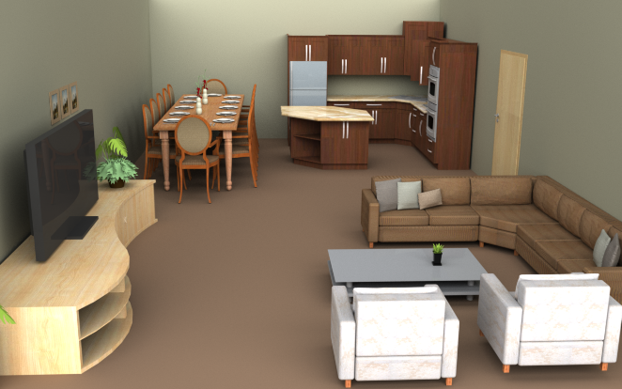
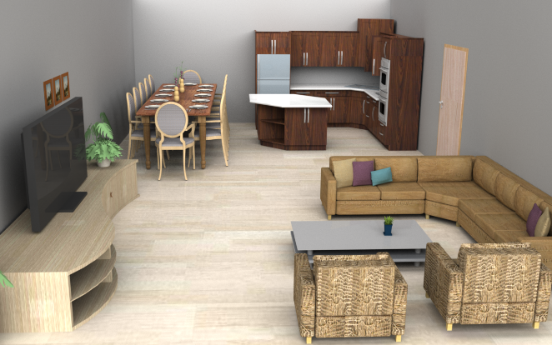
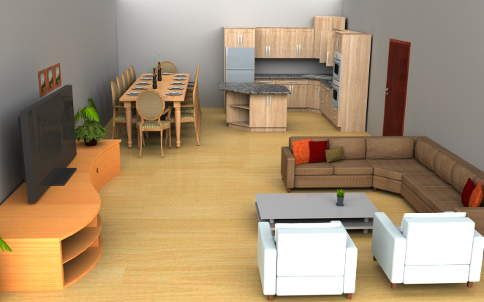
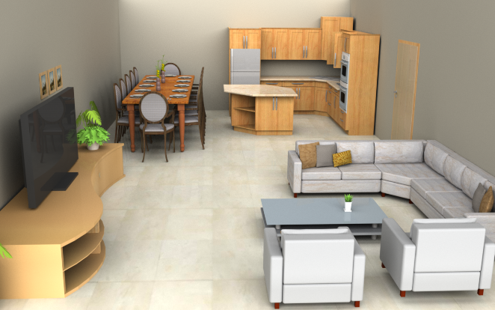
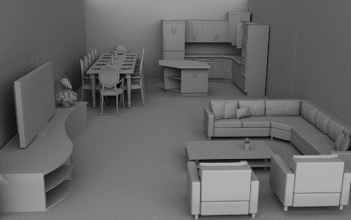
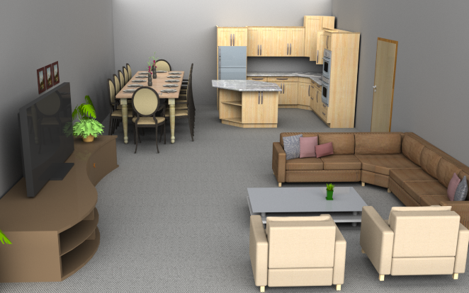
Magic Decorator
Input Scene
Notes:
Taking a 3D digital indoor scene without material properties as input, <CLICK> it can automatically generate various types of aesthetic decorations by making suitable and beautiful material suggestions for every object part in the scene.

Slide 3
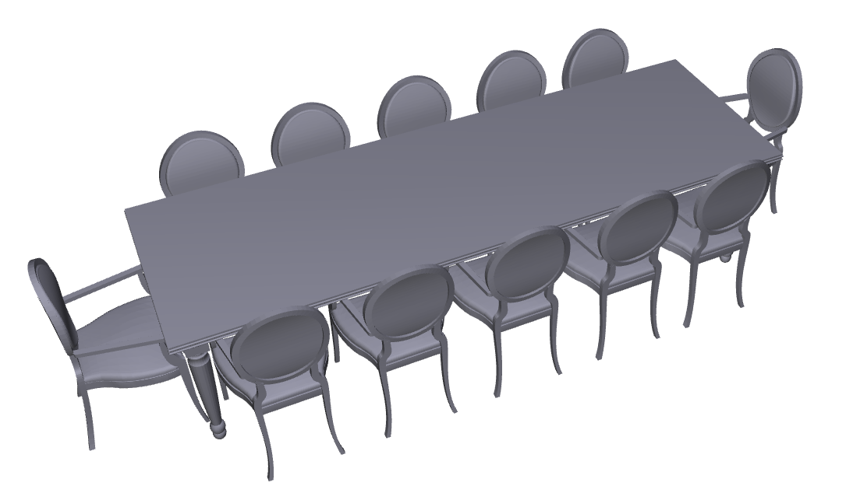
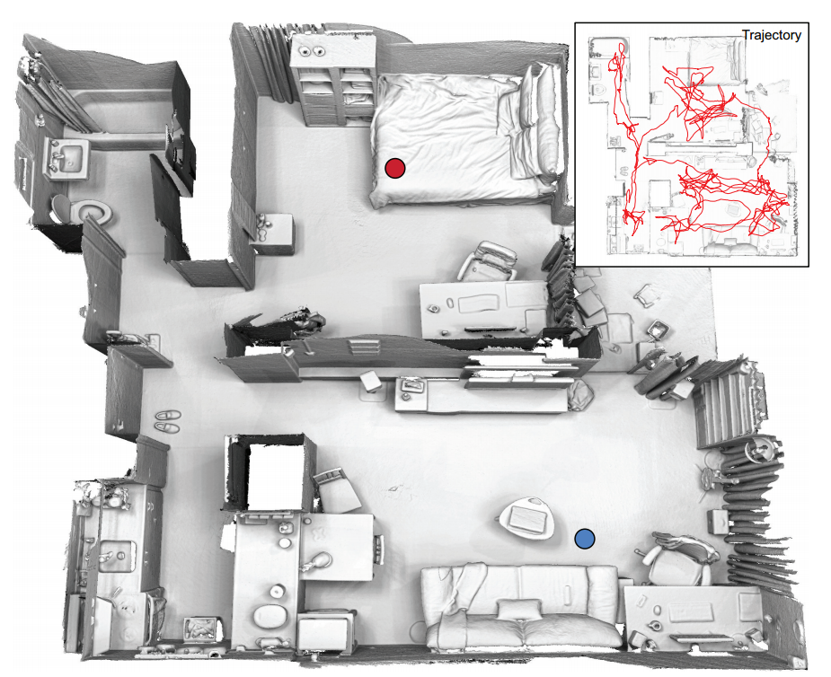
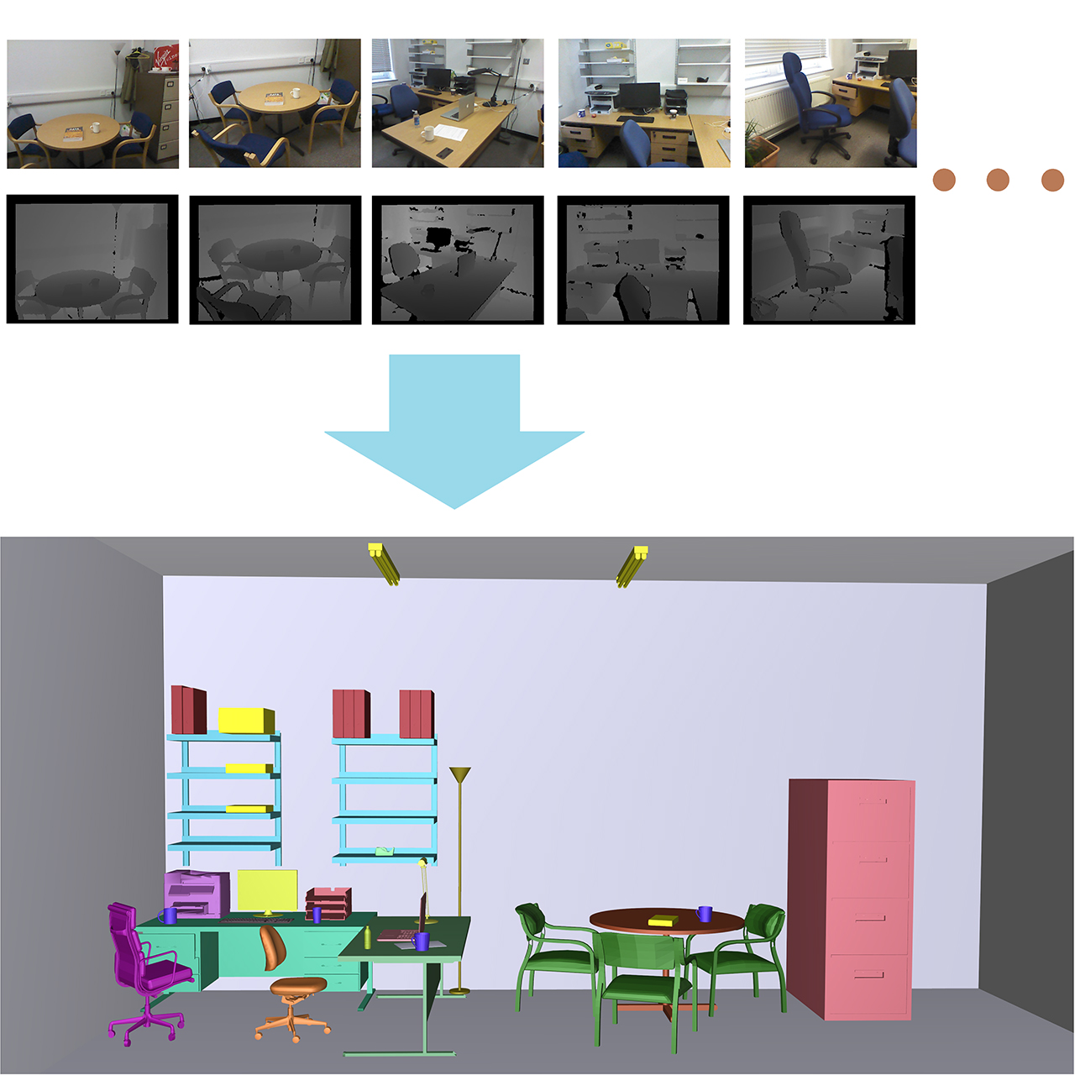
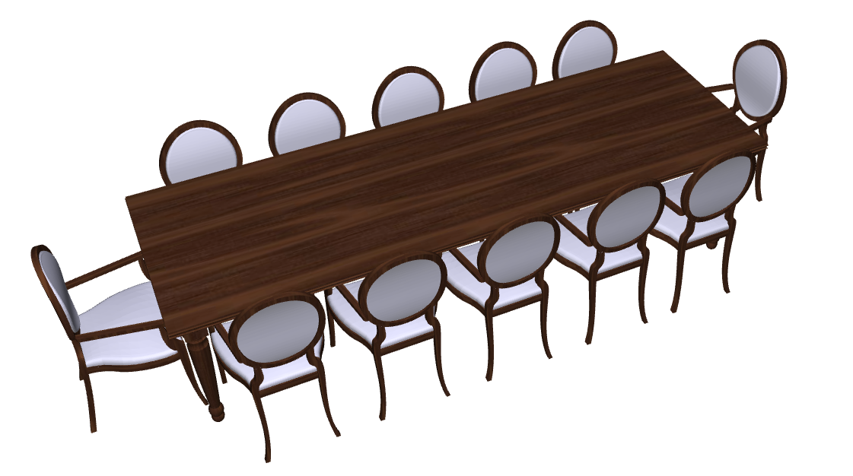
Motivation
Geometric Shapes
Dense reconstruction
Synthesis based on
sketch drawings
sparse scans
examples
…
Visual Appearance
[Xu et al. 2013]
[Fisher et al. 2012]
[Chen et al. 2014]
[Choi et al. 2015]
Notes:
First, let me explain why such a system is valuable. The traditional modeling pipeline for creating 3D digital scenes involves two key steps: building geometric shapes and assigning visual appearance. As you all know, both of them are demanding tasks that require sufficient professional skills. <CLICK> For quickly and easily producing desired 3D scenes models in terms of geometry, we have witnessed various techniques in the past five years. For example, dense reconstruction from point cloud stream, <CLICK> or model-driven synthesis <CLICK> under different types of guidance such as sketch drawings<CLICK> , sparse scans<CLICK> , example scenes<CLICK> and so on<CLICK>. However, none of these techniques take visual appearance into account. <CLICK>To fully complete the modeling task, one also needs to specify material properties and textures for each 3D part in the model. <CLICK>So are there any computer-aided methods that can help with this process.

Slide 4
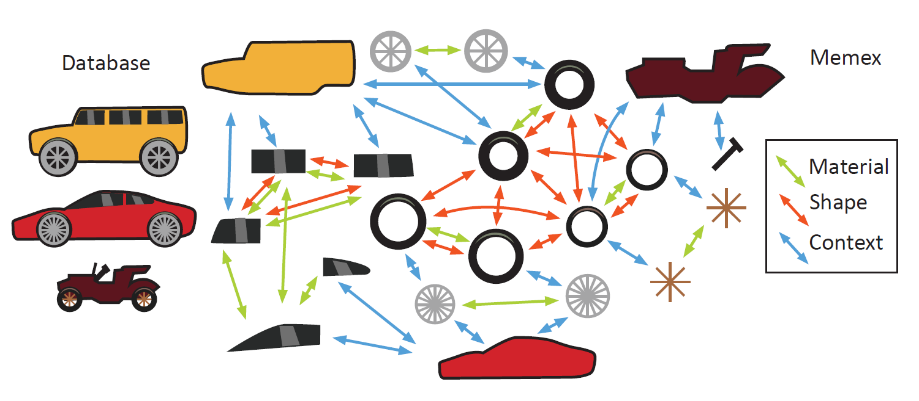
Previous Work
Material Memex [Jain et al. 2012]
Model database (276 models)
Factor graph based on
material similarity
shape similarity
spatial relationship
distances between centers of mass
Notes:
It is a pity that so far very little work has been done in this area. The only related work is Material Memex， which is a system that automatically assigns materials to parts in a 3D object model. Let me quickly explain how this system works. <CLICK>They built a database of 3D models with predefined material properties (not a very big database), from which <CLICK>they trained a factor graph to represent the contextual information between materials and shapes. By querying this graph, this system can automatically suggest feasible materials for each part of the input object.

Slide 5
Previous Work
Material Memex for indoor scenes?
A factor graph characterizing material
contextual information in indoor scenes
A database of high-quality 3D indoor scenes
Extremely difficult!
Geometry
Materials
Notes:
However, we are dealing with indoor scenes rather than single objects. Let’s see what we need if we want to adapt Material Memex to cope with 3D indoor scenes. <CLICK> We need a factor graph characterizing material contextual information in indoor scenes. <CLICK>To train this graph, we need a database with a moderate number of high-quality 3D indoor scene models.
Here high-quality means both high- quality geometry<CLICK> and materials<CLICK>. Obviously, under current condition, it is extremely difficult <CLICK>to build such a database.

Slide 6
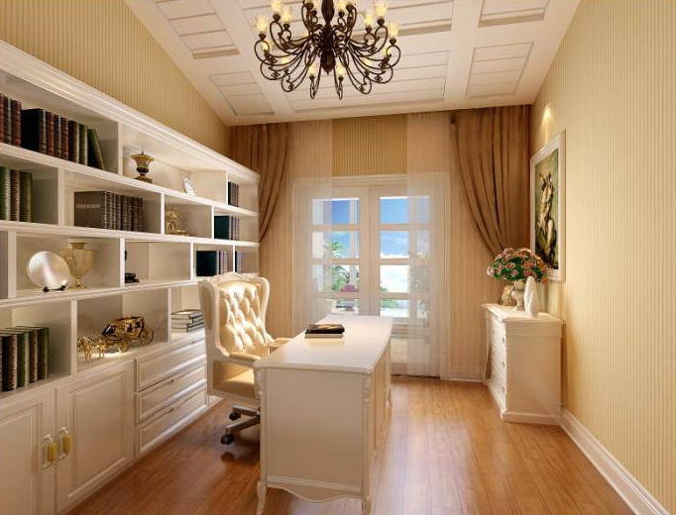
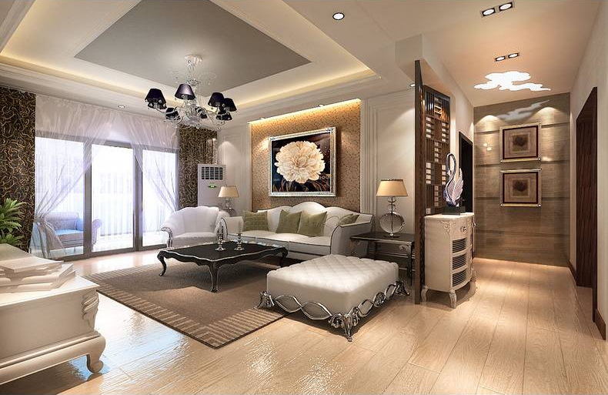
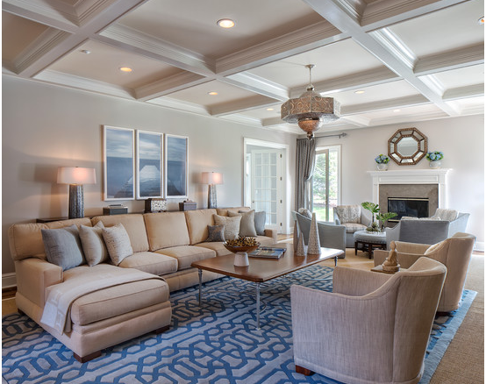
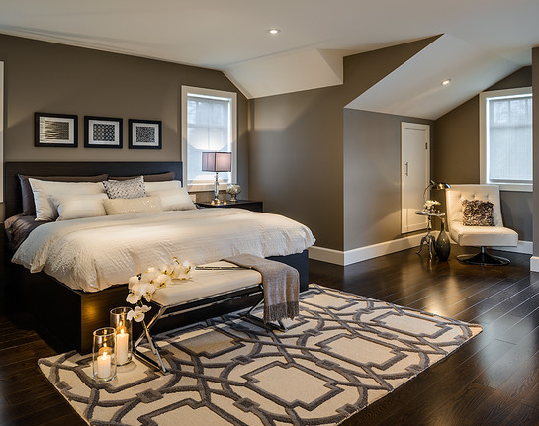
Our Approach
Material context from annotated images
Where to get such images?
http://www.houzz.com
http://www.kujiale.com
Google/Bing image search …
kujiale
What kind of annotation?
houzz
representative region
object category
material type
reflectance parameters
Tough Job!
Notes:
To overcome this difficulty our system collects training data from an annotated image database of indoor objects and scenes. This immediately raises the question <CLICK> where can we get such images? Actually, there is no need to worry about image sources. <CLICK> Since everyone has the need to design and decorate their homes, online interior designing has become a hot business today. So we can easily obtain tens of thousands of desired images from websites like: houzz, kujiale, or even google/bing image search<CLICK>.
<CLICK> Another question is what kind of annotation do we need? For each object in the image, we need to specify a representative region<CLICK>, two text tags indicating its object category<CLICK> and material type<CLICK> respectively, and most importantly reflectance parameters<CLICK> of that material. The biggest problem is that labeling materials in images is also a very tough job. <CLICK>

Slide 7
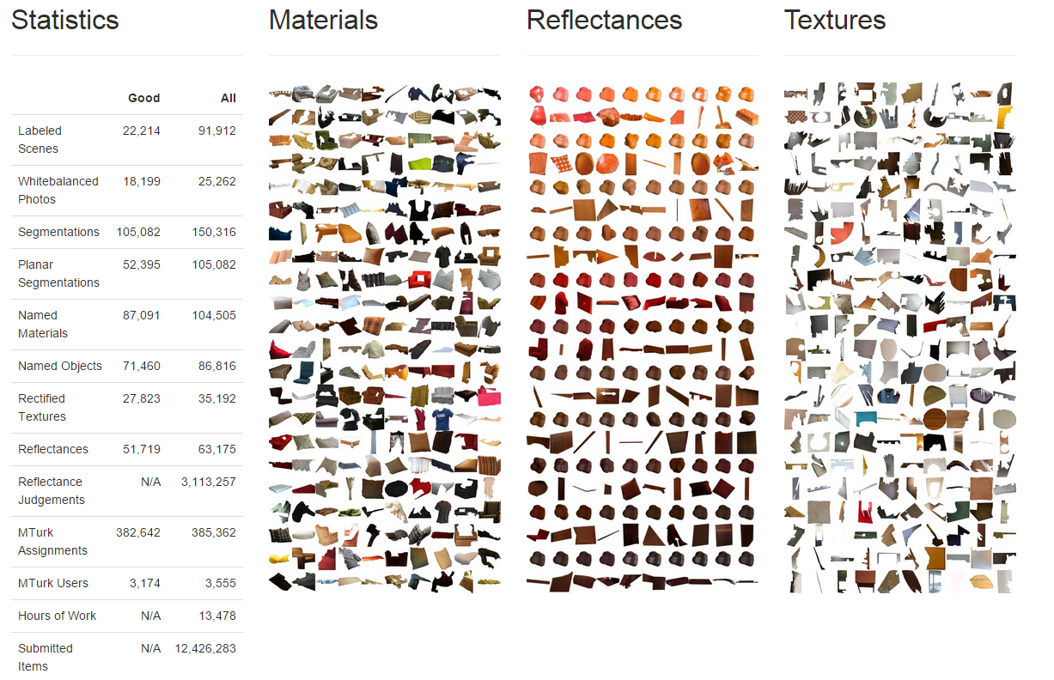
Database
OpenSurfaces [Bell et al. 2013]
100k+ annotated regions
20k+ interior scenes
Each annotation include:
cropped image region
object category
material type
reflectance parameters
surface normal
Notes:
Fortunately, in 2013 Bell et al. from Cornell University presented OpenSurfaces, which is a richly annotated database of surface appearance in real-world interior photographs. <CLICK>And its annotation perfectly covers our needs. However, we cannot directly use OpenSurfaces as our training data.

Slide 8
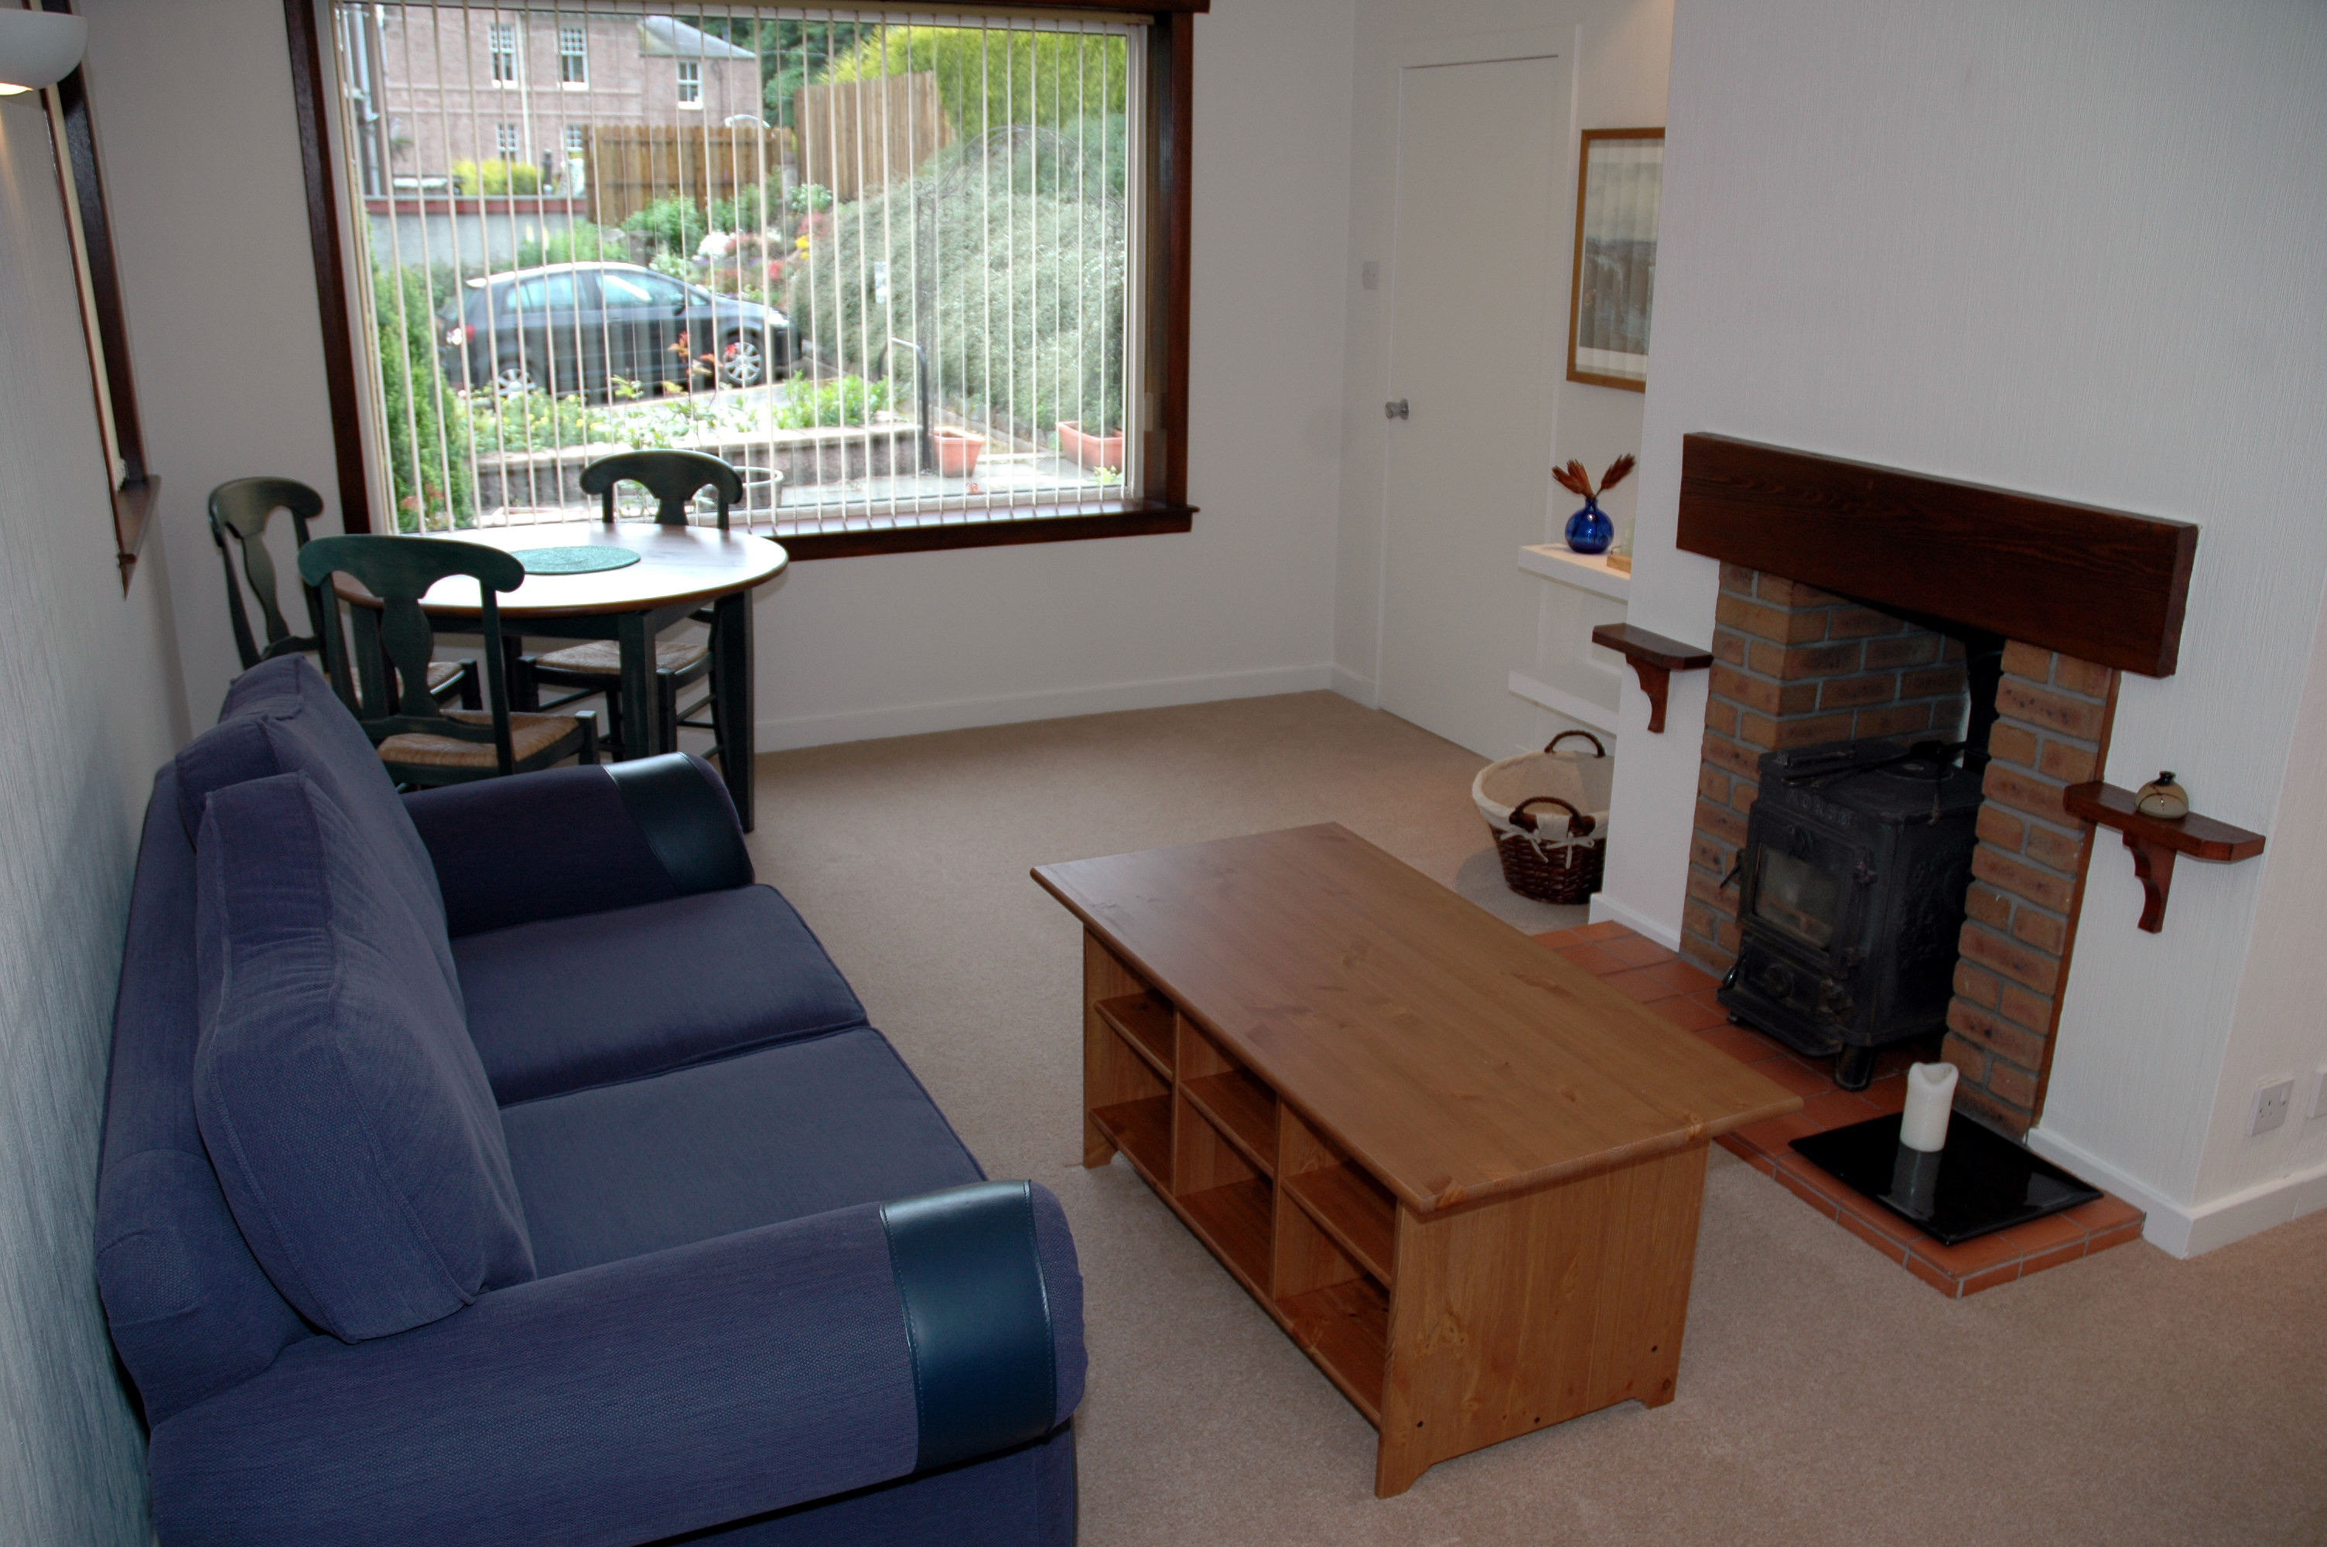
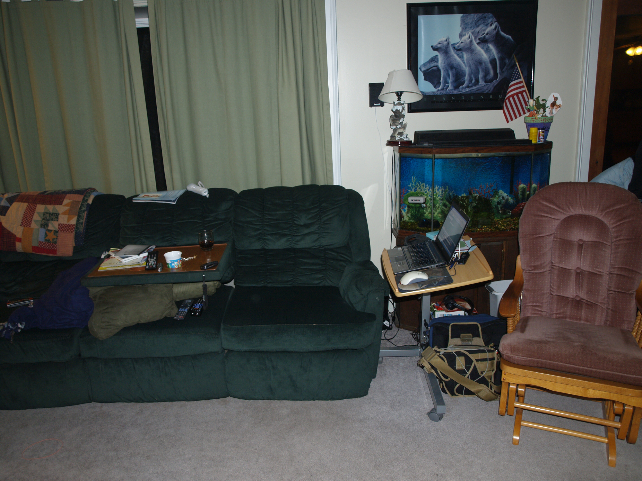
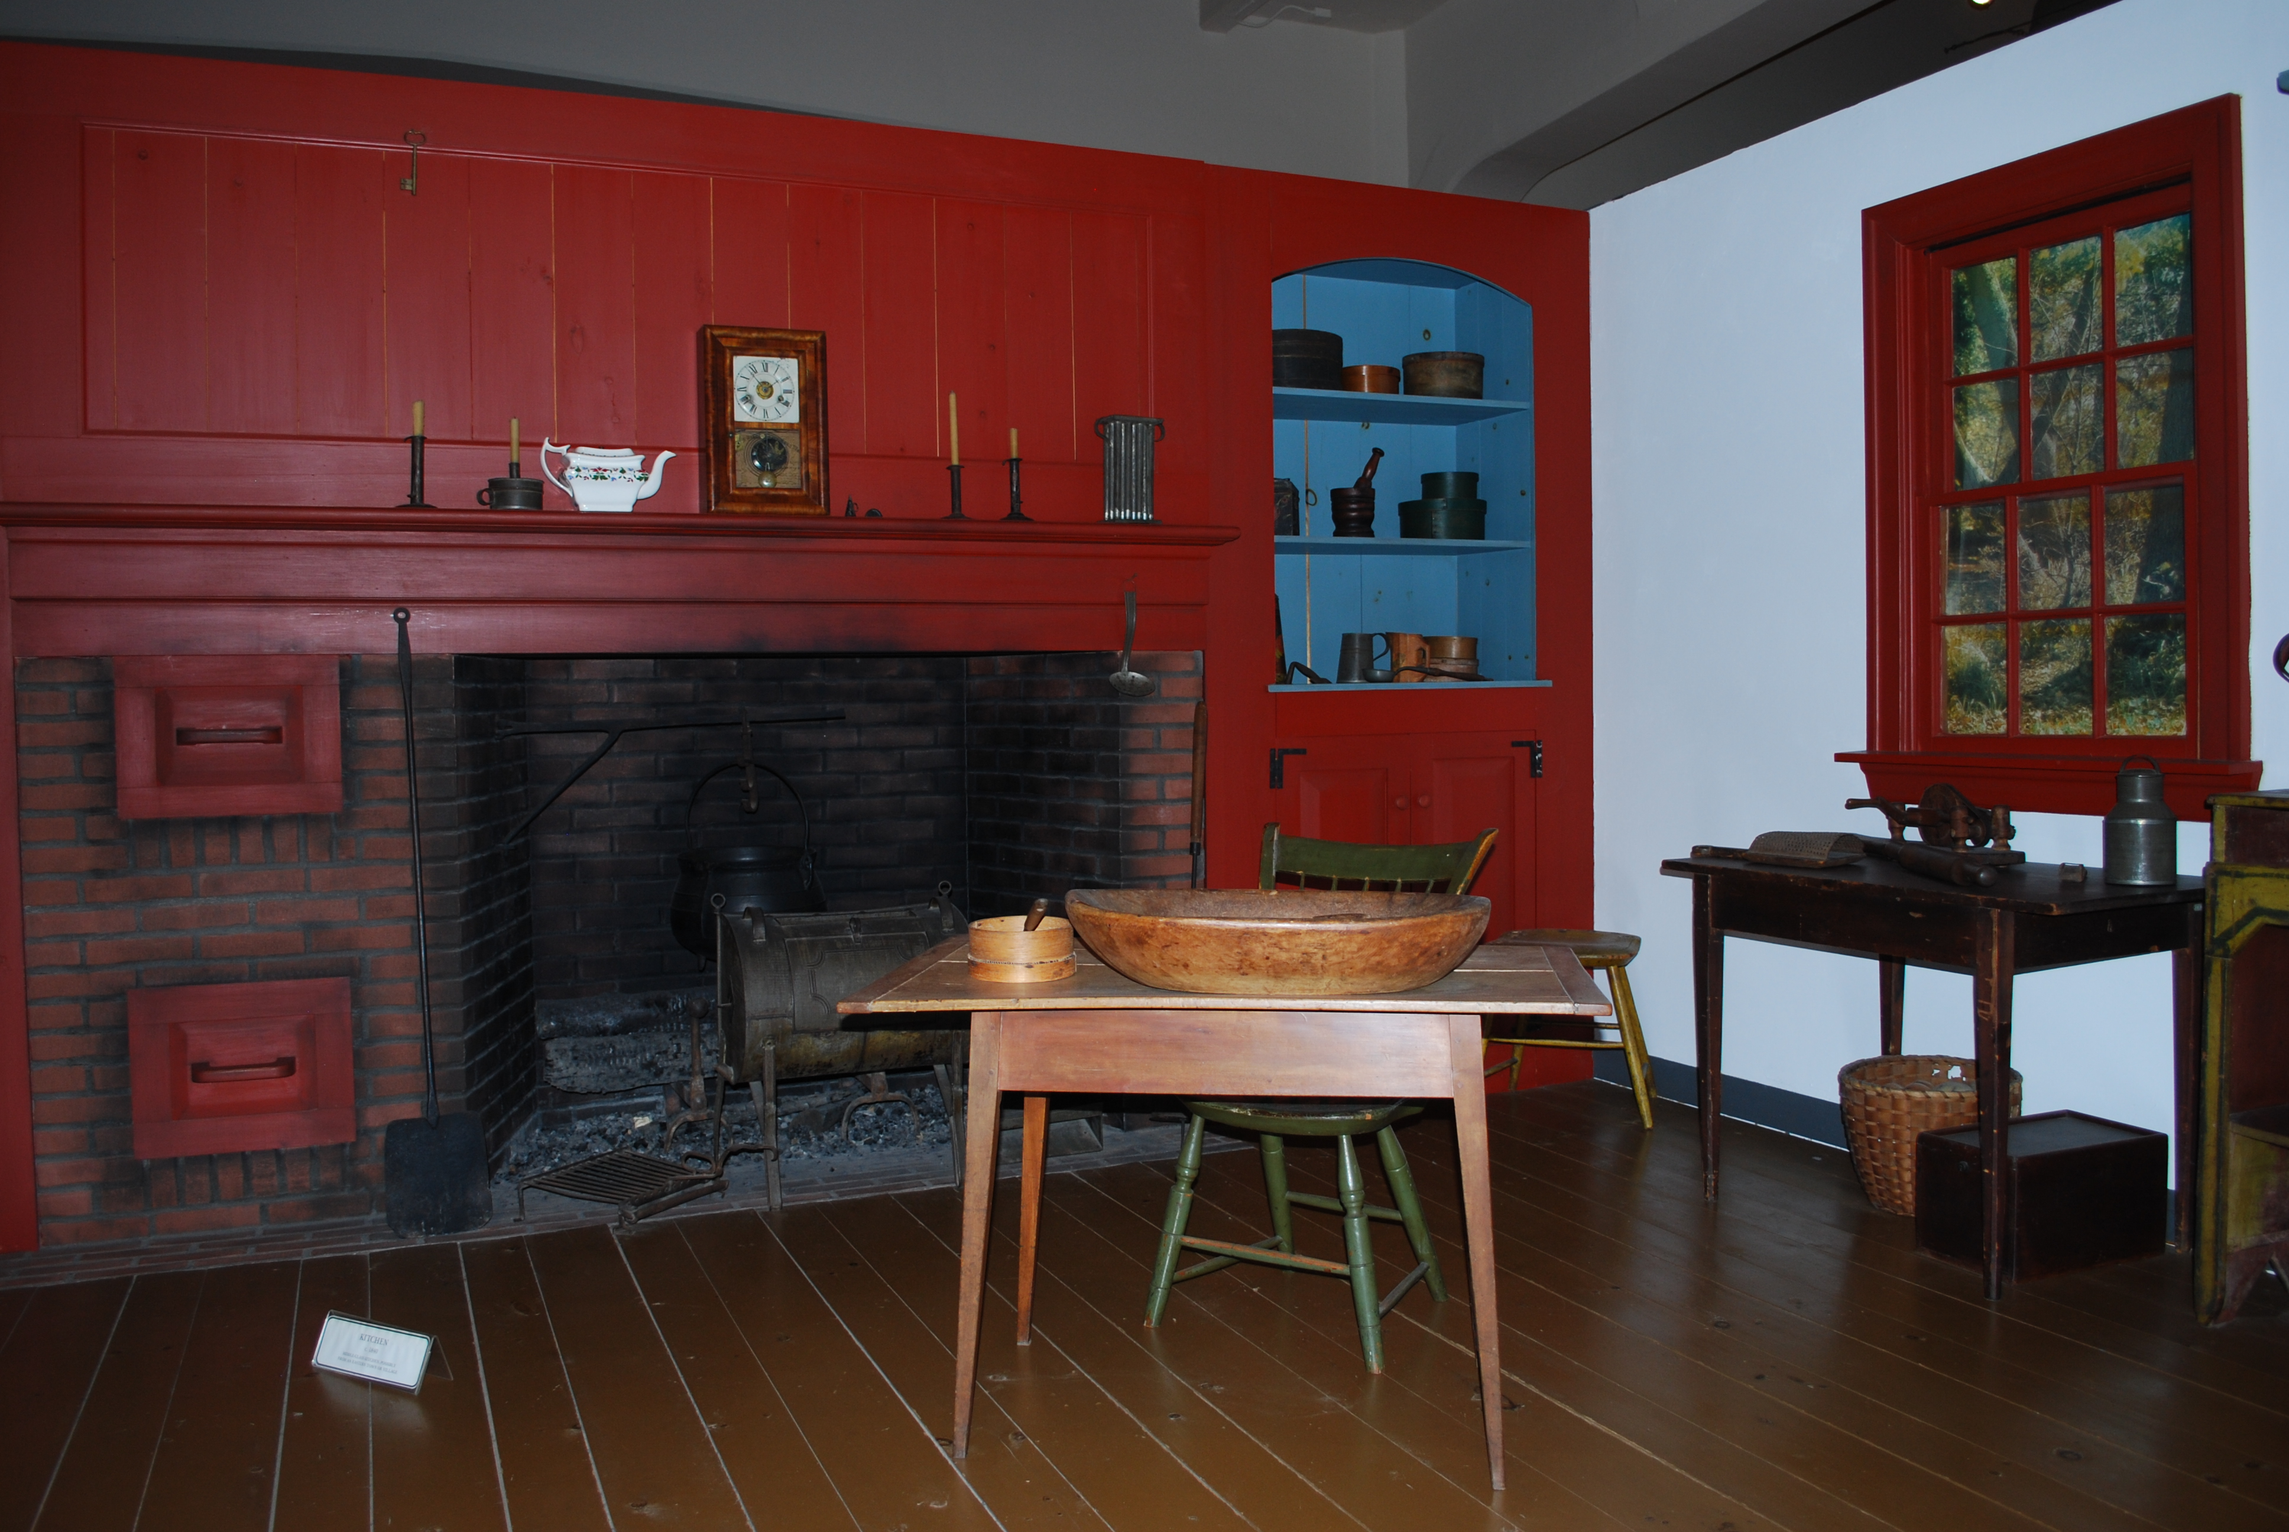
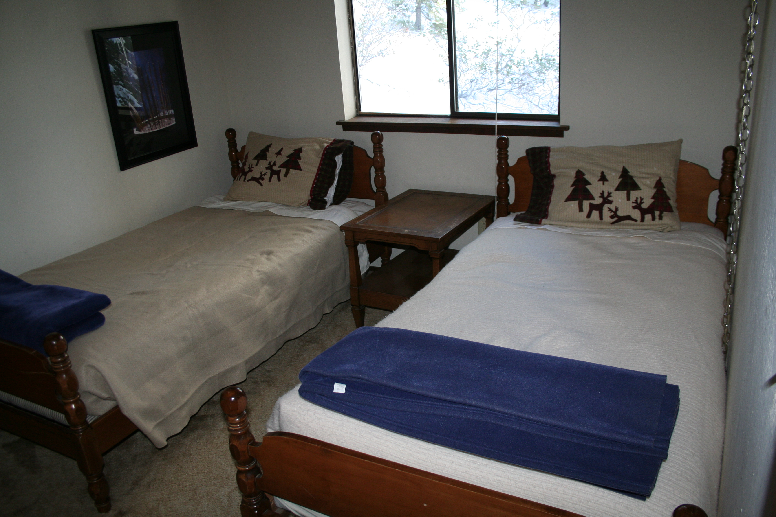
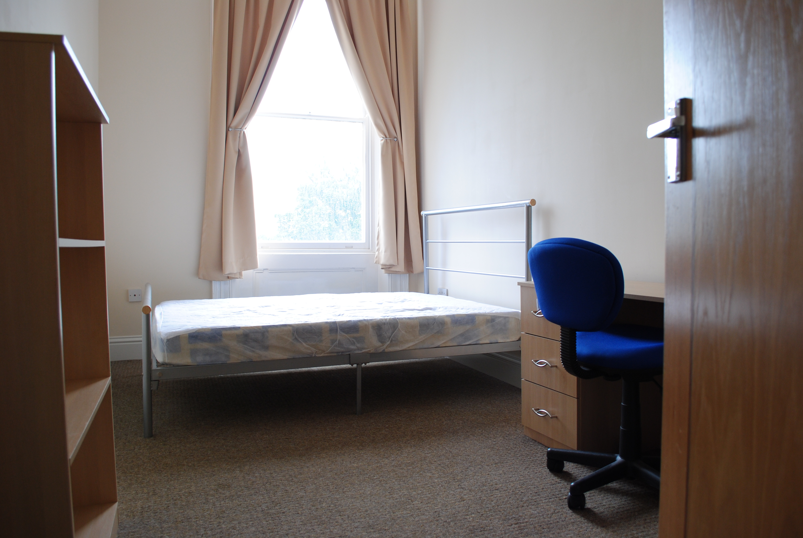
Database
OpenSurfaces [Bell et al. 2013]
Not beautiful
enough!
Notes:
One reason is that images in OpenSurfaces all came from real-world consumer photographs, while what we need are images of aesthetic interior designing cases. In other words, <CLICK> images in OpenSurfaces are not beautiful enough for our application.

Slide 9
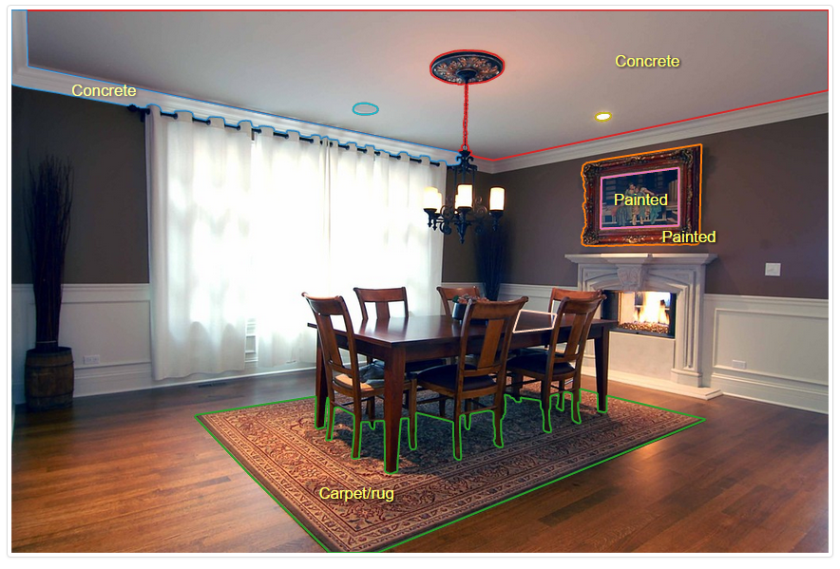
Database
OpenSurfaces [Bell et al. 2013]
Most regions
remain unlabeled!
Notes:
Another reason is OpenSurfaces focus on the material property of individual surfaces rather than the scene as a whole. Here is a typical annotated image in OpenSurfaces, you can see that most regions therein remain unlabeled<CLICK>. And thus provides little pairwise compatibility information for materials.

Slide 10
Database
OpenSurfaces [Bell et al. 2013]
100k+ annotated regions
20k+ interior scenes
Each annotation include:
cropped image region
object category
material type
reflectance parameters
surface normal
We can rely on OpenSurfaces to
build our own database！
Notes:
Anyway, as such a big richly annotated database, OpenSurfaces is quite useful for inferring material parameters from images.
<CLICK> Actually, we can rely on OpenSurfaces to quickly build a new database!

Slide 11
Representative Region Labeling
Labeling Process (Speed X5)
Notes:
Here is an example of our image labeling process. Since we did not need the precise shape of each object part, we simply specify a rectangular or elliptical region, which shows the representative appearance of the material of that object part. And then we associate text tags indicating object category information for each region.

Slide 12
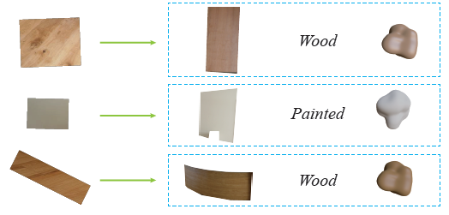
Material Parameters Matching
Our database OpenSurfaces
$r$：image region
$o$：object category
$m$：material type
$p$：reflectance parameters
Regions in OpenSurfaces $<r,o,m,p>$
Regions in our database $<r,o$
$$,m,p$$
$$>$$
Notes:
After labeling, each annotation in our database <CLICK> contains a representative image region and its object category. What we are going to do next is to <CLICK> match the regions between these two databases and thus transfer <CLICK> the material information from OpenSurfaces to our database.

Slide 13
Material Parameters Matching
Appearance distance between two regions
consistency of object tags
color distance
texture distance
Features | Precision
HSV | 43.6%
BGLAMs | 14.4%
HSV and BGLAMs | 47.2%
HSV and object tags | 85.4%
BGLAMs and object tags | 26.8%
HSV, BGLAMs and object tags | 93.2%
$\left\{\begin{matrix}\text{1}\text{,} \\ \text{∞}\text{, }\end{matrix} \begin{matrix}\text{if} \text{object} \text{tags} \text{are} \text{consistent} \\ \text{otherwise} \end{matrix}\right.$
$𝒳$-squared distance [Asha et al. 2011] between HSV color histograms
distance between BGLAMs (Basic Gray Level Aura Matrix) [Qin and Yang 2005]
Notes:
To do so, we define an appearance distance between two regions as follows, where ri and rj are two regions, one from our database, and the other from OpenSurfaces.
<CLICK> s is set to one if the labeled object tags of the two regions are consistent, and is set to infinity otherwise.
<CLICK> Dc accounts for color difference and is defined as the kai-squared distance between the HSV color histograms of the two regions
<CLICK> Dt accounts for the texture difference and is defined as the distance between the Gray Level Aura ['ɔːrə] Matrix using the Basic Gray Level Aura Matrix measure
<CLICK> We measured the matching precision over a small testing dataset for different feature combinations. Since it is hard to verify the correctness of material parameters, the precision here is based on material types. From the results, we can see that <CLICK> our feature achieves a high precision. In addition, with the help of object tag information<CLICK> , the annotation precision is significantly improved.

Slide 14
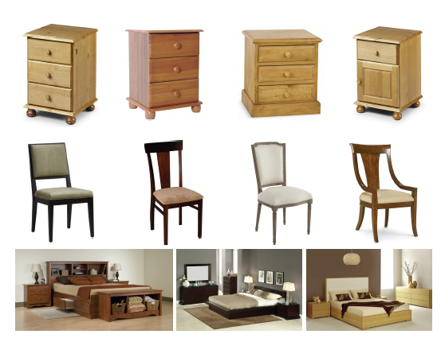
Material Rules
Local Material Rules
Unary Relationship $f_{1}\left(p,m\right)$
Pairwise Relationship $f_{2}\left(p_{1},m_{1},p_{2},m_{2}\right)$
Global Aesthetic Rules
the likelihood of a specific object category $p$ having a specific material $m$
the likelihood of two object categories $p_{1}$ and $p_{2}$
co-occur with specific materials $m_{1}$ and $m_{2}$
the harmony among the entire set of colors in a scene
Notes:
Next, we are going to learn material contextual information from the images. A basic observation concerning indoor scenes is that there exist some local material patterns among a small group of objects or parts. For instance, a night table is usually made of wood, a dining chair often comprises a wooden frame and fabric cushions, and a bed-frame, night table and dresser in the same bedroom typically share similar or the same material. To describe these local patterns, we introduce local material rules. Specifically, <CLICK> we estimate the unary relationship f1, which is the likelihood of a specific object part category p having a specific material m. And <CLICK> Pairwise Relationship f2, which is the likelihood of two object categories $p_{1}$ and $p_{2}$ co-occur with specific materials $m_{1}$ and $m_{2}$.
Local material rules make sure that the assigned materials are reasonable and consistent with the functionality of the objects. Besides, to account for the harmony among the entire set of colors in a scene<CLICK> , we introduce global aesthetic rules.

Slide 15
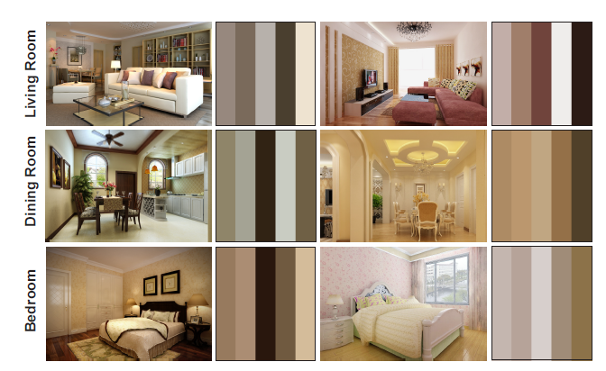
Global Aesthetic Rules
Color Compatibility Model
[O’Donovan et al. 2011]
color theme five-color palette
rates a color theme based on its compatibility
Notes:
However, the impression given by a color combination is highly dependent on the perception of different subjects. To quantitively describe this rule, We adopt the color compatibility model proposed by O’Donovan et al. It represents a color theme with a five-color palette, and rates a color theme using a data-driven approach. <CLICK> Here are some extracted color themes from images in our database. We can see that the color theme of an indoor scene can be well characterized by a five-color palette. These color themes are then used to customize a color compatibility model for our specific scenario of interior decoration.

Slide 16
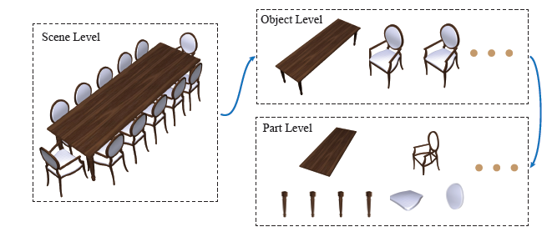
Problem Setup
Input Scene:
With object category labels for each part
Material Configuration:
Notes:
OK, let me formally set up the material suggestion problem. We represent an input scene P with a scene-object-part 3-level hierarchy. Object parts are the basic units in our material assignment tasks, so text labels of object categories must be given for each part. Here pi denotes the i-th object part in the scene. A material configuration of P is denoted as M, where mi is the material of the i-th object part.

Slide 17
Combinatorial Optimization
Energy Function
Unary Relationship
Pairwise Relationship
Local Material Rules
Global Aesthetic Rules
Notes:
In our system this problem is cast as a combinatorial optimization problem that searches for feasible material configurations under the guidance of the learned material distributions.
<CLICK> So the energy function is defined based on the previously constructed local material rules and global aesthetic rules.

Slide 18
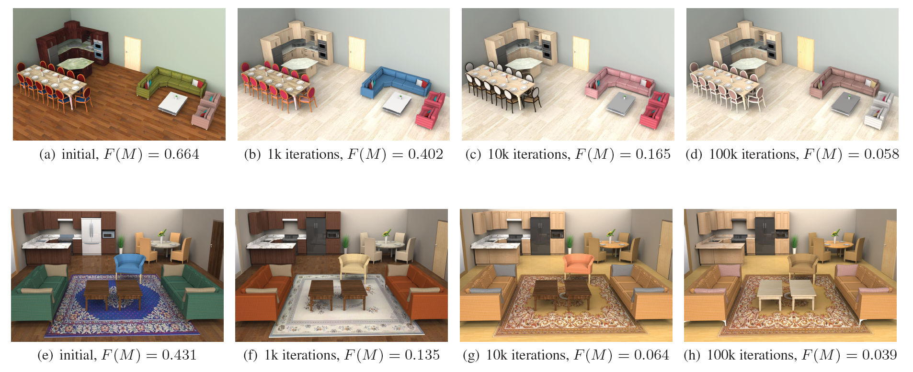
Optimization
Simulated Annealing
Notes:
In order to quickly obtain a suitable solution, we use a classic heuristic search algorithm, simulated annealing. Here are two examples of the optimization process. You can see that as the number of iterations increases, the cost function progressively decreases while the overall material suggestion becomes better.
Next, I will give you some examples to show how each term in the cost function contributes to the final decoration.

Slide 19
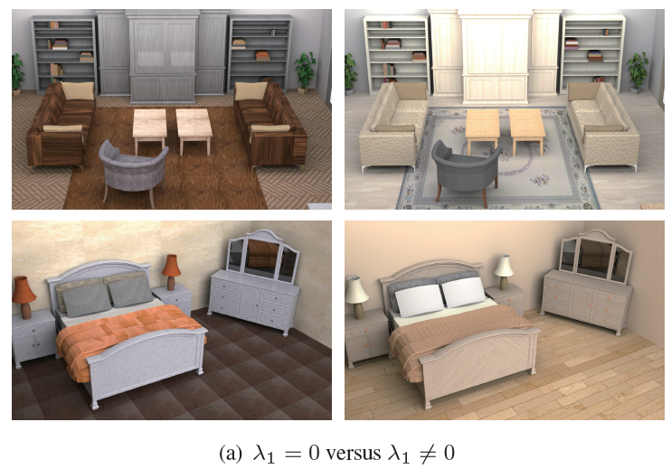
Unary Rule
Living room
metal cabinets
marble chair
leather rug
Bedroom
marble walls
wooden quilt
metal night tables, dresser, bed frame
leather floor
Without With
Notes:
If we turn off the unary term, the resulting material configuration may contains many weird material assignments. <CLICK>
For example, the living room scene <CLICK> includes metal cabinets<CLICK>, a marble chair<CLICK> and a leather rug<CLICK>
and the bedroom scene <CLICK> includes marble walls<CLICK> , a wooden quilt<CLICK> , metal night tables, dresser and bed frame<CLICK>, and leather floor<CLICK>, all of which are unlikely to appear in the real world.
While turn on this term<CLICK>, everything get back to normal.

Slide 20
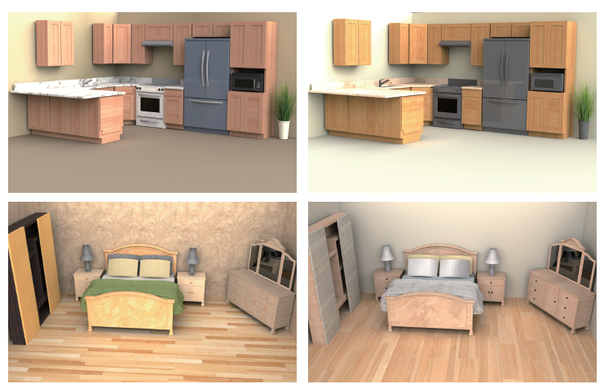
Pairwise Rule
Kitchen
refrigerator
oven
microwave oven
Bedroom
bed frame
night table
dresser
wardrobe
Without With
Notes:
If we turn off the binary term<CLICK> , there exists obvious color inconsistency among <CLICK> the refrigerator, oven and microwave oven, and also among <CLICK> the bed frame, night table and dresser.
While turn on this term<CLICK>, they look consistent.

Slide 21
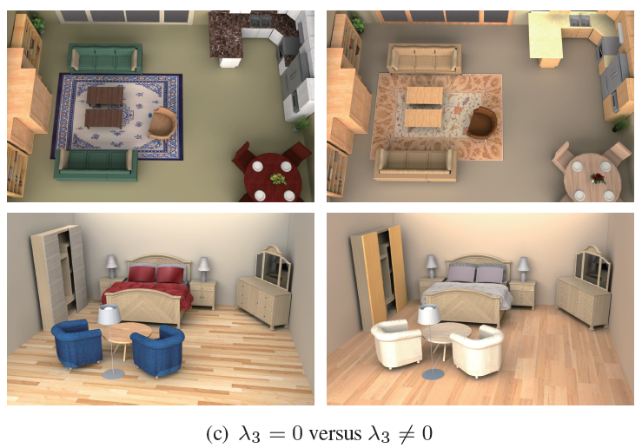
Global Rule
Without With
Notes:
without the global aesthetic term<CLICK> , the color combination of the entire scene no longer looks harmonious.
With this term<CLICK>, looks better.

Slide 22
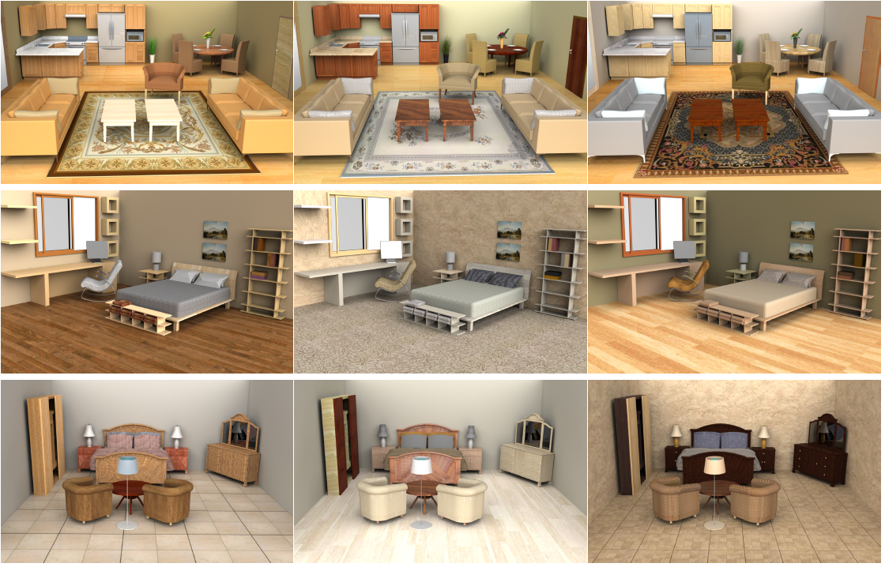
Gallery
Notes:
We have tested our system on a variety of indoor scenes.
Here are some of the decorations automatically generated by our system using 100 thousand iterations.

Slide 23
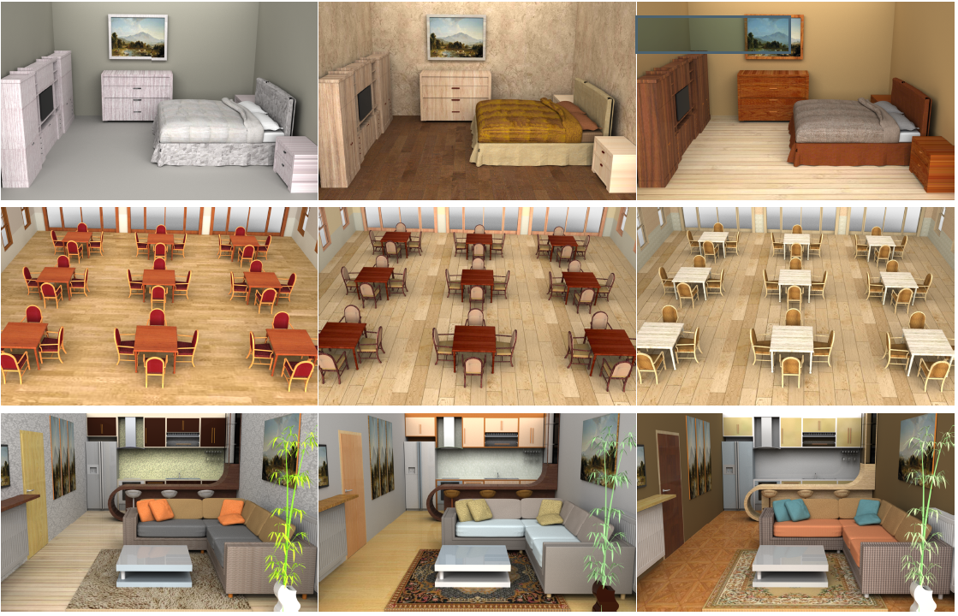
Gallery
Notes:
All the results were rendered offline using path tracing.

Slide 24
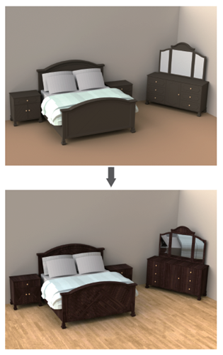
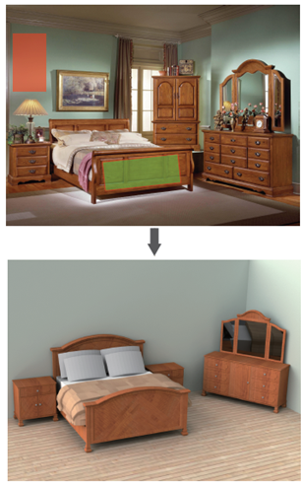
Constraint Decoration
Constraints from color
Constraints from image
Notes:
Our system also allows users to specify constraints. By constraining the unary term<CLICK> , we can set material constraints for individual parts. Specifically<CLICK>, we can specify as a value constraint by directly supplying desired material type and diffuse color, or <CLICK>an image constraint by providing a reference region from an image.

Slide 25
Constraint Decoration
Notes:
To better reflect user preferences and produce customized results, our system can also generate decorations guided by a user-specified decoration style. <CLICK>This is done by setting constraints to the global aesthetic term. Here are some results generated with respect to the input themes.

Slide 26
System Interface
Automatic decoration demo (Speed X 3)
Notes:
This is the interface of our system. The video clip is speeded up 3 three times. So you can see that it takes about 1-2 seconds to obtain a good decoration after the default number of 100,000 iterations.
<CLICK> another scene.

Slide 27
System Interface
Constraint decoration demo(Speed X 5)
Notes:
This is another example showing how to perform constraint decoration.
Users can selected some parts in the scene and then specify their desired material type and diffuse color.

Slide 28
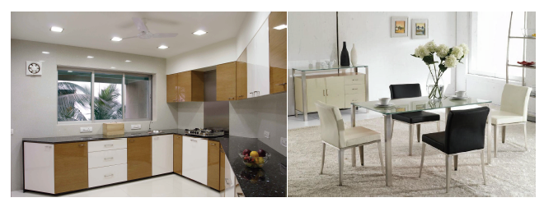
Limitations
Spatially related material patterns
interleaving colors of the cabinet
white and black chairs
…
Notes:
Currently, our system is unable to make material suggestions for spatially related material patterns, such as the interleaving colors of the cabinet doors and the white and black chairs. This is because robustly recovering 3D spatial relations from 2D images is still an unsolved problem. So as you may have noticed that our cost function does not take spatial information into consideration.

Slide 29
Thank You!
Notes:
Thank you very much~

Slide 30
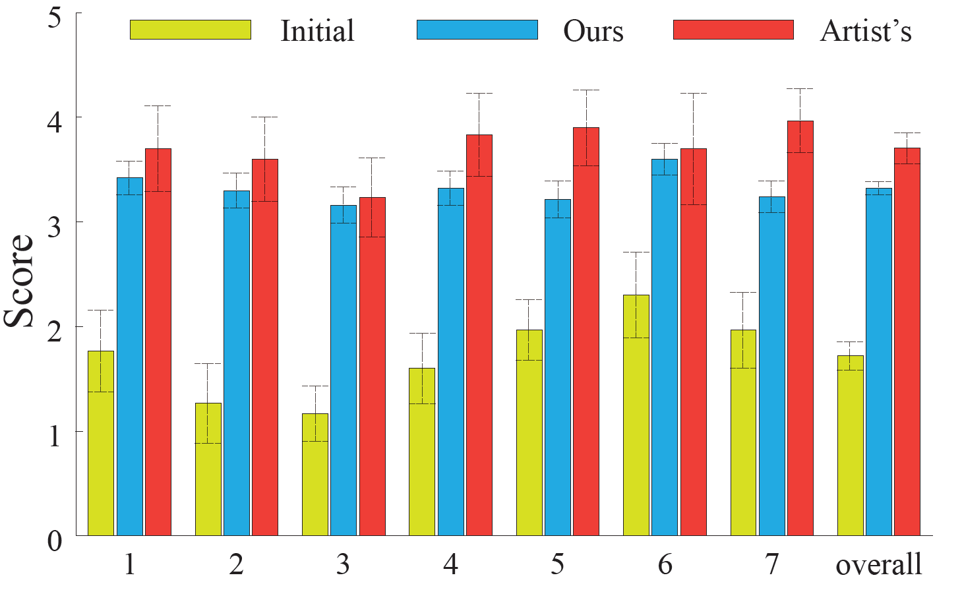
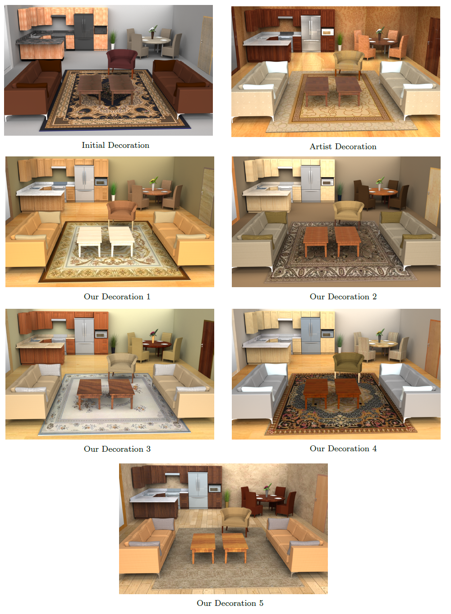
User Study
30 participants
7 image each scene:
one initial decoration
one artist’s decoration
five our decorations
Our results outperform the initial decorations by more than 78%.
Artist’s results outperform ours by no more than 17%.
Notes:
We invited 30 users to participate in the user study. For each scene, each participant was given 7 rendered images of the scene: one with the initial decoration of the scene, one with a decoration designed by an artist, and five different material assignment results generated by our system. The initial decoration of a 3D scene refers to the original material properties possessed by the 3D models in the scene when these models were downloaded.

