Slide 1
Inverse Image Editing:
Recovering a Semantic Editing History from a Before-and-After Image Pair
Shi-Min Hu¹ Kun Xu¹ Li-Qian Ma¹
Bin Liu¹ Bi-Ye Jiang¹ Jue Wang²
¹TNList, Tsinghua University, Beijing
²Adobe Research
Notes:
Thanks for the introduction. In this talk, I will talk about a technique called Inverse Image Editing.

Slide 2
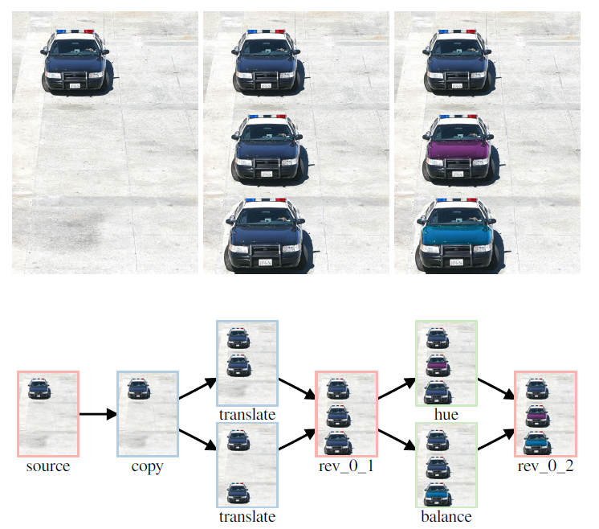
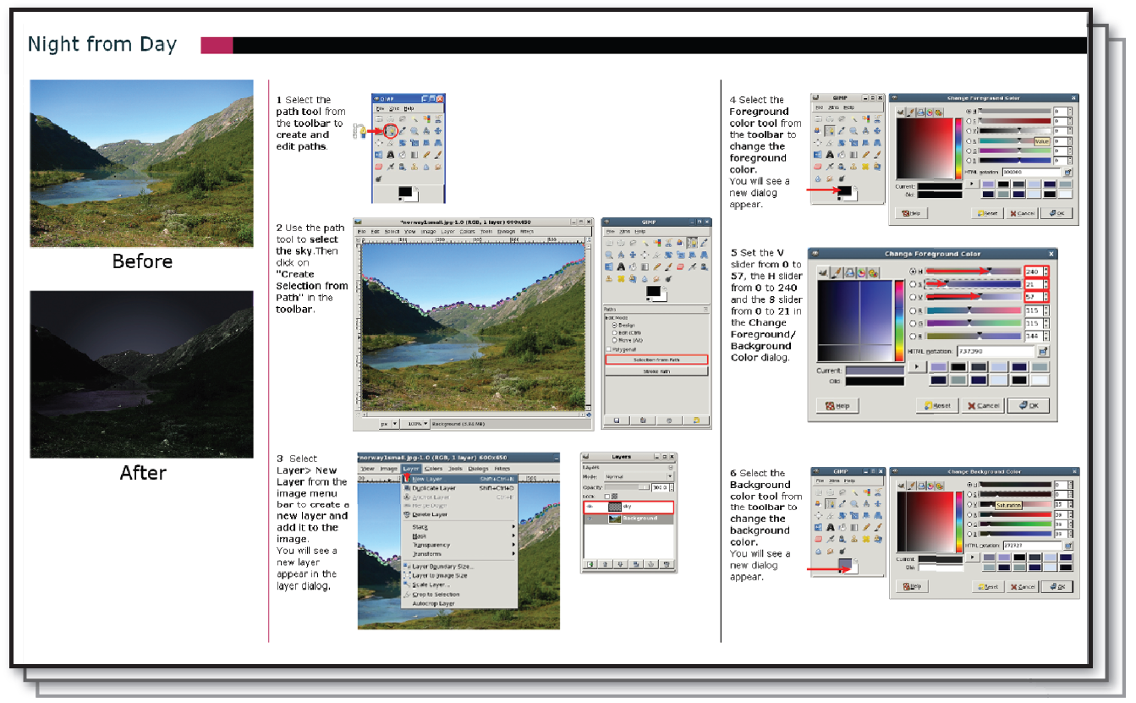
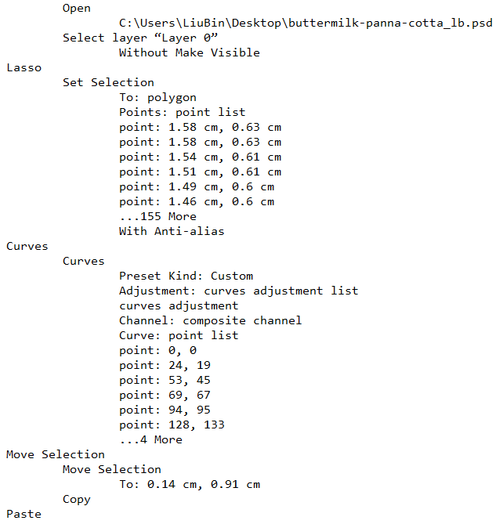
Motivation
Many applications require editing history
  Image revision control [Chen et al. 2011]
  Automatic tutorial generation [Grabler et al. 2009]
  Editing visualization [Heer et al. 2008]
Poor editing history record
  Layers
  Command log file
Notes:
In image editing tasks, a series of operations are often performed to accomplish an editing task.
Many application requires a clean and complete editing history(--click), for example, image editing revision control(--clickx3), automatic tutorial(--clickx3) and editing visualization(--click).
But unfortunately(--click), although existing software can do complicated tasks, they hardly record the editing progress.
For example, (--click)Adobe Photoshop only saves edited image layers in the psd file. Its command log file keeps very limited information, too(--clickx3).

Slide 3

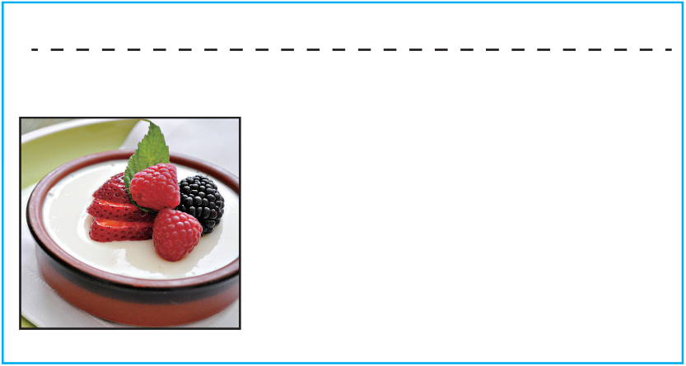
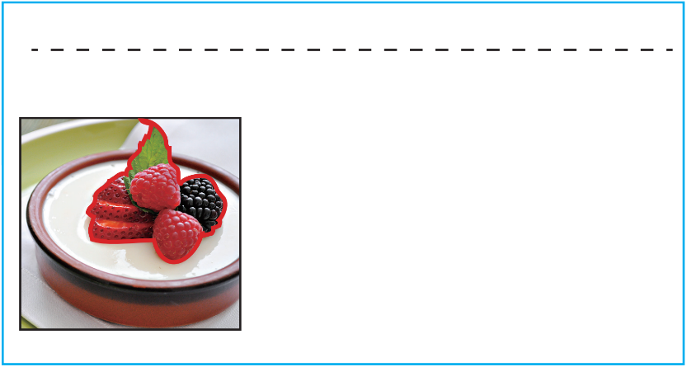
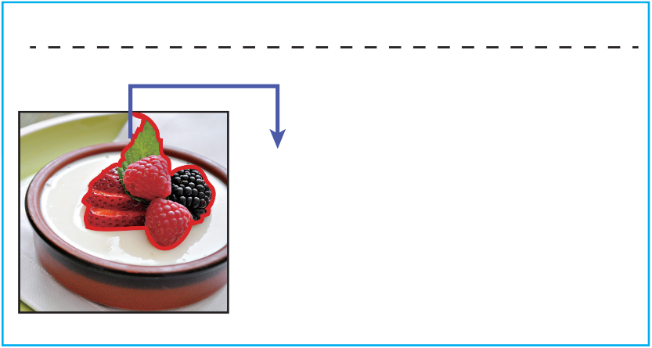
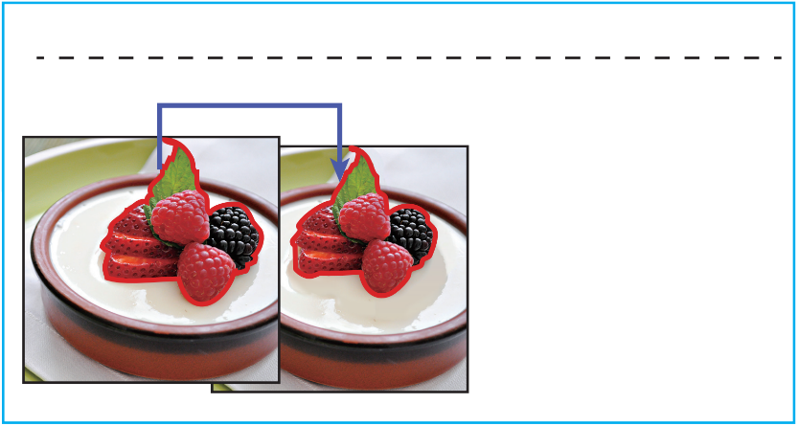
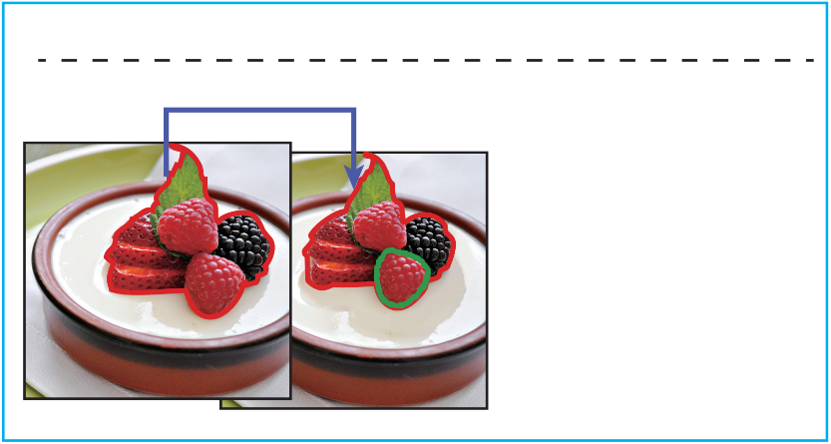
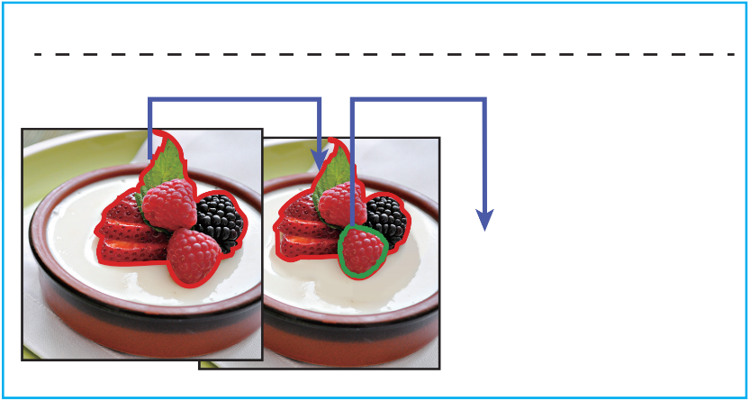
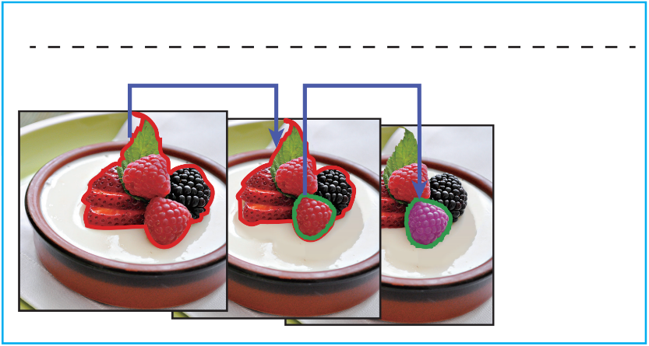
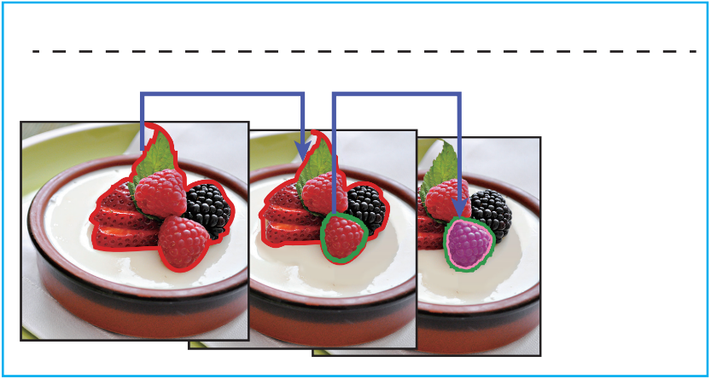
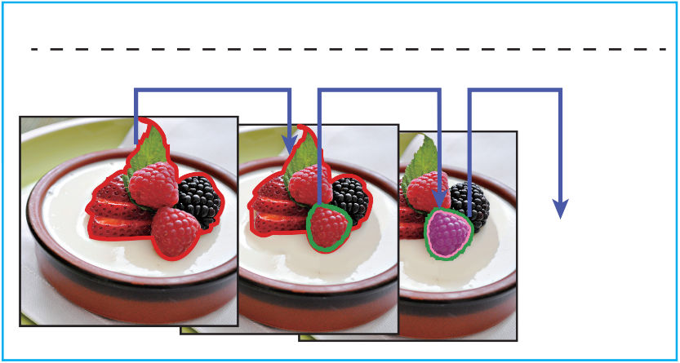
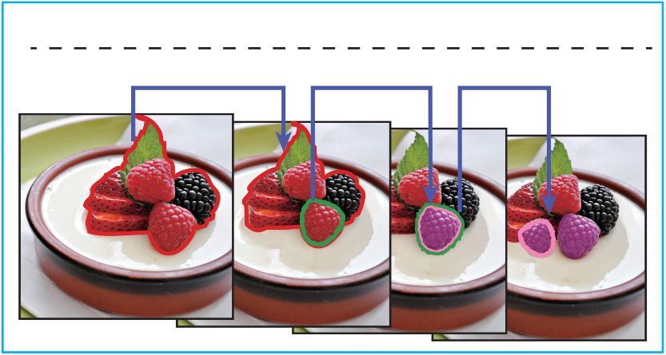
Goal
Give a source and edited image
Recover a semantically-meaningful editing history
Recovered Editing History
Scale the region
Adjust hue
Copy, rotate and
scale
Before
After
Notes:
To solve this problem, we give our goal here.(--click)
Give a source image and a edited copy, for example the two images of berries.(--click)
we try to recover the editing history.(--click) Like this, (--click).
(--slow~)The history is as follows: firstly the berries are scaled, then the hue of this berry is adjusted, then the berry is copied, rotated and moved to this place.

Slide 4
Challenges
Challenges
  Discover edited regions
  Recover the edit operator
  Generate the editing path
Step assumption
  Select a region
  Transform geometry
  Adjust color
Notes:
This problem involves several technical challenges. (--click)Firstly, we need to discover which regions have been edited(--click). Secondly, we need to determine how each region has been edited(--click). Finally, a semantically meaningful editing path needs to be generate.
(--click) We survey on various real edit histories and find that each edit step can be assumed to contains three operations: First, (--click)select a region; then apply geometry transform(--click), include scaling, rotation, translation; then (--click)apply color adjustments to the region, including brightness, hue, saturation changes, etc..

Slide 5
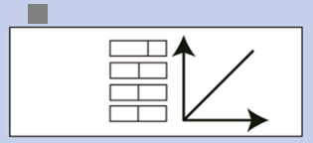
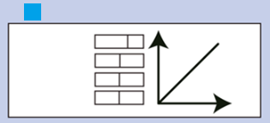
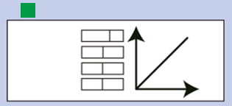
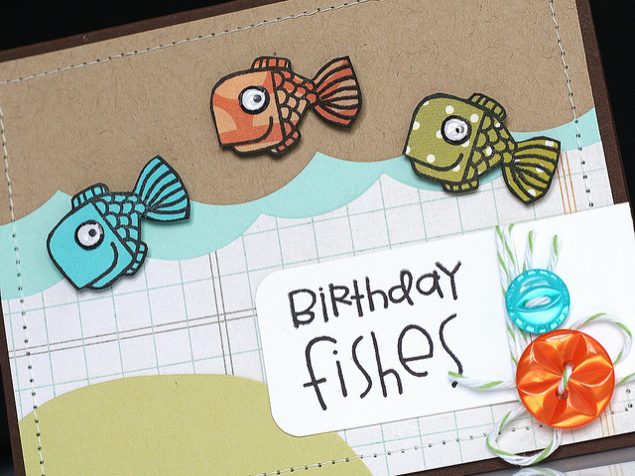
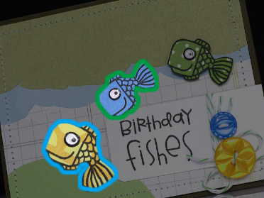
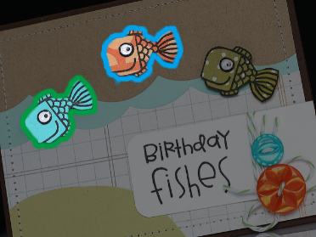
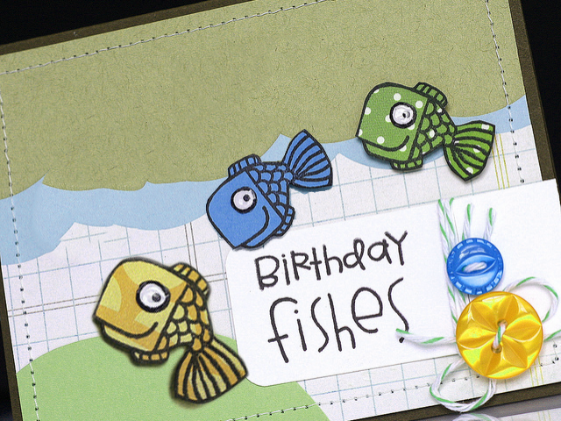
Pipeline
adjust hue
Step 1: Region Matching
Step 2: Appearance Operator Recovery
Step 3: Recovering Editing History
adjust hue
Hue
Tone
Saturation
adjust hue
Hue
Tone
Brightness
Saturation
Tone
Exposure
Hue
Brightness
Saturation
Exposure
Brightness
Exposure
Notes:
This is our pipeline. Overall our algorithm consists of three steps.
The first step is region matching(--click), which finds all matched region pairs between source and edited images.
(--click)This is an example(--click), obtained matched regions are marked with the same color strokes.
(--click) Then for each matched region, we recover the appearance operator that applied to it.(--click)
These are the appearance operators that our algorithm recovered.(--click)
After that, as the final step, (--click) we generate a compact editing history.(--click)

Slide 6


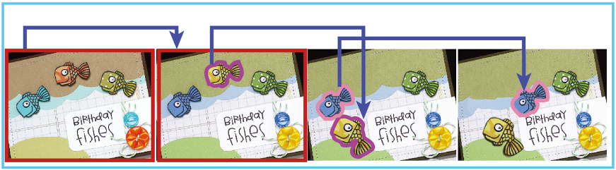
Pipeline
Step 1: Region Matching
Step 2: Appearance Operator Recovery
Step 3: Recovering Editing History
1. adjust hue
2. deform
3. move
Notes:
Final recovered history is showed here.

Slide 7
Pipeline
Step 1
  Region Matching
Step 2
  Appearance Operator Recovery
Step 3
  Recovering Editing History
Notes:
Now let’s discuss each step in detail.
Our first step is region matching.

Slide 8
Step 1: Region Matching
Target
  Give source and edited image pair
  Find matched regions
Sub-steps
  1. Compute dense correspondence between image pairs
  2. Merge consistent patches into regions
  3. Color transform estimation for each region
Notes:
In this step, (--click)our target is to seek to reliably recover region pairs between the source and edited images that share the same content.
This step contains following sub-steps.(--click)
(--click)First, we compute dense correspondence between the image pairs.
(--click)Then we merge these consistent patches into regions.
(--click)Then for each region we estimate its color transform matrix.

Slide 9
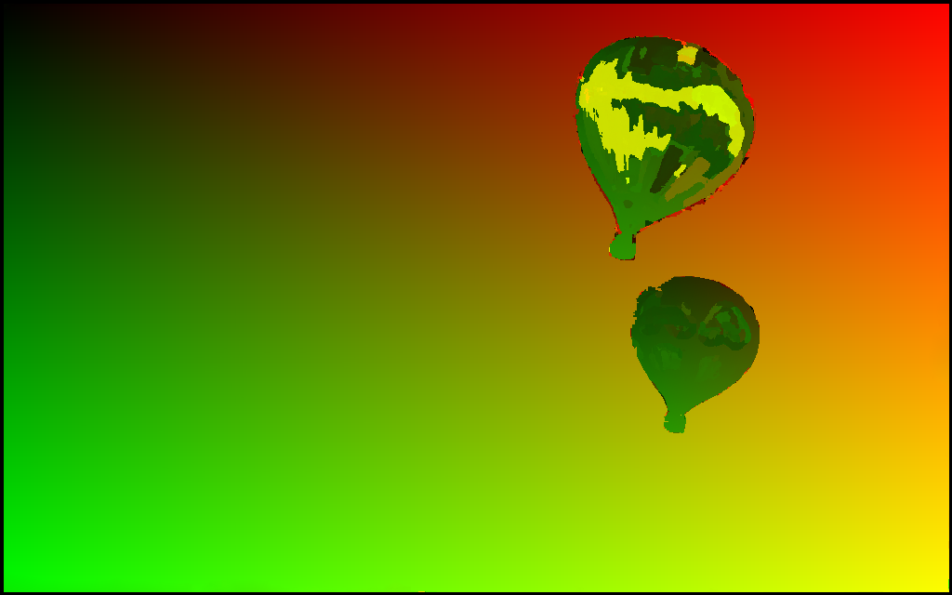

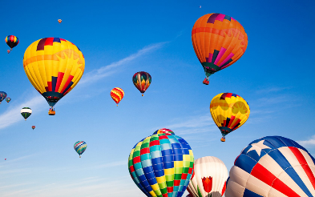
Step 1: Region Matching
Compute dense correspondence between image pairs
  NRDC [[HaCohen et al. 2011]
    Based on Generalized PatchMatch
    Randomly initialize correspondence
    Propagate good matches
    Coarse to fine
    Cannot handle drastic hue change
Notes:
(--click)Our algorithm to compute dense correspondence between image pairs is extended from NRDC.
NRDC is based on the generalized patch match algorithm(--click), which randomly initialize the correspondence(--click), then propagate matches to the nearby pixels(--click).
And it is overall a coarse to fine algorithm(--click).
NRDC is very robust in common situations. But it does not work in this example.
(--click)This is the image pair, and once applying NRDC, the correspondence map is like this(--click).
Although the new balloons are copied from the left image, the correspondence of them is not smooth.
(--click)That’s because NRDC cannot handle drastic hue change well, and that’s his limitation.

Slide 10


Step 1: Region Matching
Compute dense correspondence between image pairs
  NRDC [[HaCohen et al. 2011]
  Consider cross-channel color changes when defining matching cost
  $$D\left(u→u^{′}\right)=\min_{C_{u}}{\sum_{p∈u}{\left\|C_{u}I\left(p\right)−I(p^{′})\right\|}}$$
    $C_{u}$： 3x3 color transform matrix
Notes:
Since drastic hue change must be supported when computing correspondence, we improve NRDC to consider cross-channel color changes when defining matching cost to support hue change.(--click)
The key of our improvement is when computing the distance between two patches in the matching process, we involve an extra 3 by 3 color transform matrix Cu.(--click)
The matching cost between the two patches is the minimum distance of the two patches using all possible color transform matrix.
The three by three color transform matrix can approximate cross-channel color transforms well such as a hue change.
When applying this improvement to the previous image pair(--click), the result correspondence map becomes quite smooth(--click).

Slide 11




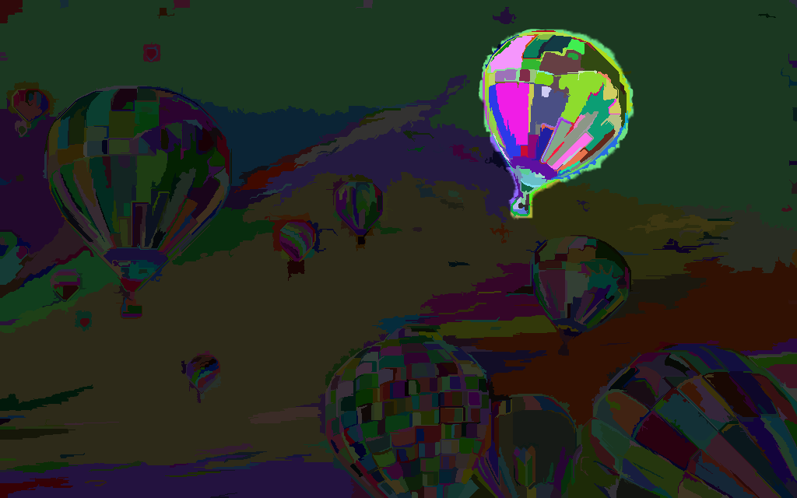

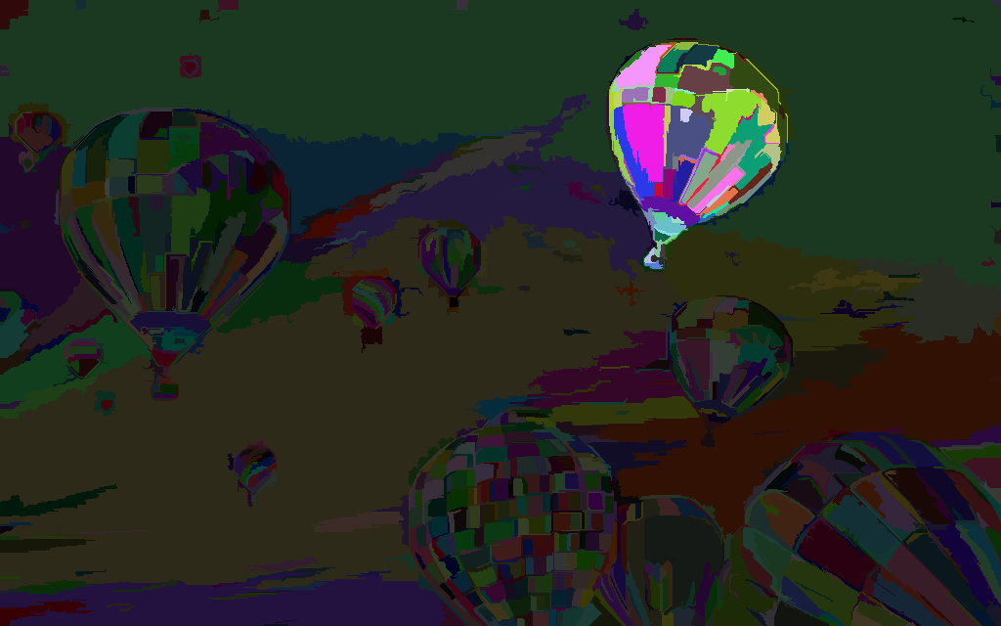
Step 1: Region Matching
Merge consistent patches into regions
  Geometric consistent
  Color consistent
  Boundary refinement & matting
Notes:
After finding dense correspondence, we merge patches with consistent transforms into regions. (--click)In the merging process we consider geometric and color consistent factors. Only nearby patches with similar geometry transform and color adjustment matrix can be merged.
This shows the regions after merging(--click). The correspondence are merged into three regions.
Since we use patches of size seven by seven in the region matching process, the boundary of each matched region is typically not located accurately.(--clickx2)
To further improve the accuracy of region boundaries, we apply boundary refinement and matting algorithm.(--click)
Firstly the images are over-segmented using the Mean Shift algorithm.(--click)
And if eighty percent of a segment is inside a matched region, we assign the whole segment to the same region. Otherwise we remove these pixels from the region.
(--click)The region is now well suited to the segment boundaries.
Finally we use alpha matting to accurately refine the region boundaries, and the result is showed here(--click)

Slide 12
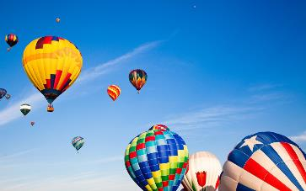



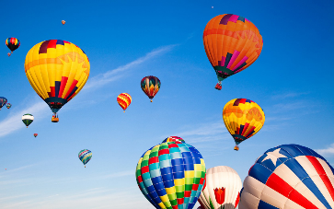
Step 1: Region Matching
Color transform estimation for each region
  Cross-channel cubic color transform
  Spatially-varying edit strength map
  EM algorithm
Notes:
After regions matching, we estimate a cross-channel cubic color transform for each region pair, along with a per-pixel smoothly-varying strength map w.(--click)
Look at this matched region pair(--click), the balloon is copied and the hue is also adjusted with a strength map like a smile face.
The cubic color transform and the strength map is computed via a EM manner. The color transform is computed trying to minimize the sum of errors to all region pixels. And the strength map is computed using the estimated color transform. We do the steps iteratively and finally it converges.
The computed strength map in this example is showed here.(--click)

Slide 13
Pipeline
Step 1
  Region Matching
Step 2
  Appearance Operator Recovery
Step 3
  Recovering Editing History
Notes:
After we find all matched region pairs, our second step is to recover the appearance operator.

Slide 14


Step 2: Appearance Operator Recovery
Target
  Give matched region pairs
  Compute sematic appearance operation
Adjust hue:
Notes:
Recall that we use a per-region cross-channel cubic transform to describe appearance changes between a matched region pair(--click). Such a transformation is powerful for reconstruction, but lacks semantic meanings.
In this step we will compute the semantic appearance operations.(--click), like in this example, the operation we extract is the hue adjustment

Slide 15
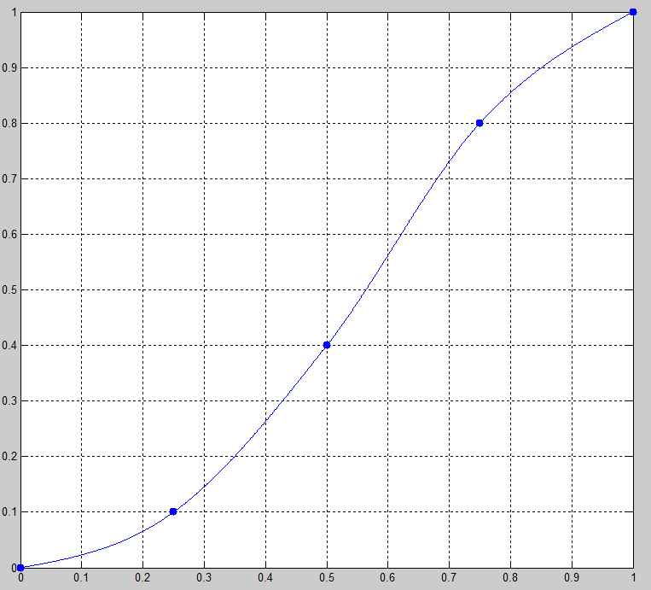
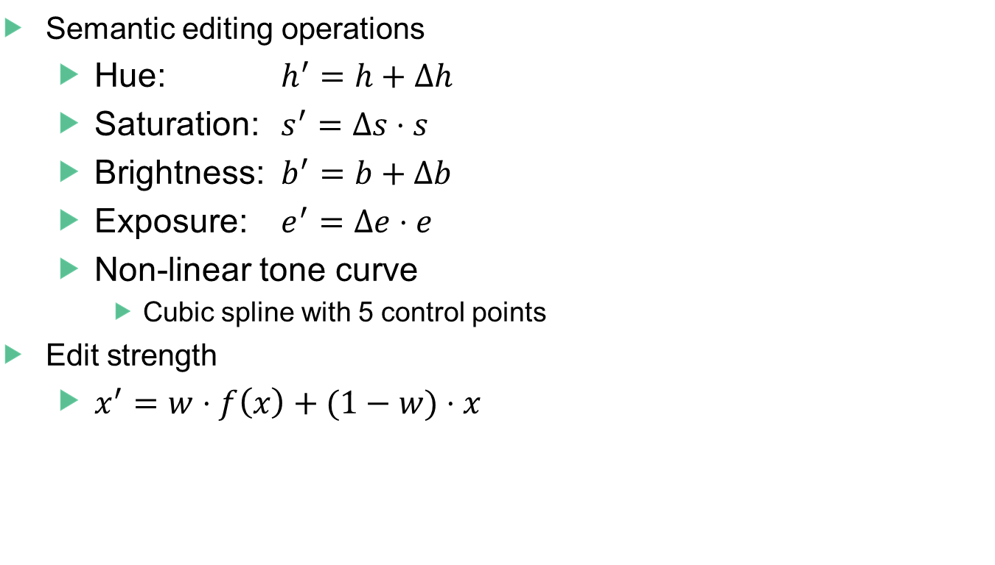
Step 2: Appearance Operator Recovery
Semantic editing operations
  Hue: $h^{′}=h+∆h$
  Saturation: $s^{′}=∆s⋅s$
  Brightness: $b^{′}=b+∆b$
  Exposure: $e^{′}=∆e⋅e$
  Non-linear tone curve
    Cubic spline with 5 control points
Edit strength
  $x^{′}=w⋅f\left(x\right)+(1−w)⋅x$
Notes:
We assume the edit process only contains 5 operators in following order(--click): hue, saturation, brightness, exposure and non-linear tone curve. They are the most commonly used basic appearance operators. We approximate the non-linear tone curve as a cubic spline with 5 control points.(--click)
Besides, each pixel inside the region still maintains a per-pixel editing strength. We should estimate all parameters above for each region accurately.

Slide 16
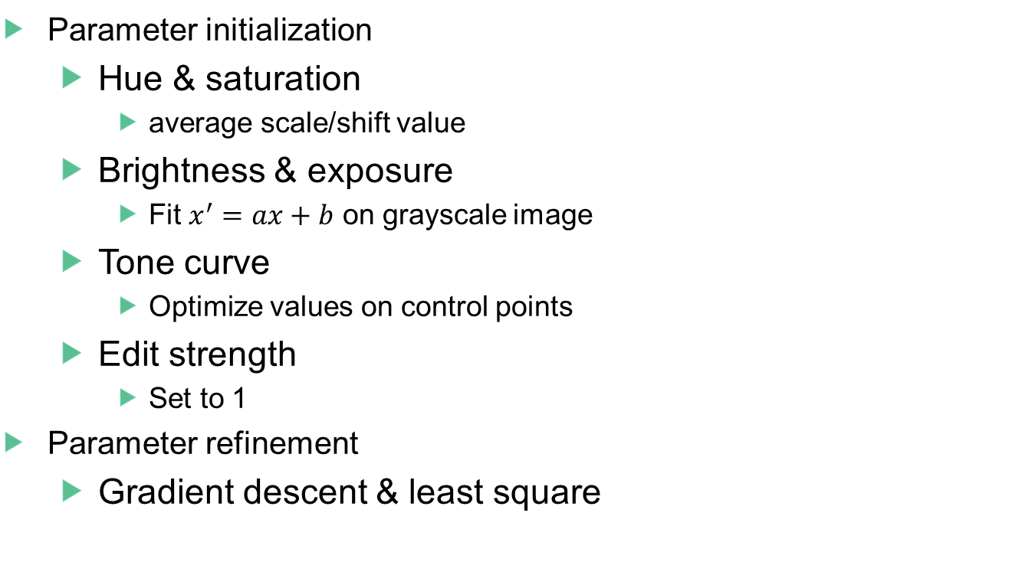
Step 2: Appearance Operator Recovery
Parameter initialization
  Hue & saturation
    average scale/shift value
  Brightness & exposure
    Fit $x^{′}=ax+b$ on grayscale image
  Tone curve
    Optimize values on control points
  Edit strength
    Set to 1
Parameter refinement
  Gradient descent & least square
Notes:
We use iterative method to alternately optimize operator parameters and the strength map.
(--click)When initialize the parameters, we use the average scale or shift value for hue and saturation; fit a linear function on grayscale images to initialize brightness and exposure; use least square fitting to obtain initial tone curve parameters; and set edit strength to be one;
(--click)Then we use gradient descent to optimize operator parameters and least square method to optimize strength map.

Slide 17
Pipeline
Step 1
  Region Matching
Step 2
  Appearance Operator Recovery
Step 3
  Recovering Editing History
Notes:
So far we have generated a list of matched region pairs, and appearance and geometric transforms between each pair. Our third step is to generate a compact editing history.

Slide 18
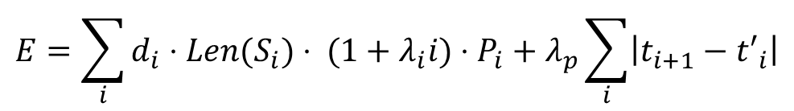
Step 3: Recovering Editing History
Motivation
  There are many ways leads to final edit results
  Find the most reasonable edit path
Minimize the edit cost function
$$E=\sum_{i}{d_{i}⋅Len(S_{i})⋅ (1+λ_{i}i)⋅P_{i}}+λ_{p}\sum_{i}{\left|t_{i+1}−{t′}_{i}\right|}$$
Notes:
The problem of generating an editing path from matched regions does not have a unique solution, because many different paths can lead to the same editing result.
(--click)In this phase, our goal is to get a edit path that people think reasonable.
(--click)We achieve this by carefully define a edit cost function, and return the history that has the minimum edit cost.
I will show you the construction of our edit cost function.
(--click)Initially we define the edit cost of the history as the sum of costs in each step. The cost of each step di is the amount of color and geometry transforms.
This function is simple and naïve, and we will involve several principles to make the function more reasonable.

Slide 19
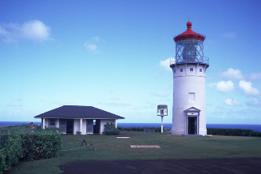
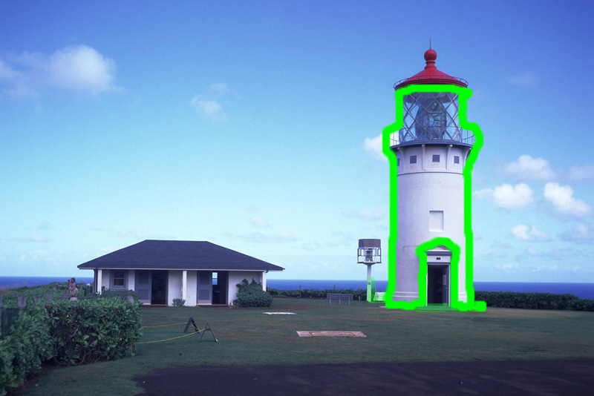
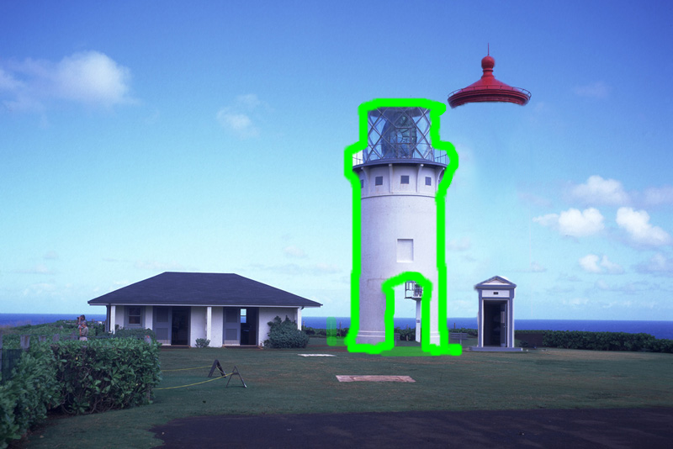
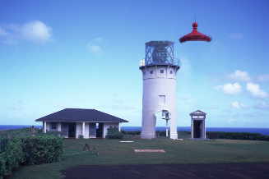
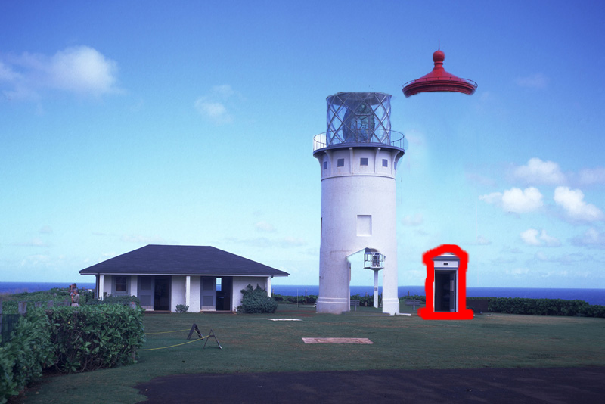
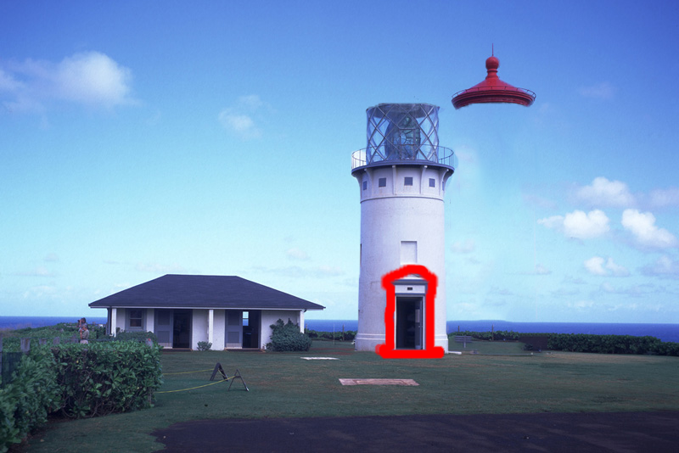
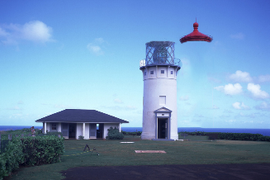
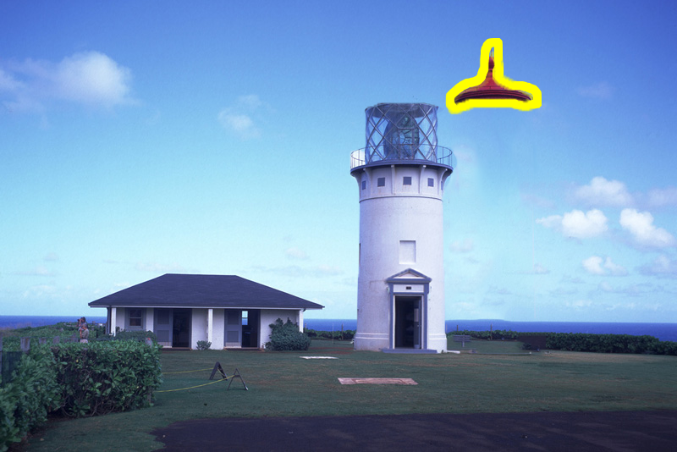
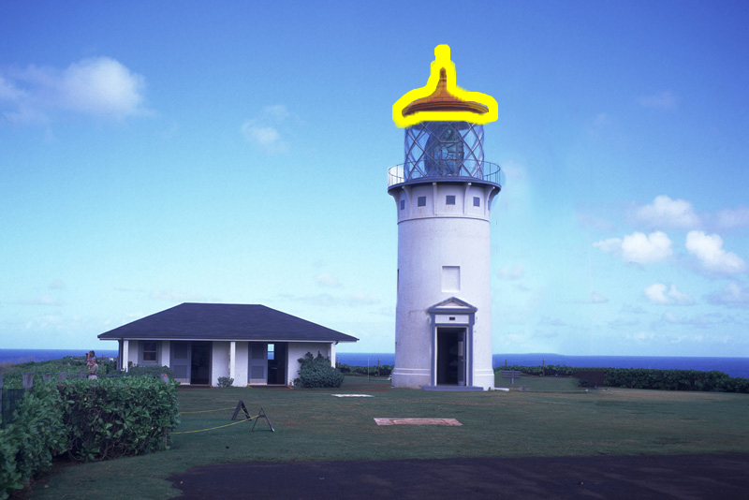
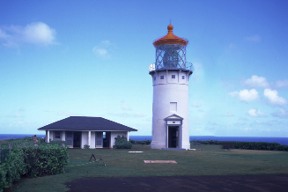
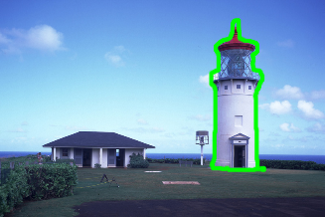
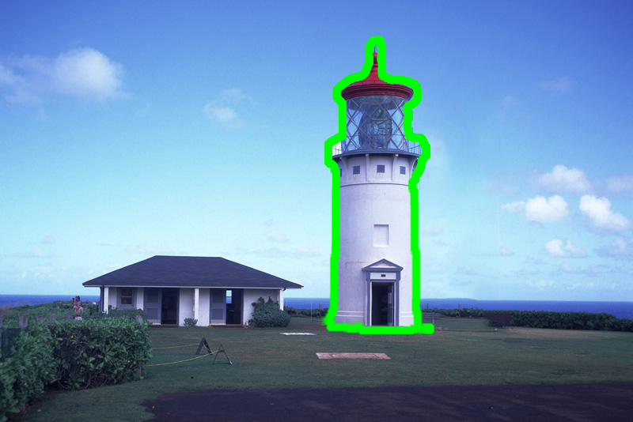

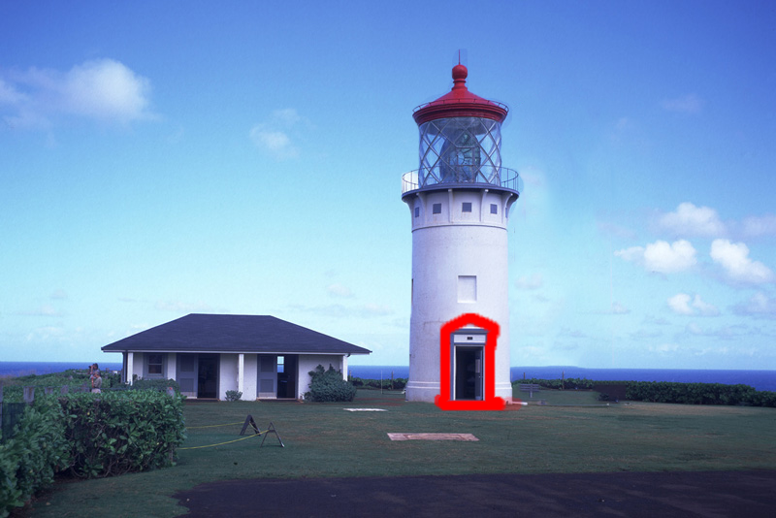
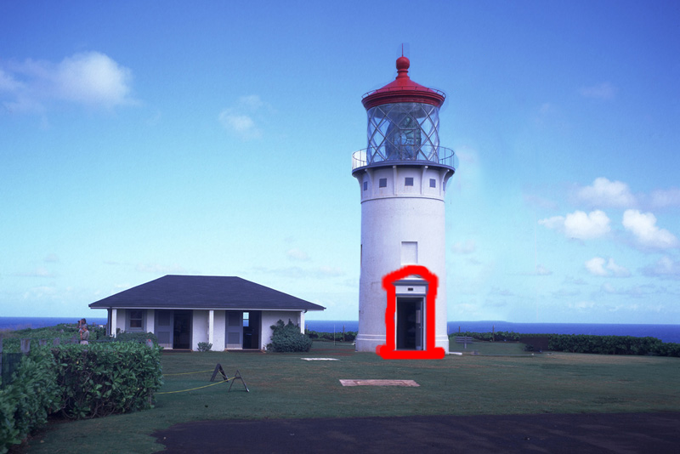




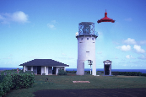

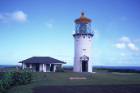




Step 3: Recovering Editing History
Principle 1: Temporal focus
$$E=\sum_{i}{d_{i}⋅Len(S_{i})⋅ (1+λ_{i}i)⋅P_{i}}+λ_{p}\sum_{i}{\left|t_{i+1}−{t′}_{i}\right|}$$
$$E=\sum_{i}{d_{i}⋅Len(S_{i})⋅ (1+λ_{i}i)⋅P_{i}}+λ_{p}\sum_{i}{\left|t_{i+1}−{t′}_{i}\right|}$$
Move the body
Scale and move the door
Move the top and adjust hue
Move the tower
Scale the door
Adjust hue of the top
Notes:
Principle 1, temporal focus, if the same edits are applied on multiple objects, then they are applied either together at once, or sequentially without interruption.
Let’s look at this example, the tower. The same edit result can also be achieved by different histories.
In one history , we move its body, scale and move its door, and then adjust the hue of the top and move it.
And in the second history, we moved the tower as a whole, then scale its door, and change the hue of its top. (--clickx20)
(--click)We prefer to firstly move the tower as a whole because it is more reasonable.
Apart from the edit cost of each step, we involve the perimeter of the changed region in our cost function to additionally emphasize the temporal focus(--click)

Slide 20
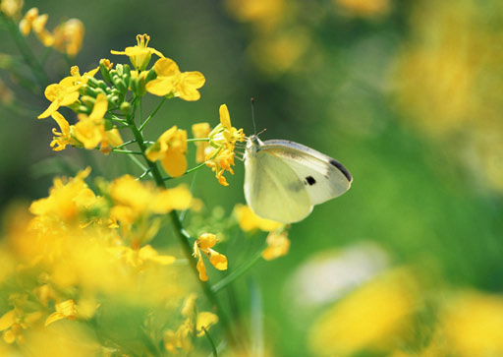
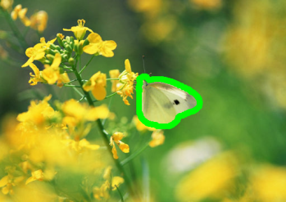














Step 3: Recovering Editing History
Principle 2: Coarse-to-fine order
$$E=\sum_{i}{d_{i}⋅Len(S_{i})⋅ (1+λ_{i}i)⋅P_{i}}+λ_{p}\sum_{i}{\left|t_{i+1}−{t′}_{i}\right|}$$
$$E=\sum_{i}{d_{i}⋅Len(S_{i})⋅ (1+λ_{i}i)⋅P_{i}}+λ_{p}\sum_{i}{\left|t_{i+1}−{t′}_{i}\right|}$$
Copy and move
Adjust hue
Adjust hue
Copy and move
Notes:
Principle 2: the objects are edited in the coarse-to-fine order. Large visually dominant edits are applied before fine-tuning the appearance of small objects.
Look at this example, in one history, the butterfly is firstly copied and moved, then the hue of the background is adjusted.
Or, the hue of the background is adjusted and the butterfly is secondly copied and moved. (--clickx14)
(--click)we prefer to edit the hue of the background first, then copy and move the butterfly since the dominant edits are usually firstly be applied in artists’ perspective.
(--click) So in the edit cost function, we involve the index of each step to prefer larger region edited earlier.

Slide 21
















Step 3: Recovering Editing History
Principle 3: Deferring down-sampling
$$E=\sum_{i}{d_{i}⋅Len(S_{i})⋅ (1+λ_{i}i)⋅P_{i}}+λ_{p}\sum_{i}{\left|t_{i+1}−{t′}_{i}\right|}$$
$$E=\sum_{i}{d_{i}⋅Len(S_{i})⋅ (1+λ_{i}i)⋅P_{i}}+λ_{p}\sum_{i}{\left|t_{i+1}−{t′}_{i}\right|}$$
Scale
Copy and scale
Copy and scale
Scale
Notes:
Principle 3, Down-sampling is deferred as much as possible. We hope to preserve the quality of image.
Look at this example. (--click)In the first history, we scale down the yellow balloon, then copy and scale up it. The result becomes blurry.
(--click)But a better way is to first copy and scale the balloon, then shrink it.(--click)
We involve a term P_i to penalize this early down-sampling in our cost function.(--click)

Slide 22



















Step 3: Recovering Editing History
Principle 4: Spatial focus
$$E=\sum_{i}{d_{i}⋅Len(S_{i})⋅ (1+λ_{i}i)⋅P_{i}}+λ_{p}\sum_{i}{\left|t_{i+1}−{t′}_{i}\right|}$$
$$E=\sum_{i}{d_{i}⋅Len(S_{i})⋅ (1+λ_{i}i)⋅P_{i}}+λ_{p}\sum_{i}{\left|t_{i+1}−{t′}_{i}\right|}$$
Adjust hue
Adjust hue
Move the label
Adjust hue
Move the label
Adjust hue
Notes:
Principle 4: Nearby objects are edited sequentially before moving to far away objects. We call it spatial focus.
Look at these two bags, we can adjust hue of 2 bags in sequence, and move the label.
Or we can adjust the hue of the right bag, then move the label, and then edit the left bag.(--clickx18)
(--click)We prefer first edit the bag on the right, then that on the left since the spatial location of the right bag and the label are more closer.
(--click) In the edit cost function, we involve a term that takes distance between centers of changing objects in consecutive steps into consideration.

Slide 23

Step 3: Recovering Editing History
Temporal focus
Coarse-to-fine order
Deferring down-sampling
Spatial focus
$$E=\sum_{i}{d_{i}⋅Len(S_{i})⋅ (1+λ_{i}i)⋅P_{i}}+λ_{p}\sum_{i}{\left|t_{i+1}−{t′}_{i}\right|}$$
Notes:
After defining the four principles, we obtain the final definition of our edit cost energy function.
We seek to get a step sequence that has the minimum edit cost as our editing history.

Slide 24



Results
1. adjust hue
2. copy, move, scale, adjust hue
Notes:
Here we show some results. The bottom history is obtained from the top two images with our algorithm.
In this example, the hue of the background is modified, before we copy the butterfly and make some adjustments.

Slide 25



Results
1. move
3. move
6. move and rotate
2. copy and move
4. adjust hue
5. copy and rotate
Notes:
This is an example with multiple changing objects.

Slide 26



Results
1. move and adjust hue
3. adjust hue
2. copy and move
4. adjust hue
Notes:
This is another example.

Slide 27
Results
1. adjust hue
2. deform
3. move
Notes:
This is an example with deformation.

Slide 28






Applications
Automatic tutorial generation
Re-editing
Scale the region
Adjust hue
Copy, rotate and
scale
Edited image
Re-edited image
Notes:
Our method of recovering edit history can be used in many applications.
(--click)First, we can generate image editing tutorial automatically. (--click)The picture shows a simple example of turning the history into a step-by-step tutorial.(--click)
In addition, (--click)users can modify the recovered history, for example to remove steps, or change parameters of some steps, and re-apply the modified history to the source image, and generate a new edited image.
(--click)in this example, (--clickx3)we change the hue adjustment parameter, and get two blue berries in the final result(--click).

Slide 29



Applications
Automatic tutorial generation
Re-editing
Edit transfer
crop the region, adjust hue
copy and move the dolphin
Notes:
(--click)The recovered editing history from one pair of images can be transferred to a new image to achieve edit transfer. (--click)Here is source and edited image, (--click)and we have recovered the editing history.

Slide 30




Applications
Automatic tutorial generation
Re-editing
Edit transfer
Notes:
We can apply the editing operators to a new image with similar composition.(--clickx2)

Slide 31







Applications
Automatic tutorial generation
Re-editing
Edit transfer
Image revision control
Notes:
(--click)Our approach can be combined with the image revision control system to merge different editing paths. (--click)In the first edit version, the artist adjusted the hue of one car; (--click)in the second version, another artist copied the same car. (--click)We merge the two versions and get a new result.

Slide 32


Limitations
Region matching algorithm may fail
  Regions are too small
  Regions are textureless
  Geometric/color transformations are too dramatic
More complicated operations are not supported
  Bilateral filtering
  Poisson blending
  …
Source image
Edited image
Reconstructed image
Source image
Edited image
Reconstructed image
Notes:
Our system has several limitations. First, we rely on region matching algorithm, which may fail if regions are too small(--clickx2),
or if regions are texureless,
or if the geometric and color transformations are too drastic(--clickx2).
Second, more complicated operators are not supported, for example, filtering and blending.

Slide 33
Conclusion & Future works
Conclusion
  A novel editing history recovery system
  Improving NRDC for region matching
  Wide range of applications
Future works
  Improve robustness
  Handle vector images
  Apply to large image libraries
Notes:
Here is the conclusion. We have presented a novel editing history recovery system, which automatically recover a edit history from before and after image pair. We improve NRDC algorithm for better region matching. Our system can be used in a wide range of applications.
As future work, we would like to improve the robustness of the proposed system by replacing some technical components with newly developed, more advanced methods.
For example, we could potentially improve the robustness of the region matching step by using recently proposed higher-order deformation models.
We can also extend our method to handle vector images.
Another potential extension is to apply our method to large image libraries for analyzing image correlations or dependencies within a large dataset.

Slide 34
Acknowledgement
  Anonymous reviewers
  Artists & user study participants

Slide 35
Thank you very much
Notes:
Thank you very much. Any questions?

