Slide 1
Interactive Hair Rendering and Appearance Editing under Environment Lighting
Kun Xu¹, Li-Qian Ma¹, Bo Ren¹, Rui Wang², Shi-Min Hu¹
¹Tsinghua University
²University of Massachusetts
Notes:
Thank you Dr. Xin Tong for the introduction.
In this talk, I will present a technique for interactively rendering and appearance editing of hairs under environment lighting.

Slide 2
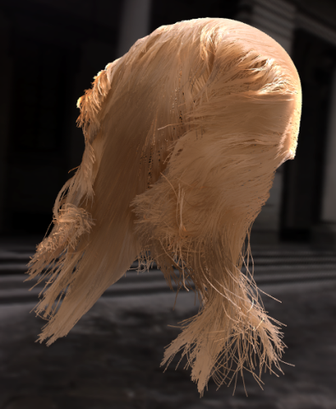
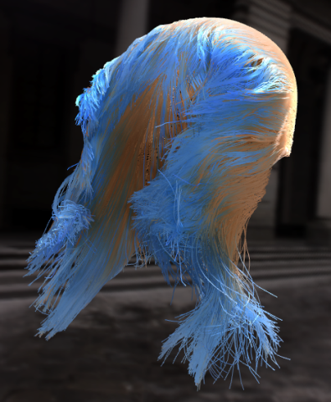

Hair Appearance Editing under Environment Lighting
Motivation
  hair appearance editing
  Natural illumination
Challenges
  Light integration complexity
Notes:
In hair rendering, it is often desirable to dynamic changing of hair’s scattering properties,
Such as highlight position, highlight size, absorption coefficients.
Because this could enable artists to edit hair appearance at will.
On the other hand, environment lighting is also very important,
because it can convey the natural look of hairs under natural illumination.
However, it is still a difficult problem to achieve hair appearance editing under environment lighting.
The main challenge lies in how to efficient integrate the environment lighting with complex hair scattering function, and self shadowing functions.

Slide 3
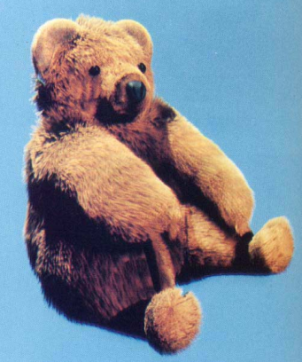
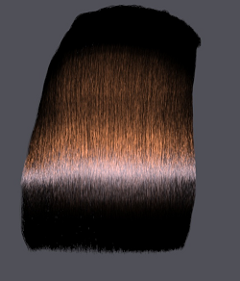
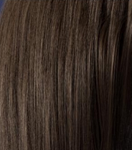
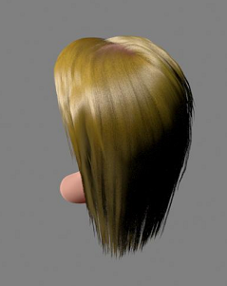
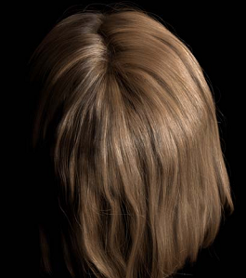
Related Works
Hair scattering function/models
Self Shadowing
  deep shadow maps [Lokovic & Veach 2000]
  opacity shadow maps [Kim & Neumann 2001]
  density clustering [Mertens et al. 2004]
  deep opacity maps [Yuksel & Keyser 2008]
  occupancy maps [Sintorn & Assarson 2009]
[Kajiya & Kay 89]
[Marschner 03]
[Zinke & Webber 07]
[Sadeghi 10]
[d’Eon 11]
Notes:
Before introducing our work, let me first reviewer some important related works.
Hair scattering model describes how a single fiber of hair reflects lights.
The representative models include Kajiya and Kay’s model, which is the first hair scattering model.
Marschner’s model.
The model proposed by Zinke and Webber which supports near field scattering.
Artist friendly model,
And energy conserving model.
Since Marschner’s is physically based and the most general one, we use Marschner’s model in our paper.
For interactively rendering, many works have succesfully addressed the problem of efficient self shadowing.
Some representative works include: deep shadow maps, opacity shadow maps, density clustering, deep opacity maps, occupancy maps.
Kajiya and Kay proposed the first hair scattering model, which is still widely used today. However, it ignores the variation of scattering in the azimuthal dimension and it is not physically based.
Marschner et al. proposed a more accurate model based on the measurements of fiber scattering, assuming distant lighting and view.
Zinke and Webber later proposed a model that generalizes to near field scattering.
Recently, Sadeghi et al. proposed an artist friendly model for intuitive editing of hair parameters, but their method is limited to simple lighting conditions.
dEon et al. proposed an energy-conserving model by considering higher-order light paths.

Slide 4
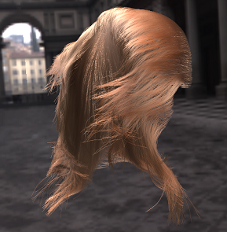
Related Works
Multiple scattering
  Photon Mapping [Moon & Marschner 2006]
  Spherical Harmonics [Moon et al. 2008]
  Dual Scattering [Zinke et al. 2008]
Environment lighting [Ren 2010]
  Model lighting using SRBFs
  Precomputed light transport into
  4D tables
  Fix hair scattering properties
hair appearance editing under environment lighting remains unsolved
Notes:
Multiple scattering describes how light bounces and scatters between multiple hair fibers.
photon mapping and spherical harmonics approximations have been employed to greatly improve offline rendering speed.
Zinke et al. has introduced a dual scattering approximation that achieves real-time performance.
Up to now, all the works discussed are restricted to simple lighting conditions.
Recently, Ren et al. proposed a hair rendering technique that supports environment lighting. They represent environment lighting using SRBFs, and precomputes light transport of each SRBF light into 4D tables. It achieves interactive framerates, however, it requires fixing hair scattering properties.
Even with the impressive progress, we see that hair appearance editing under environment lighting is still an unsolved problem.

Slide 5
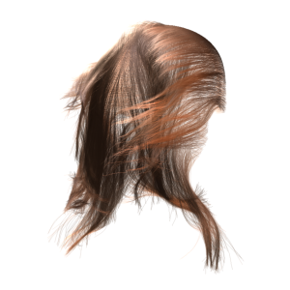

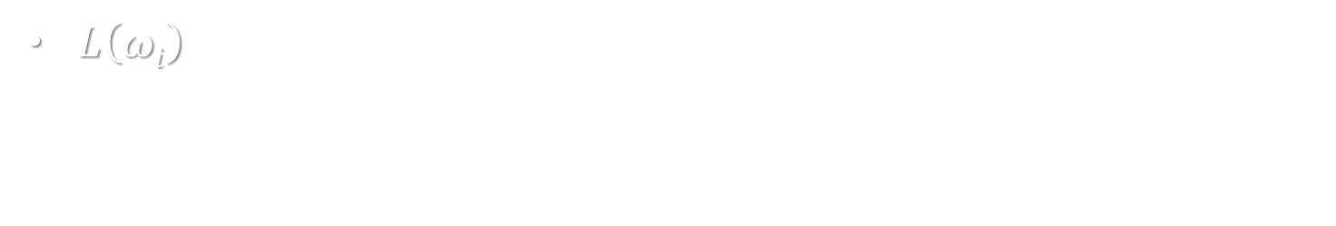
Light Integration
Single scattering
$$L\left(ωo\right)=D\int_{Ω}{L\left(ωi\right)T\left(ωi\right)S(ωi,ωo)\cos{θi}dωi}$$
$L\left(ωi\right)$: environment lighting
$T\left(ωi\right)$: self shadowing
$S(ωi,ωo)$: hair scattering function
Notes:
Let’s see how to evaluate single scattering under evnrionment lighting.
As in the equation,
the single scattering outgoing radiance could be evaluated by integrating over the whole hemisphere,
Where, L is the incident environment lighting. T is the self shadowing term, and S is the hair scattering function.
The form of a hair scattering functions looks like a BRDF, however, evaluating it is more complex, we would explain it in detail later.

Slide 6




Light Integration
Single scattering
$$L\left(ωo\right)≈D\sum_{j}{l_{j}\int_{Ω}{G_{j}\left(ωi\right)T\left(ωi\right)S\left(ωi,ωo\right)\cos{θi}dωi}}$$
$$L\left(ωo\right)≈D\int_{Ω}{\left(\sum_{j}{l_{j}G_{j}\left(ωi\right)} \right)T\left(ωi\right)S(ωi,ωo)\cos{θi}dωi}$$
$$L\left(ωo\right)=D\int_{Ω}{L\left(ωi\right)T\left(ωi\right)S(ωi,ωo)\cos{θi}dωi}$$
Approximate $L\left(ωi\right)$ by a set of SRBFs $Gj(ωi)$ [Tsai and Shih 2006]
Notes:
A natural approximation is to represent the environment lighting by a set of spherical radial basis functions,
Which are typically spherical Gaussians. After this approximation, we can pull the coefficients out and
rewrite the equation.

Slide 7



Light Integration
Single scattering
$$L\left(ωo\right)≈D\sum_{j}{l_{j}\tilde{T}\int_{Ω}{G_{j}\left(ωi\right)S\left(ωi,ωo\right)\cos{θi}dωi}}$$
$$L\left(ωo\right)≈D\sum_{j}{l_{j}\int_{Ω}{G_{j}\left(ωi\right)T\left(ωi\right)S\left(ωi,ωo\right)\cos{θi}dωi}}$$
Approximate $L\left(ωi\right)$ by a set of SRBFs $Gj(ωi)$ [Tsai and Shih 2006]
Move T out from the integral [Ren 2010]
Problem:
evaluate scattering Integral
Notes:
By assuming the self shadowing function is smooth across the support of the SRBF,
we can move the self shadowing function out of the integral.
Now, the problem left is to evaluate this integral, integrating a SRBF light with the hair scattering function.

Slide 8

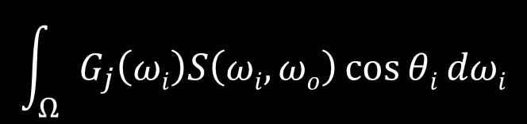
Single Scattering
Integral
$$\int_{Ω}{G_{j}\left(ωi\right)S\left(ωi,ωo\right)\cos{θi}dωi}$$
Previous Approach [Ren 2010]
  Precompute the integral into 4D table
Our key insight
  Is there an approximated analytic solution?
  YES
    Decompose SRBF $G_{j}\left(ωi\right)$ into products of circular Gaussians
    Approximate scattering function $S\left(ωi,ωo\right)$ by circular Gaussians
Notes:
Ren et. al. precomputes the integral and stores it as a 4D table.
However, since it bakes scattering functions into the precomputed tables, it does not allow on-the-fly hair parameters editing.
Our key insight is, since both the SRBF light function and hair scattering function are analytic functions.
It there an accurate analytic solution to evaluate the integral. The answer is no,
We have tried symbol computing library using matlab software, and it cannot find an analytic expression.
Nonintegrable.
However, is there an approximated one?
Fortunately, we find such a solution.
In a high level, by decompositing SRBF lights into products of circular Gaussians, and approximating hair scattering functions also by circular Gaussians, we could evaluate the integral analytically

Slide 9
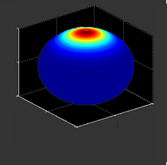
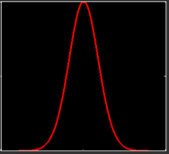
Circular Gaussian
SRBF (Spherical Radial Basis Function)
  Typically spherical Gaussian
  Widely used in rendering
    Environment lighting [Tsai and Shih 2006]
    Light Transport [Green 2007]
    BRDF [Wang 2009]
Circular Gaussian
  1D case of SRBF
  Share all benefits of SRBFs
Notes:
So, what is circular Gaussians?
We are familiar with SRBF, short for Spherical Radial Basis Functions, has been used widely in rendering. It has been used to represent environment lighting, light transport and BRDFs.
Circular Gaussian is essentially the 1D case of SRBF, which is defined on a unit circle. So it shares all the benefits of SRBFs, such as all-frequency signals and trivial rotation.

Slide 10


Circular Gaussian
$$g^{c}\left(x;u,λ\right)=e^{\frac{2[\cos{(x−u)}−1]}{λ^{2}}}$$
center
bandwidth
Useful Properties
  Local approximation by Gaussian
  $g^{c}\left(x;u,λ\right)dx≈$ $e^{−{{\left(x−u\right)}^{2}}/{λ^{2}}}$, error < 1.3%, $λ<π/6$
  Closed on product
  $g^{c}\left(x;u_{1},λ_{1}\right)g^{c}\left(x;u_{2},λ_{2}\right)=bg^{c}\left(x;u_{3},λ_{3}\right)$
Notes:
Let’s quickly review the definition of circular Gaussian.
It has two parameters, center position and bandwidth.
And it can be interchangably used with 1D Gaussian, the relative error is bounded to be a small value when the bandwidth is not very large.
Besides, the product of two circular Gaussian is still a circular Gaussian.

Slide 11


Circular Gaussian
SRBF Decomposition
$G\left(ω_{i};ω_{j},λ_{j}\right)=e^{{2(ω_{i}⋅ω_{j}−1)}/{λ^{2}}}$
$$=g^{c}\left(θ_{i};θ_{j},λ_{j}\right)⋅g^{c}\left(φ_{i};φ_{j},{λ_{j}}/{\sqrt{\cos{θ_{i}}cosθ_{j}}}\right)$$
=
*
1D Longitudinal
circular Gaussian
1D Azimuthal
circular Gaussian
2D SRBF
Notes:
And more importantly,
by expressing the SRBF in spherical coordinates,
it could be decomposed into the product of two circular Gaussians.
one is a circular Gaussian of theta, along the longitudinal direction,
The other is a circular Gaussian of phi, along the azimuthal direction.

Slide 12
Scattering Function
Sum of three modes: R, TT, TRT [Marschner03]
R mode: Reflection (p=0)
TRT Mode:
Transmission-Reflection-Transmission (p=2)
hair fiber
longitudinal angle
TT Mode:
Transmission-Transmission (p=1)
tilted angle
Notes:
Now, let’s review the definition of scattering function.
As described by Marschner et al.
Hair scattering paths could be divided into three modes,
R, TT, and TRT, where each mode corresponds to one kind of light paths.
For example, R mode represents light paths with only one reflection without scattering inside hair fiber;
TT mode corresponds to a transmission inside hair fiber; while TRT mode corresponds to light paths with an internal reflection.
The reflection in the longitudinal direction is mainly specular.

Slide 13
Scattering Function
Sum of three modes: R, TT, TRT [Marschner03]
R mode: Reflection (p=0)
hair fiber cross section
azimuthal angle
TT Mode:
Transmission-Transmission (p=1)
TRT Mode:
Transmission-Reflection-Transmission (p=2)
Notes:
This figure illustrates how light is scattered along the azimutal direction for different modes.
In the azimuthal direction, the scattering function is much more smooth.

Slide 14

Scattering Function
Definition [Marschner03]
$$S\left(ωi,ωo\right)=\sum_{t∈(R,TT,TRT)}{{M_{t}\left(θ_{h}\right)N_{t}(φ_{i}−φ_{o})}/{\cos^{2}{θ_{d}}}}$$
Notes:
Finally, As derived by Marschner et al.
The hair scattering function is the sum of three modes, each mode is a product of a longitudinal function
And an azimuthal function.

Slide 15

Scattering Function
Definition [Marschner03]
$$S\left(ωi,ωo\right)=\sum_{t∈(R,TT,TRT)}{{M_{t}\left(θ_{h}\right)N_{t}(φ_{i}−φ_{o})}/{\cos^{2}{θ_{d}}}}$$
  Longitudinal function : normalized Gaussian
  $M_{t}\left(θ_{h}\right)=g\left(θ_{h};α_{t},β_{t}\right)$
  simulates specular reflection
  along longitudinal direction
Notes:
Since the reflection along the longitudinal direction is specular,
So that the longitudinal function could be naturally expressed by a normalized Gaussian.

Slide 16
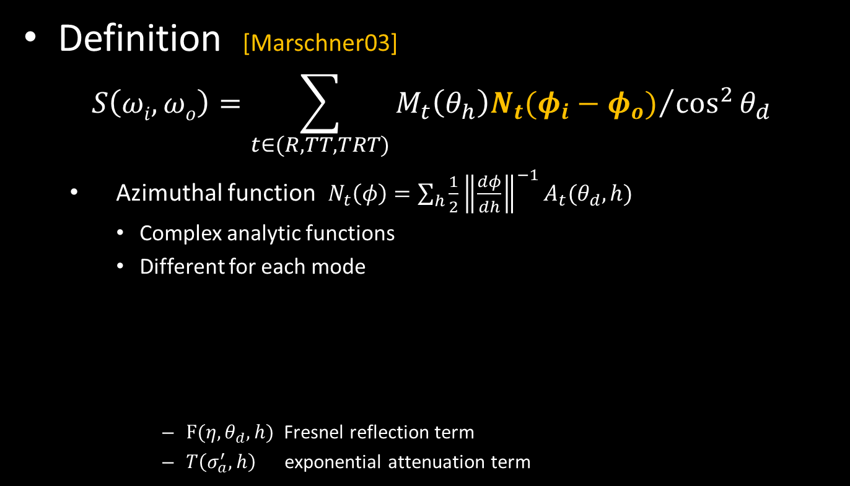

Scattering Function
Definition [Marschner03]
$$S\left(ωi,ωo\right)=\sum_{t∈(R,TT,TRT)}{{M_{t}\left(θ_{h}\right)N_{t}(φ_{i}−φ_{o})}/{\cos^{2}{θ_{d}}}}$$
  Azimuthal function $N_{t}\left(φ\right)=\sum_{h}{\frac{1}{2}{\left\|\frac{dφ}{dh}\right\|}^{−1}A_{t}(θ_{d},h)}$
    Complex analytic functions
    Different for each mode
      $F(η, θ_{d},h)$ Fresnel reflection term
      $T\left(σ_{a}^{′},h\right)$ exponential attenuation term
  $A_{R}(θ_{d},h)=F(η, θ_{d},h)$
  $A_{TT}\left(θ_{d},h\right)={\left(1−F\left(η, θ_{d},h\right)\right)}^{2}T\left(σ_{a}^{′},h\right)$
  $$A_{TRT}\left(θ_{d},h\right)=F\left(η, θ_{d},h\right){\left(1−F\left(η, θ_{d},h\right)\right)}^{2}T^{2}(σ_{a}′,h)$$
Notes:
the expression of the azimuthal function is much more complex. It is determined by examining the scattering paths through the hair fiber cross section. The azimuthal functions are complex analytic functions and the formulas are defined differently for each mode, as shown in the equations. We don't need to remember the exact formulas. However, we see that they are composed of two basic terms, the Fresnel reflection term, and an exponential attenuation term.
Now, let's see how to further simplify and approximate the azimuthal functions.

Slide 17

Azimuthal Functions
  R mode
  $$N_{R}\left(φ\right)=\frac{1}{4}\cos{\frac{φ}{2}} F(η,θ_{d},−\sin{\frac{φ}{2}})$$
  Fresnel term (Schlick’s approximation)
$$F\left(η,θ_{d},−\sin{\frac{φ}{2}}\right)≈F_{0}+\left(1−F_{0}\right){\left(1−cosθ_{d}\cos{\frac{φ}{2}}\right)}^{5}$$
  Approximated by polynomial of $cos\frac{ φ}{2}$
  $$N_{R}\left(φ\right)≈\sum_{0≤k≤6}{C_{k}\left(θ_{d},η\right)\cos^{k}{\frac{ φ}{2}}}$$
Notes:
For R mode, the azimuthal function is defined as the product of a cosine and the Fresnel reflection term.
By making use of schlick’s approximation, which approximates fresnel reflection function by a 5-order polynomial of cosine. We can also approximates the azimuthal function by a polynomial of cosine up to order 6.

Slide 18




Azimuthal Functions
TT mode
$$N_{TT}\left(φ\right)=\sum_{h}{\frac{1}{2}{\left\|\frac{dφ}{dh}\right\|}^{−1}{\left(1−F\left(η, θ_{d},h\right)\right)}^{2}T\left(σ_{a}^{′},h\right)}$$
  Simple shape: look like Gaussian
  approximated by 1 circular Gaussian centered at $φ=π$
    $$N_{TT}\left(φ\right)≈b_{TT}g^{c}(φ;π,λ_{TT})$$
  Parameters fitted by preserving energy
$$θ_{d}=0$$
$$θ_{d}=\frac{π}{6}$$
$$θ_{d}=\frac{ π}{3}$$
Notes:
For TT mode, definitely, the function expression is rather complex.
However, if plotting the shape of function, you will find that the shape is rather simple. It always has a lobe when \phi is equal to pi and the lobe size varies when function parameters change.
Under this observation, we can approximate the azimuthal function using a circular Gaussian.
The center is directly set as \pi, the coefficient and bandwidth are determined by preserving function energy

Slide 19





TT mode approximation
$b_{TT}$: coefficient
  set as the peak value, $N_{TT}(π)$
$λ_{TT}$: bandwidth
  Preserving energy $λ_{TT}=∫N_{TT}(φ)dφ/(\sqrt{π}b_{TT})$
$$N_{TT}\left(φ\right)≈b_{TT}g^{c}(φ;π,λ_{TT})$$
$$∫N_{TT}\left(φ\right)dφ$$
$$=\frac{1}{2}∫{\left(1−F\left(η, θ_{d},h\right)\right)}^{2}T\left(σ_{a}^{′},h\right)dh$$
$F\left(η, θ_{d},h\right)$: fresnel reflection
$T\left(σ_{a}^{′},h\right)$: attenuation function
Notes:
In detail,
first, the coefficient is directly set as the peak value at peak point \phi is \pi.
The bandwidth is determined by preserving the energy, or function integral.
Calculating the energy involves an integration over the azimuthal function.
However, this function is nonintegrable,

Slide 20



TT mode approximation
$b_{TT}$: coefficient
  set as the peak value, $N_{TT}(π)$
$λ_{TT}$: bandwidth
  Preserving energy $λ_{TT}=∫N_{TT}(φ)dφ/(\sqrt{π}b_{TT})$
$$N_{TT}\left(φ\right)≈b_{TT}g^{c}(φ;π,λ_{TT})$$
$$∫N_{TT}\left(φ\right)dφ$$
$$=\frac{1}{2}\sum_{k=0,2,4}{a_{k}\left(θ_{d},σ_{a}\right)}\int{{\left(1−F\left(η, θ_{d},h\right)\right)}^{2}h^{k}dh}$$
$$=\frac{1}{2}∫{\left(1−F\left(η, θ_{d},h\right)\right)}^{2}\left(\sum_{k=0,2,4}{a_{k}\left(θ_{d},σ_{a}\right)h^{k}}\right)dh$$
$$=\frac{1}{2}∫{\left(1−F\left(η, θ_{d},h\right)\right)}^{2}T\left(σ_{a}^{′},h\right)dh$$
$F\left(η, θ_{d},h\right)$: fresnel reflection
$T\left(σ_{a}^{′},h\right)$: attenuation function
Precompute into 2D tables
4-th order Taylor expansion
Notes:
In order to integrate it, we further approximate the attenuation function using a 4-th order Taylor expansion.
Then, we can pull the coefficients out. And the left term could be precomputed and stored as 2D tables.
Note that, this table is independent of scenes. So that it only needs to be computed only once and can be used for all scenes.

Slide 21




Azimuthal Functions
TRT mode:
$$N_{TRT}\left(φ\right)=\sum_{h}{\frac{1}{2}{\left\|\frac{dφ}{dh}\right\|}^{−1}F\left(η, θ_{d},h\right){\left(1−F\left(η, θ_{d},h\right)\right)}^{2}T^{2}\left(σ_{a}^{′},h\right)}$$
  Shape: sum of Circular Gaussians
    $η^{′}<2$: approximated by 3 circular Gaussians
    $η^{′}>2:$ approximated by 1 circular Gaussian
  Fitted by preserving energy similar as TT mode
$$θ_{d}=0$$
$$θ_{d}=\frac{π}{6}$$
$$θ_{d}=\frac{ π}{3}$$
Notes:
For TRT mode, we analysis the azimuthal function similarly.
By plotting the function, we find that the function contains one lobe or two lobes. The number, center and sizes of lobes vary with function parameters.
So that we approximate the azimuthal function using 1 circular Gaussian or 3 circular Gaussians, depending on function parameters. Consistency is also carefully maintained across change boundaries.
The coefficients, and bandwidths are determined similarly as in TT mode by preserving function energy.

Slide 22


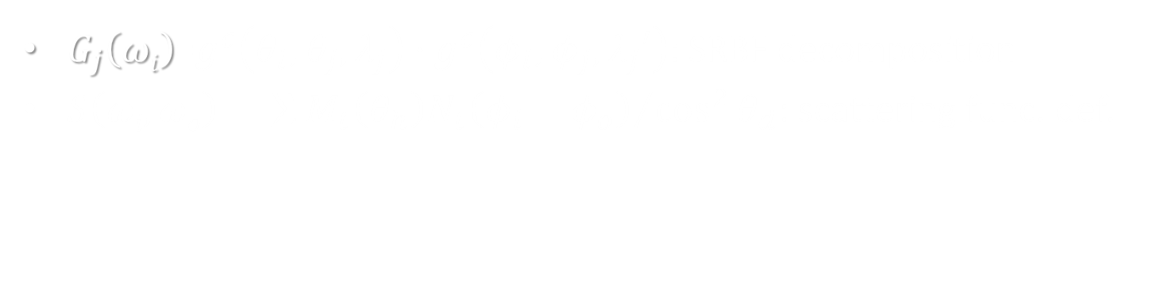
Single Scattering
Integral
$$\int_{Ω}{G_{j}\left(ωi\right)S\left(ωi,ωo\right)\cos{θi}dωi}$$
$$=\int_{Ω}{\left(g^{c}\left(θ_{i}\right)⋅g^{c}\left(φ_{i}\right)\right)\left(\sum{{M_{t}\left(θ_{h}\right)N_{t}\left(φ_{i}−φ_{o}\right)}/{\cos^{2}{θ_{d}}}}\right)\cos{θi}dωi}$$
Circular Gaussian
Circular Gaussian
Analytic Integral
Gaussian
Cosine /
Circular Gaussian
$G_{j}\left(ωi\right)$=$g^{c}\left(θ_{i};θ_{j},λ_{j}\right)⋅g^{c}\left(φ_{i};φ_{j},λ_{j}′\right)$: SRBF decomposition
$S\left(ωi,ωo\right)=\sum{{M_{t}\left(θ_{h}\right)N_{t}\left(φ_{i}−φ_{o}\right)}/{\cos^{2}{θ_{d}}}}$: scattering func. def.
Notes:
Now, let's come back to check the single scattering integral.
By definition, we have decomposed SRBF to product of circular Gaussians,
And the scattering function is the sum of products of a longitudinal function and an azimuthal function.
After using our approximation, the functions involved are all simple functions, such as circular Gaussians, Gaussians, or polynomial of cosine functions.
It is not difficult to derive an approximate analytic formula to evaluate this integral.
Please refer to our paper for details.

Slide 23


Light Integration
Multiple scattering
$$L\left(ωo\right)≈D\sum_{j}{l_{j}T_{f}\int_{Ω}{ψ\left(⋅\right)S^{D}\left(ωi,ωo\right)\cos{θi}dωi}}$$
[Ren 2010]
Spread function: $ψ\left(⋅\right)=s_{f}\left(φ_{i},φ_{j}\right)g^{u}(θ_{i};θ_{j},σ_{f})$
BCSDF: $S^{D}\left(ω_{i},ω_{o}\right)=S\left(ω_{i},ω_{o}\right)+d_{b}S_{back}\left(ω_{i},ω_{o}\right)$ [Zinke 2010]
Approximate scattering function similarly
Analytic Integral
Notes:
Our approximation could also be used in rendering multiple scattering effects.
Here I do not plan to go into the details,
But basically, we also approximate the hair scattering function using circular Gaussians.
And the multiple scattering integral could also be evaluated analytically.

Slide 24
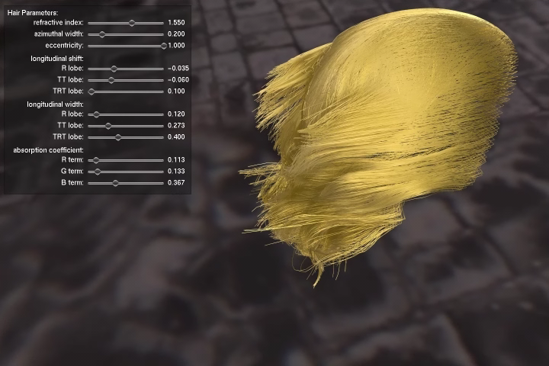
Results
Notes:
let’s see some beautiful results and videos.

Slide 25
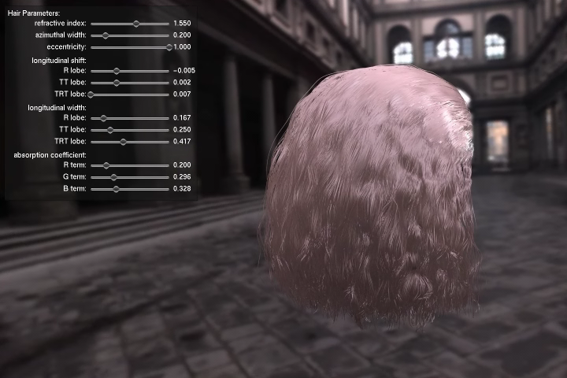
Results

Slide 26
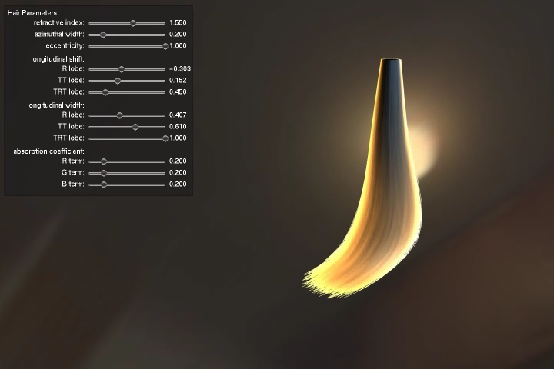
Results

Slide 27
Performance
hair model | #fibers | #segments | FPS
animation | 10K | 270K | 8.3
ponytail | 6K | 100K | 8.9
natural | 10K | 1.6M | 4.8
Testing Machine
  Intel Core 2 Duo 3.00 GHz CPU, 6 GB RAM NVIDIA GTX 580
  720 * 480 with 8x antialias
Notes:
We implemented our rendering algorithm on a PC with an Intel Core2 Duo 3.0G CPU, 6GB memory, and an nVidia Gtx 580 graphics card.
This table lists the run-time performance statistics for all our examples.
The performance of our method is comparable to the work of Ren et. al. Our method enables on-the-fly hair scattering parameters change without reducing performance.

Slide 28
Conclusion
1D circular Gaussian
  Accurate and compact for representing hair scattering functions
  Closed form integral with SRBF lights
New effects
  interactive hair appearance editing under environment lighting
  Rendering of spatially varying hair scattering parameters under environment lighting
Notes:
In conclusion,
We have proposed a circular Gaussian representation for approximating Marschner’s hair scattering function. This approximation is both accurate and compact. The main benefit of this representation is that it enables a closed form integrals with SRBF lights. This would allow us to achieve some new rendering effects.
Such as, interactive hair appearance editing under environment lighting, and spatially varying hair scattering parameters rendering under environment lighting.

Slide 29
Future works
View transparency effects [Sintorn and Assarsson 2009]
Other hair scattering models
  Artist friendly model [Sadeghi 2010]
  Energy conserving model [d’Eon 2011]
Near-field light sources
Accelerate off-line hair rendering
Notes:
Our method could be improved in several ways.
First, we do not consider view transparency effects in our current implementation, and it could be added by using
Occupancy maps.
Secondly, now we only deal with marschner’s hair scattering model.
It would be useful to handle recent models such as the artist friendly model and the energy conserving model.
We are also interested in exploring ways to handle near-field light sources and use circular Gaussians to accelerate offline hair rendering.

Slide 30
Acknowledgement
Anonymous Siggraph and Siggraph Asia reviewers
Ronald Fedkiw, Cem Yuksel, Arno Zinke, Steve Marschner
  Sharing their hair data
Zhong Ren
  Useful discussion
Thank you
for your attention.

Slide 31

Circular Gaussian vs Gaussian
1D Circular Gaussian
  Defined on unit circle :
  $g^{c}\left(x;u,λ\right)=e^{\frac{2[\cos{(x−u)}−1]}{λ^{2}}}$
  $g^{c}\left(x;−π,λ\right)=g^{c}\left(x;π,λ\right)=g^{c}\left(x;3π,λ\right)=…$
1D Gaussian
  Defined on x-axis
  $g\left(x;u,λ\right)=e^{\frac{{−\left(x−u\right)}^{2}]}{λ^{2}}}$
  $g\left(x;−π,λ\right)≠g\left(x;π,λ\right)$

Slide 32


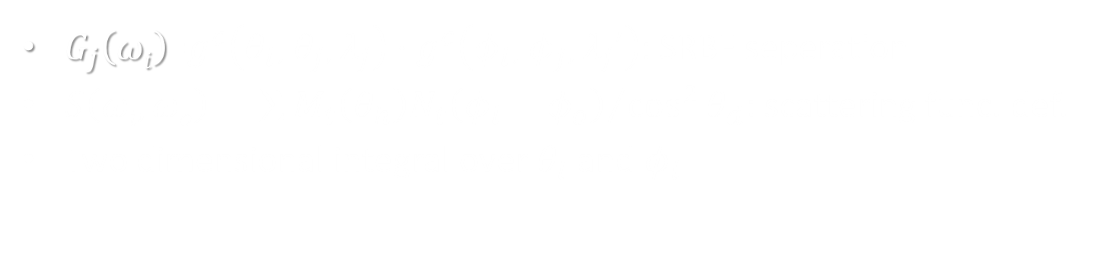
Single Scattering
Integral
$$\int_{Ω}{G_{j}\left(ωi\right)S\left(ωi,ωo\right)\cos{θi}dωi}$$
$$=\int_{Ω}{\left(g^{c}\left(θ_{i}\right)⋅g^{c}\left(φ_{i}\right)\right)\left(\sum{{M_{t}\left(θ_{h}\right)N_{t}\left(φ_{i}−φ_{o}\right)}/{\cos^{2}{θ_{d}}}}\right)\cos{θi}dωi}$$
$$=\sum{\int_{θ_{i}}{g^{c}\left(θ_{i}\right)}M_{t}\left(θ_{h}\right)\frac{\cos^{2}{θ_{i}}}{\cos^{2}{θ_{d}}}{\text{N}}_{t}\left(⋅\right)dθ_{i}}$$
Outer integral
$${\text{N}}_{t}\left(⋅\right)=\int{N_{t}\left(φ_{i}−φ_{o}\right)}g^{c}\left(φ_{i}\right)dφ_{i}$$
inner integral:
$G_{j}\left(ωi\right)$=$g^{c}\left(θ_{i};θ_{j},λ_{j}\right)⋅g^{c}\left(φ_{i};φ_{j},λ_{j}′\right)$: SRBF seperation
$S\left(ωi,ωo\right)=\sum{{M_{t}\left(θ_{h}\right)N_{t}\left(φ_{i}−φ_{o}\right)}/{\cos^{2}{θ_{d}}}}$: scattering func. def.
Two dimensional integral over $θ_{i}$ and $φ_{i}$

Slide 33




Inner Integral
R Mode
Hair scattering function approx.
  polynomial of $cos\frac{ φ}{2}$:
  $$N_{R}\left(φ\right)≈\sum_{0≤k≤6}{C_{k}\left(θ_{d},η\right)\cos^{k}{\frac{ φ}{2}}}$$
Inner integral
$${\text{N}}_{R}\left(⋅\right)=\int{N_{R}\left(φ_{i}−φ_{o}\right)}g^{c}\left(φ_{i};φ_{j},λ_{j}\right)dφ_{i}$$
  $${\text{N}}_{R}\left(⋅\right)≈\int{\left(\sum_{0≤k≤6}{C_{k}\left(θ_{d},η\right)\cos^{k}\left(\frac{φ_{i}−φ_{o}}{2}\right)}\right)g^{c}\left(φ_{i};φ_{j},λ_{j}\right)dφ_{i}}$$
  $${\text{N}}_{R}\left(⋅\right)≈\sum_{0≤k≤6}{C_{k}\left(θ_{d},η\right)\int{\cos^{k}\left(\frac{φ_{i}}{2}\right)g^{c}\left(φ_{i};φ_{j}−φ_{o},λ_{j}\right)dφ_{i}}}$$
Precompute into 2D tables

Slide 34




Inner Integral
TT & TRT modes
Hair scattering function approx.
  sum of circular Gaussians :
  $$N_{t}\left(φ\right)≈\sum{b_{k}g^{c}(φ;φ_{k},λ_{k})}$$
Inner integral
  $${\text{N}}_{t}\left(⋅\right)≈\int{\left(\sum{b_{k}g^{c}\left(φ_{i}−φ_{o};φ_{k},λ_{k}\right)}\right)g^{c}\left(φ_{i};φ_{j},λ_{j}\right)dφ_{i}}$$
  $${\text{N}}_{t}\left(⋅\right)=\int{N_{t}\left(φ_{i}−φ_{o}\right)}g^{c}\left(φ_{i};φ_{j},λ_{j}\right)dφ_{i}$$
  $${\text{N}}_{t}\left(⋅\right)≈\sum{b_{k}\int{g^{c}(φ_{i}−φ_{o};φ_{k},λ_{k})g^{c}\left(φ_{i};φ_{j},λ_{j}\right)dφ_{i}}}$$
Analytic Integral

Slide 35

Outer Integral
$$\int_{θ_{i}}{\left(g^{c}\left(θ_{i}\right)M_{t}\left(θ_{h}\right)\right)\left(\frac{\cos^{2}{θ_{i}}}{\cos^{2}{θ_{d}}}{\text{N}}_{t}\left(⋅\right)\right)dθ_{i}}$$
Gaussian
Smooth Function
Piecewise Linear approximation
Analytic Integral

Slide 36
Summary of
Single Scattering
Hair scattering function approximation
  R mode: polynomial of cosine
  TT/TRT mode: circular Gaussian
Inner integral
  R mode: 2D tables
  TT/TRT mode: 2D tables, analytic integral
Outer integral
  Piecewise linear approximation for smooth func.
  Analytic integral.

