Slide 1
Image vectorization and editing via linear gradient layer decomposition
Zheng-Jun Du Qinghai University, Tsinghua University
Liang-Fu Kang Tsinghua University
Jianchao Tan Kuaishou Technology
Yotam Gingold George Mason University
Kun Xu Tsinghua University
Notes:
Hello everyone, I am Yotam Gingold from George Mason University, it’s my honor to present our work ‘Image vectorization and editing via linear gradient layer decomposition’.

Slide 2
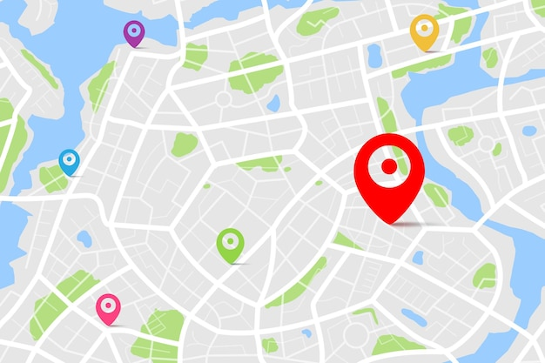
Vector graphics are editable and resolution independent
Widely used in illustrations, font, logo and map design.
Font
Logo
Map
Notes:
A key advantage of vector graphics over raster graphics is their editability and resolution independence. Which making it widely used in font, logo, map design, etc.

Slide 3
Multi-layer vectorization
Multi-layer vectorization aims to decompose a raster image into multiple semi-transparent layers.
Input image
Notes:
In this work, we focus on a specific type of vectorization i.e., multi-layer vectorization. For a given raster image, multi-layer vectorization decompose it into a set of ordered semi-transparent layers.

Slide 4
Multi-layer vectorization
Multi-layer vectorization aims to decompose a raster image into multiple semi-transparent layers.
Input image
Decomposed semi-transparent layers

Slide 5
Multi-layer vectorization
In turn, these decomposed layers can accurately reconstruct the input raster image by alpha blending.
Input image
Recon. Image
Notes:
Meanwhile, these decomposed layers can accurately reconstruct the input by alpha blending.

Slide 6
Multi-layer vectorization
Applications: recoloring, objects insert-remove-replace edits, etc.
Input image
Recon. Image
Recoloring
inserting objects
Notes:
After decomposition, we can perform recoloring or object insert-remove-replace edits using these linear gradient layers in illustrator software.

Slide 7
Related work: Multi-layer vectorization
Multi-layer vectorization
Vectorizing Bitmaps into Semi-Transparent Gradient Layers, Orzan et al. EGSR 2014
Photo2ClipArt:lmage Abstraction and Vectorization Using Layered Linear Gradients
Favreal et al. SIGGRAPH Asia 2017
These methods require user interaction and may get stuck in local minima.
Notes:
The most similar works to ours are [Richardt et al. 2014] and [Favreau et al. 2017]. The former work proposed to iteratively decompose the image region into linear or radial gradient layers by manually selecting the regions. The latter proposed a Monte Carlo Tree Search algorithm to multi-layer decomposition.
But both methods require user interaction and cannot perform automatically decomposition.

Slide 8
Our contribution
A fully automatic approach to layer decomposition with the given segmented input image.
A drastically reduced search space via perceptually-motivated constraints.
Notes:
To address this problem, we propose a fully automatic approach to gradient layer decomposition that finds globally optimal layers given a segmented input image. Besides, we drastically reduce the search space with perceptually-motivated constraints, resulting in a small space that can be exhaustively enumerated quickly.

Slide 9
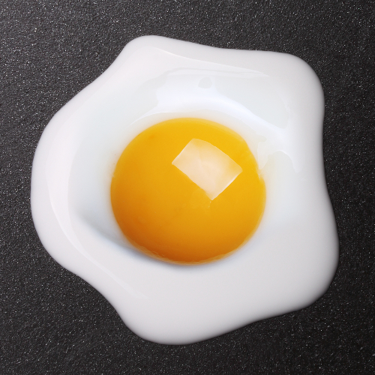
Our approach
Input: a segmented raster image.
Output: a set of semi-transparent layers $L=\{L_{1},L_{2},…,L_{n}\}$.
Input image & its segmentation
Output ordered semi-transparent layers (from low to high)
Notes:
Our method takes a raster image and its segmentation mask as input, outputs a set of ordered semi-transparent layers.

Slide 10
Main challenge
Multi-layer vectorization is severely under-constrained.
…
Input image
Some possible decompositions
Given #layer = $l$，#pixel = $n$， #decomposition = $2^{nl}$.
Given #layer = $l$，#region = $m$， #decomposition = $2^{ml}$.
Notes:
Multi-layer vectorization is a severely under-constrained problem, for a given rater image, there are infinite number of possibilities.
Assuming there are l layers and all n pixels in the input image are independent, so there are $2^{nl}$ possible decompositions.
If we segment the input into m regions and force pixels in a region to share the same layers, then there are still $2^{ml}$ possible decompostions.

Slide 11
Main challenge
For a decomposition, two types of parameters are difficult to solve
Layer configuration: the number of layers, their masks, and stack orders.
Layer parameter: linear gradient parameters of each layer.
Layers: ${[L}_{1},L_{2}$, $L_{3}$, $L_{4}]$
Layer masks
Stack order: $L_{1}→L_{2}→$ $L_{4}$, $L_{1}→L_{3}→L_{4}$
$$L_{4}$$
$$L_{2}$$
$$L_{3}$$
$$L_{1}$$
$$C_{RGBA}\left(p\right)=c_{0}+(p∙n)∙c_{g}$$
Input image
Layers
Layer configuration & layer parameters
Notes:
For a specific decomposition, two types of parameters need to be determined.
One type is the discrete parameters: the number of layers, their masks, and stack order, which we refer to as the layer configuration.
The other type is the continuous parameters: the linear gradient parameters for each layer, which we refer to as the layer parameters.
It is difficult to optimize both types of parameters simultaneously.

Slide 12
Our approach
We propose a two-step solution to multi-layer vectorization
1. Determining the layer configuration.
2. Estimating the layer parameters.
$$R_{1}$$
$$R_{3}$$
1
2
$$R_{2}$$
$$R_{6}$$
$$R_{4}$$
$$R_{5}$$
Input seg. image
Layer configuration
Output layers
Notes:
In general, our proposed method contains two steps. Firstly, we determine the layer configuration from the input image and its segmentation. Secondly, we optimize the layer parameters from the layer configuration.
Next, before introducing our method, we first give two basic concepts used throughout our paper.

Slide 13
Basic concepts
Layer support: A lower layer $L_{i}$ supports ($→$) a higher one $L_{j}$ if
1) $L_{i}$ and $L_{j}$ overlap.
2) at least one overlapping region is not covered by any in-between layer.
$$R_{1}$$
$$L_{4}$$
$$R_{3}$$
$L_{1}→L_{2}$ via $R_{2}$ , $L_{1}→L_{3}$ via $R_{3}$
$L_{2}→L_{4}$ via $R_{4}$ , $L_{3}→L_{4}$ via $R_{6}$
$$R_{2}$$
$$R_{6}$$
$$L_{2}$$
$$L_{3}$$
$$R_{4}$$
$$R_{5}$$
$$L_{1}$$
Input seg. image
Layers
Layer supporting relationships
Notes:
The first concept is the layer supporting.
We say that a lower layer $L_{i}$ supports a higher layer $L_{j}$ if they satisfy two conditions:
the two layers overlap;
one or more overlapping regions are not covered by any in-between layer
The overlapping regions satisfying condition 2) are referred to as the supporting region(s)
In this example, $L_{1}→L_{2}$ via supporting region $R_{2}$ , $L_{1}→L_{3}$ via supporting region $R_{3}$.

Slide 14
Basic concepts
Region support: Region$R_{i}$ supports ($→$) region $R_{j}$ if
1) they are adjacent regions.
2) $R_{i}$’s top (covered) layer $L_{i}$ supports $R_{j}$’s top (covered) layer $L_{j}$.
3) $R_{j}$ is in the overlap of $L_{i}$ and $L_{j}$.
$$R_{1}$$
$$L_{4}$$
$$R_{3}$$
$R_{1}→R_{2}$, $R_{1}→R_{3}$, $R_{1}→R_{5}$,
$R_{2}→R_{4}$, $R_{3}→R_{6}$
$$R_{2}$$
$$R_{6}$$
$$L_{2}$$
$$L_{3}$$
$$R_{4}$$
$$R_{5}$$
$$L_{1}$$
Input seg. image
Layers
Region supporting relationships
Notes:
The second concept is the region supporting.
We say that region $R_{i}$ supports region $R_{j}$ if
they are adjacent regions.
$R_{i}$’s top (covered) layer $L_{i}$ supports $R_{j}$’s top (covered) layer $L_{j}$.
$R_{j}$ is one of the supporting regions from $L_{i}$ to $L_{j}$.
In this example, $R_{1}→R_{2}$ , $R_{2}→R_{4}$

Slide 15
1. Determining the layer configuration
Key observation
A layer configuration can be expressed as a region supporting tree, and which can be enumerated from an region adjacency graph.
$$R_{1}$$
$${ R}_{4}$$
$${ R}_{6}$$
$${ R}_{4}$$
$${ R}_{5}$$
$$L_{4}$$
$${ R}_{6}$$
$$R_{3}$$
$$R_{2}$$
$$L_{3}$$
$${ R}_{2}$$
$${ R}_{3}$$
$${ R}_{5}$$
$$R_{6}$$
$$L_{2}$$
$${ R}_{3}$$
$$R_{4}$$
$$R_{5}$$
$${ R}_{1}$$
$${ R}_{2}$$
$${ R}_{1}$$
$$L_{1}$$
$${ R}_{0}$$
canvas
$${ R}_{0}$$
canvas
Input seg. image
Layer configuration
Region supporting tree
Region adj. graph
Notes:
With the concepts, we find that the region supporting relationships in a layer configuration can be expressed as a tree, we call it region supporting tree, and which can be enumerated from an region adjacency graph.

Slide 16
1. Determining the layer configuration
Pipeline
$$R_{1}$$
$${ R}_{4}$$
$${ R}_{5}$$
$${ R}_{4}$$
$${ R}_{6}$$
$${ R}_{6}$$
$$L_{4}$$
$$R_{3}$$
$${ R}_{2}$$
$${ R}_{3}$$
$${ R}_{5}$$
$$R_{2}$$
$$R_{6}$$
$${ R}_{3}$$
$$L_{2}$$
$$L_{3}$$
$$R_{4}$$
$$R_{5}$$
$${ R}_{2}$$
$${ R}_{1}$$
$${ R}_{1}$$
$$L_{1}$$
$${ R}_{0}$$
$${ R}_{0}$$
Input seg. image
Build the region adjacency graph
Enumerate the region supporting trees
Merge layers with the X-junction hints
The region adjacency graph implies the space of region supporting trees.
Notes:
So we propose a graph-based method to determine the layer configuration, specifically our pipeline contains three steps:
Building the region adjacency graph from the input, which essentially defines the space of all region supporting trees
Enumerating the spanning tree from the region adjacency graph as the region supporting tree
Merging layers with X-junction hints and derive the layer configuration
Next, we first introduce the region adjacency graph construction.

Slide 17
1.1 Building the region adjacency graph
Directly enumerating over all region supporting trees from the initial region adjacency graph is rather expensive.
$$R_{1}$$
$${ R}_{1}$$
$${ R}_{6}$$
$${ R}_{1}$$
$${ R}_{6}$$
$$R_{2}$$
$$R_{3}$$
$${ R}_{4}$$
$${ R}_{4}$$
…
$$R_{5}$$
$$R_{4}$$
$${ R}_{0}$$
$${ R}_{0}$$
$${ R}_{2}$$
$${ R}_{2}$$
$$R_{6}$$
$${ R}_{3}$$
$${ R}_{5}$$
$${ R}_{3}$$
$${ R}_{5}$$
Input seg. image
Initial region adj. graph
Many region supporting trees
How to reduce the space of the region supporting trees?
Notes:
In a region adjacency graph, a node corresponds to a region in the input segmentation, a directed edge corresponds to a region supporting relationship, besides, we add a virtual node $R_{0}$ as the default canvas, and add directed edges from it to all other regions.
Directly enumerating over all region supporting trees from the initial region adjacency graph is rather expensive. As the region adjacency graph implies the space of region supporting trees, Motivated by figure ground and part perception of shapes , we propose three rules to remove those very unlikely supporting edges from the graph to reduce the search space.

Slide 18
Simplifying the region adjacency graph
Size rule: very small regions can’t support large ones.
$$R_{1}$$
$$R_{2}$$
Input
Decomposition without rule ($R_{2}$→ $R_{1}$)
Decomposition with rule
($R_{1}$→ $R_{2}$)
Notes:
The first one is the size rule. For two adjacent regions, if one’s size is much larger another one, then the small-sized region are not allowed to support another one.
As shown in the figure, the decomposition results violating and obeying this rule are shown in the middle and right, respectively.
In contrast, the decomposition result on the right is more consistent with the figure ground perception.

Slide 19
Simplifying the region adjacency graph
Surrounding rule: surrounded regions (islands) can’t support their surroundings.
$$R_{1}$$
$$R_{2}$$
Input
Decomposition without rule ($R_{2}$→ $R_{1}$)
Decomposition with rule
($R_{1}$→ $R_{2}$)
Notes:
The second one is the surrounding rule. If one region is surrounded by another one, then the surrounded region is not allowed to support the surrounding one.
The decomposition results violating and obeying this rule are shown in the middle and right, respectively.
We can see that the right one is more conform to the figure ground perception, while the middle one is less intuitive because some layer contain hole.

Slide 20
Simplifying the region adjacency graph
Adjacent strength rule: Two regions sharing a very short boundary can’t support each other.
$$R_{1}$$
$$R_{2}$$
Input
Decomposition without rule ($R_{2}$→ $R_{1}$)
Decomposition with rule
($R_{1}$ and $R_{2}$ are independent)
Notes:
The last one is the adjacent strength rule. If two regions share very short boundary, then they are not allowed to support each other.
As shown in the figure, the decomposition results violating and obeying this rule are shown in the middle and right, respectively.
Compared to the middle one, the right one that decompose the input into two isolated rectangular layers is more consistent with the part perception of shapes.

Slide 21
An example
$${ R}_{1}$$
$${ R}_{6}$$
$$R_{1}$$
$$R_{2}$$
$$R_{3}$$
$${ R}_{0}$$
$${ R}_{4}$$
$$R_{5}$$
$$R_{4}$$
$${ R}_{2}$$
$$R_{6}$$
$${ R}_{3}$$
$${ R}_{5}$$
Input seg. image
Initial region adjacency graph
Notes:
Here we provide an example to show the these three rules in region adjacency graph simplification.
For this example, the initial region adjacency graph contains 6 nodes and 20 directed edges. Next, we simplify it with these aforementioned 3 rules.

Slide 22
An example
$${ R}_{1}$$
$${ R}_{6}$$
$$R_{1}$$
$$R_{2}$$
$$R_{3}$$
$${ R}_{0}$$
$${ R}_{4}$$
$$R_{5}$$
$$R_{4}$$
$${ R}_{2}$$
$$R_{6}$$
$${ R}_{3}$$
$${ R}_{5}$$
Input seg. image
Simplify with the size rule
Notes:
Firstly, we remove edges that violate the size rule.

Slide 23
An example
$${ R}_{1}$$
$${ R}_{6}$$
$$R_{1}$$
$$R_{2}$$
$$R_{3}$$
$${ R}_{0}$$
$${ R}_{4}$$
$$R_{5}$$
$$R_{4}$$
$${ R}_{2}$$
$$R_{6}$$
$${ R}_{3}$$
$${ R}_{5}$$
Input seg. image
Simplify with the size rule
surrounding rule
Notes:
secondly, we remove edges that violate the surrounding rule.

Slide 24
An example
$${ R}_{1}$$
$${ R}_{6}$$
$$R_{1}$$
$$R_{2}$$
$$R_{3}$$
$${ R}_{0}$$
$${ R}_{4}$$
$$R_{5}$$
$$R_{4}$$
$${ R}_{2}$$
$$R_{6}$$
$${ R}_{3}$$
$${ R}_{5}$$
Input seg. image
Simplify with the size rule
surrounding rule
Adjacency strength rule
Notes:
At last, we remove edges that violate the adjacent strength rule.
As a result, there are 7 edges in the simplified region adjacency graph, which greatly reduce the search space.

Slide 25
1.2 Enumerating the region support. trees
Enumerating the spanning trees (region supporting trees) from the simplified region adjacency graph.
$${ R}_{1}$$
$${ R}_{6}$$
$${ R}_{0}$$
$${ R}_{4}$$
$$R_{1}$$
$${ R}_{0}$$
$${ R}_{1}$$
$${ R}_{6}$$
$${ R}_{2}$$
$$R_{2}$$
$$R_{3}$$
$${ R}_{3}$$
$${ R}_{5}$$
$${ R}_{4}$$
$$R_{5}$$
$$R_{4}$$
$${ R}_{2}$$
$${ R}_{0}$$
$${ R}_{1}$$
$${ R}_{6}$$
$$R_{6}$$
$${ R}_{3}$$
$${ R}_{5}$$
$${ R}_{4}$$
Input seg. image
Simplified region adj. graph
$${ R}_{2}$$
$${ R}_{3}$$
$${ R}_{5}$$
…
…
Region supporting trees
Region supporting trees
Notes:
After simplifying the region adjacency graph, next we enumerate all spanning trees from the region adjacency graph and regard them as the region supporting trees.

Slide 26
1.3 Merging layers with the X-junction hints
An x-junction occurs when a semi-transparent layer runs across 2 other layers [Meteli, 1974, 1985].
R_{a}
R_{b}
R_{a}
R_{b}
R_{d}
R_{c}
R_{d}
R_{c}
R_{a}
R_{b}
R_{d}
R_{c}
R_{a}
R_{b}
R_{a}
R_{b}
An x-junction
R_{d}
R_{c}
R_{d}
R_{c}
Regions’ supporting relationships and layer configurations
Notes:
For each region supporting tree, we first convert it into a layer representation and then try to merge some of them according to the X-junction assumption.
As shown in the figure, an X-junction denotes 4 regions with a 2 × 2 grid-like layout, an x-junction occurs when a semi-transparent layer runs across 2 other layers.
According to the X-junction assumption, there are only 4 allowed configurations of supporting relationships as shown on the right.

Slide 27
1.3 Merging layers with the X-junction hints
R₁
R₆
R₂
R₅
$$R_{1}$$
$${ R}_{0}$$
$${ R}_{1}$$
$${ R}_{6}$$
$$R_{2}$$
$$R_{3}$$
$${ R}_{4}$$
$$R_{5}$$
$$R_{4}$$
$${ R}_{2}$$
$$R_{6}$$
$${ R}_{3}$$
$${ R}_{5}$$
Input seg. Image
& an x-junction
A region supporting tree
Layer configuration before layer merging
Notes:
Here for the region supporting tree, the derived layer configuration as shown in the right.
As we can see, the purple circular layer covering $R_{5}$ and $R_{6}$ spites into two layers. Next we merge the top layers of ${ R}_{5}$ and ${ R}_{6}$ according to the x-junction assumption.

Slide 28
1.3 Merging layers with the X-junction hints
R₁
R₆
R₂
R₅
$$R_{1}$$
$${ R}_{0}$$
$${ R}_{1}$$
$$R_{2}$$
$$R_{3}$$
$${ R}_{6}$$
$${ R}_{4}$$
$$R_{5}$$
$$R_{4}$$
$${ R}_{2}$$
$${ R}_{5}$$
$$R_{6}$$
$${ R}_{3}$$
Input seg. Image
& an x-junction
Merging the top layers of ${ R}_{5}$ & ${ R}_{6}$
Layer configuration after layer merging
Notes:
After layer merging, we obtain a complete circular purple layer on the top.
As a result, we get 5 layers, the layer configuration is shown on the right.
Once we have obtained a layer configuration, the next step is to estimate the layer parameters.

Slide 29
2. Estimating the layer parameters
Energy function
$$E= w_{r}E_{recon}+w_{g}E_{gamut}+w_{c}E_{compact}$$
Reconstruction loss： $E_{recon}=\frac{1}{N}\sum_{p}{{\left\|I_{RGB}^{n}\left(p\right)−I_{RGB}\left(p\right)\right\|}^{2}}$
Input
Recon. image
Notes:
We define an energy function to assess the layer quality. Our energy function is defined as the weighted sum of a reconstruction term, a gamut term, and a compactness term.
The reconstruction term prefers the reconstructed image to be as close to the input image as possible.

Slide 30
2. Estimating the layer parameters
Energy function
$$E= w_{r}E_{recon}+w_{g}E_{gamut}+w_{c}E_{compact}$$
Gamut loss：$E_{gamut}=\frac{1}{M}\sum_{i=1}^{n}{\sum_{p∈L_{i}}{{\left\|C_{RGB}^{i}\left(p\right)−\overline{C_{RGB}\left(p\right)}\right\|}^{2}+{\left\|C_{A}^{i}\left(p\right)−\overline{C_{A}\left(p\right)}\right\|}^{2}}}$
Notes:
We define a gamut term to penalize layers with color outside the RGB cube or large opacity . Its purpose is to generate layers with valid color and opacity values, and encourage more semi-transparent layers to achieve good editability

Slide 31
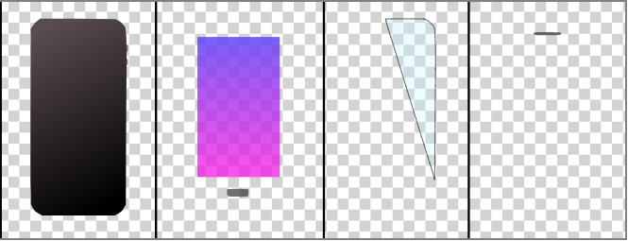
2. Estimating the layer parameters
Energy function
$$E= w_{r}E_{recon}+w_{g}E_{gamut}+w_{c}E_{compact}$$
Compactness loss：$E_{stasck}=\sum_{1≤i<j≤n,{ L}_{i}∩{ L}_{j}≠∅}{{1(\left|{ L}_{i}\right|−\left|{ L}_{j}\right|)}^{2}}$
Notes:
We define a compactness term to encourages smaller-sized layers to be on top of larger-size layers.

Slide 32
2. Estimating the layer parameters
Energy function
$$E= w_{r}E_{recon}+w_{g}E_{gamut}+w_{c}E_{compact}$$
Input
Layer configuration
Resulting layers (from low to high)
We set $w_{r}=20,w_{g}=10,w_{c}=0.02$ in all of our examples.
Notes:
For each layer configuration, we employ the L-BFGS-B algorithm via the NLopt library to optimize the layer parameters. In all of our examples, we set $w_{r}=20,w_{g}=10,w_{c}=0.02$ to achieve better results.
Finally, when all these candidate layer configurations along with layer parameters are obtained, we select the one with minimal energy loss to generate the resulting vector graph with the Potrace library.

Slide 33
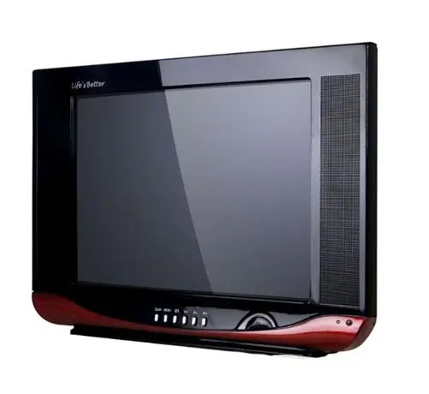
Results
Input image & segmentation
Reconstruction
Decomposed layers with our method
Notes:
Here we provide 3 decomposition results. We have consistently achieved high-quality decomposition results in all examples.
Notice how the highlight regions in TV and coffee cup are all successfully extracted as transparent layers.
Besides, all these 3 examples have x-junctions, our method perfectly recovers the layer stack and achieves reconstruction results with high accuracy.

Slide 34
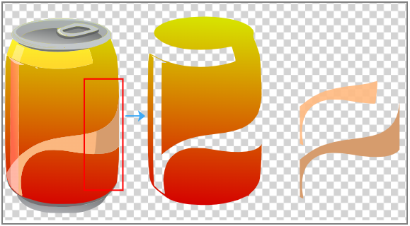
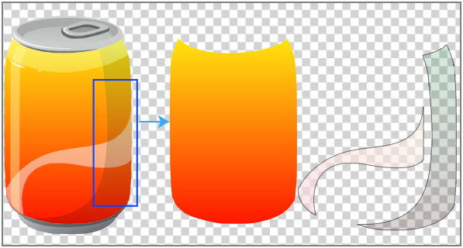
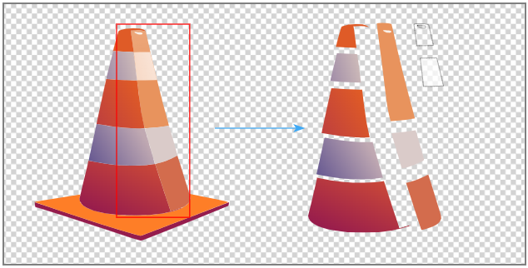
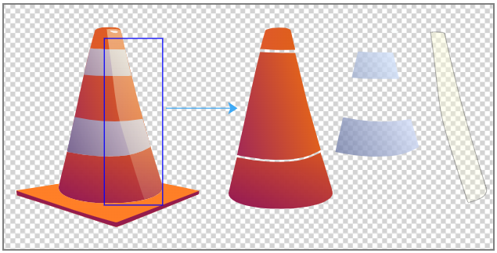
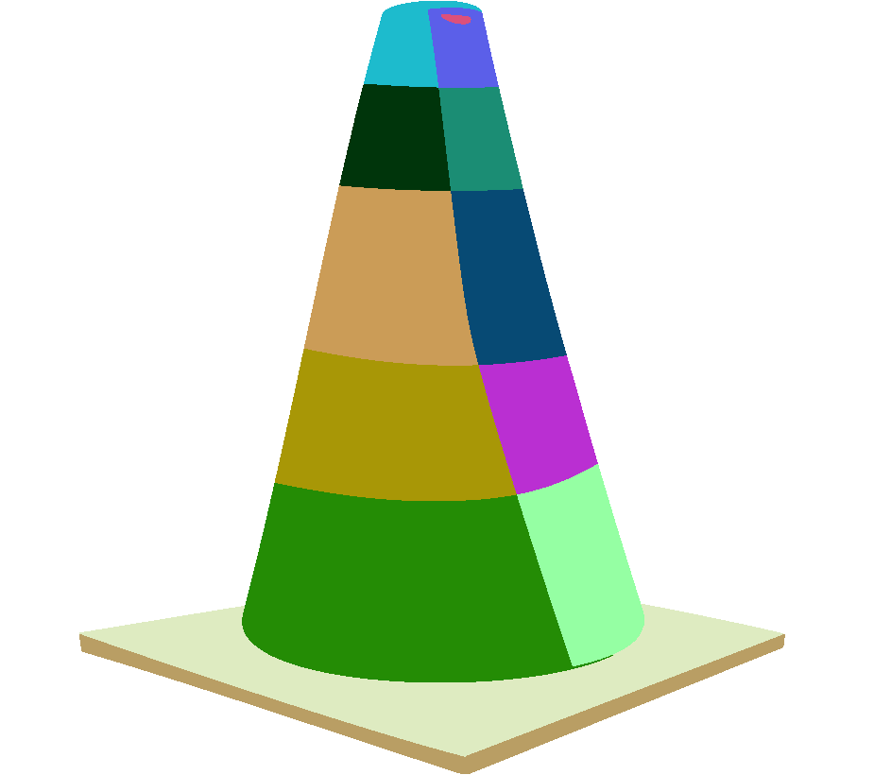
Comparison
Input image & its seg.
[Favreau et al., 2016]
Ours
Notes:
Here we provide 2 results compared to Photo2ClipArt. In general, our method successfully recovers the layer order at each X-junction, and the layers do not contain holes. In contrast, Photo2ClipArt fails to obtain complete semi-transparent layers at x-junction and tends to generate some unnatural layers with holes.

Slide 35
Conclusion
We presented a fully automatic method to multi-layer vectorization with given segmented raster image.
Perceptually-motivated rules reduce the search space, allowing us to find globally optimal layer decompositions.
The decomposed layers better reflect the shape and hierarchical structure of the input than SOAT methods.
Notes:
In conclusion, we proposed a fully automatic approach to multi-layer vectorization without any user interaction, and we introduced perceptually-motivated rules to drastically reduce the search space, allowing us to find globally optimal layer decompositions. For the decomposition results, the layers better reflect the shape and hierarchical structure of the input than SOAT methods.

Slide 36
Thank You!
Contact Information:
Zheng-Jun Du: dzj@qhu.edu.cn
Liang-fu Kang: kanglf20@mails.tsinghua.edu.cn
Jianchao Tan: tanjianchaoustc@gmail.com
Yotam Gingold: ygingold@gmu.edu
Kun Xu: xukun@tsinghua.edu.cn
Supplementary
Notes:
Thanks for you attention.
Please feel free to contact us if you have any questions.

