Slide 1



Fast and Accurate Spherical Harmonics Products
Hanggao Xin¹ Zhiqian Zhou¹ Di An¹ Ling-Qi Yan²
Kun Xu¹ Shi-Min Hu¹ Shing-Tung Yau³
¹Tsinghua University
²University of California, Santa Barbara
³Harvard University
Notes:
Hello everyone, I am Hanggao Xin from Tsinghua University. Thanks for attending my talk. I am going to present our recent work on how to solve spherical harmonics products fast and accurately.

Slide 2
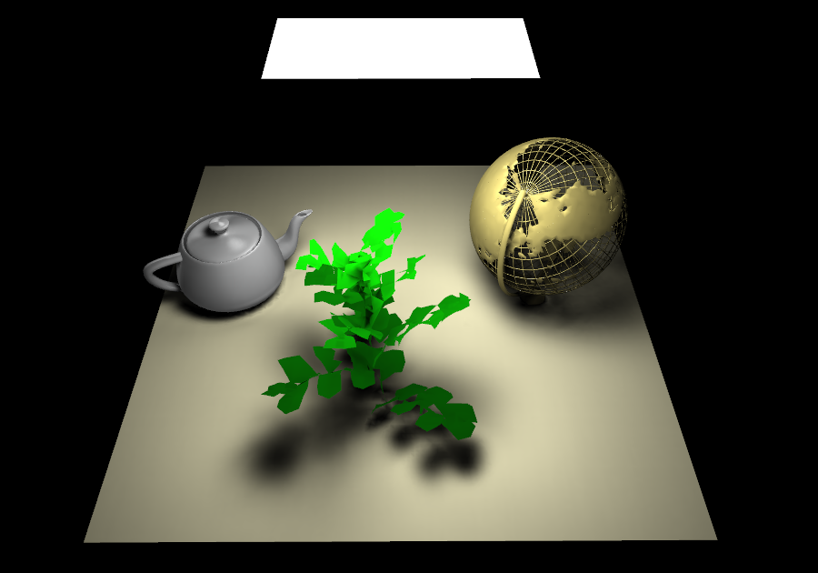
Overview
Background
Previous Works
Our Approach
Results
Notes:
In this talk, firstly, I would introduce some background knowledge and summarize previous works. Then I will show our approach to solve SH products problem. Finally, I will show some results of our method.

Slide 3
Background

Slide 4
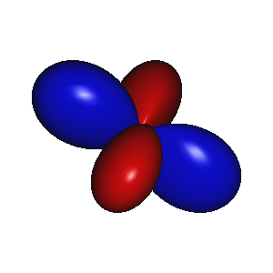

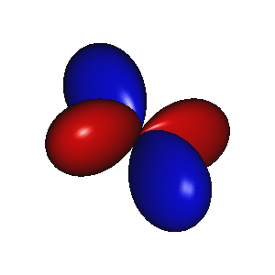
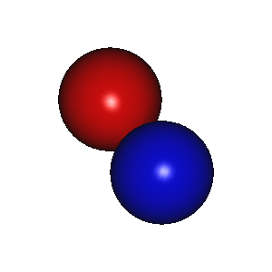
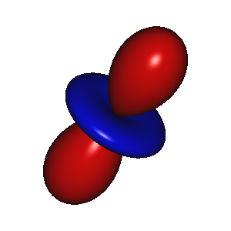

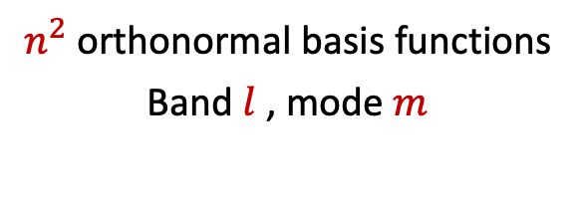
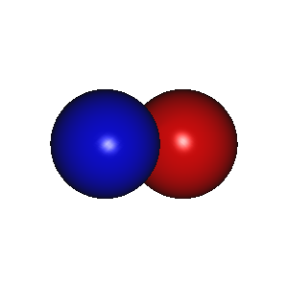

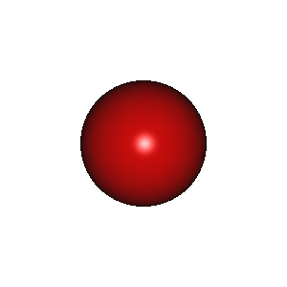
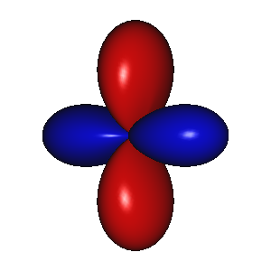


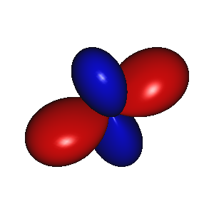
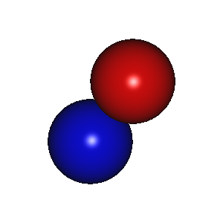

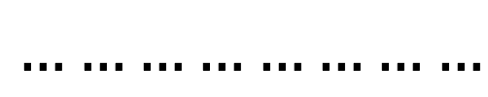
What is Spherical Harmonics?
Spherical Harmonics Basis Functions
$$l=0$$
$$B_{i}\left(ω\right)=Y_{l}^{m}(ω)$$
$$l=1$$
$n^{2}$orthonormal basis functions
Band $l$ , mode $m$
$$l=2$$
$…$…
$$……………………$$
$$l=n−1$$
Notes:
Firstly, we review the definition of spherical harmonics here. Spherical harmonics is a widely used series of orthonormal spherical basis functions defined over the unit sphere . Order 𝑛 spherical harmonics have n^2 basis functions, and each function could be indexed by Band l and mode m.

Slide 5



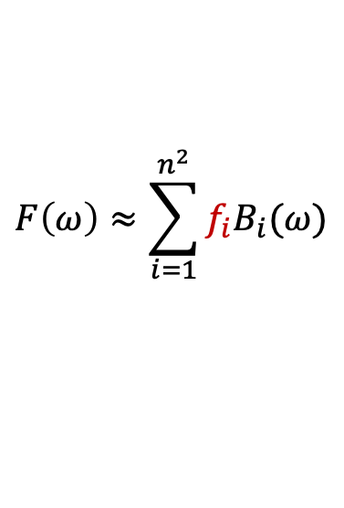










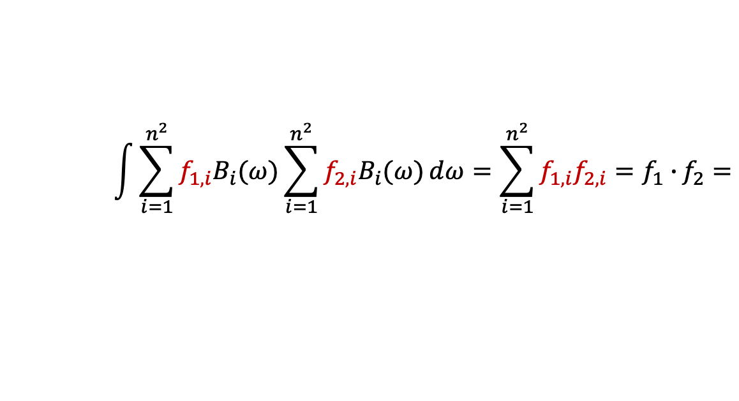

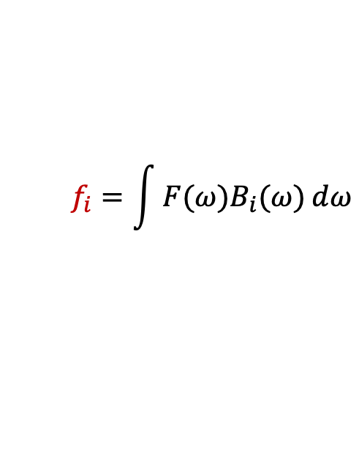


What is Spherical Harmonics?
Spherical Harmonics Projection
$$F\left(ω\right)≈\sum_{i=1}^{n^{2}}{f_{i}B_{i}(ω)}$$
$$f_{i}=\int{F(ω)B_{i}(ω})ⅆω$$
$$F\left(ω\right)≈$$
$$f_{1}$$
$$f_{2}$$
$$f_{3}$$
$$f_{4}$$
Spherical Harmonics Double Product Integral
$$\int{F_{1}(ω)F_{2}(ω) }ⅆω=$$
$$O(n^{2})$$
$$\int{\sum_{i=1}^{n^{2}}{f_{1,i}B_{i}(ω)}}\sum_{i=1}^{n^{2}}{f_{2,i}B_{i}(ω)}ⅆω=\sum_{i=1}^{n^{2}}{f_{1,i}f_{2,i}=f_{1}∙}f_{2}=$$
$$f_{1,1}$$
$$f_{1,2}$$
$$f_{1,3}$$
$$f_{1,4}$$
$$∙$$
$$f_{2,1}$$
$$f_{2,2}$$
$$f_{2,3}$$
$$f_{2,4}$$
Notes:
Spherical Harmonics functions have two important properties.
[click]
For any spherical function F(w) , we could approximate this function as a linear combination of the SH basis functions, where the coefficients vector could be got by 2D integrals over the sphere.
[click]
Another property is the SH double product integral. Given two spherical functions F_one_(w) and F_two_(w) represented by their basis function coefficients vectors, the double product integral could be simply computed as a dot product of the coefficients vectors due to the orthogonality of SH basis.

Slide 6
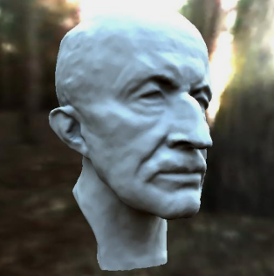
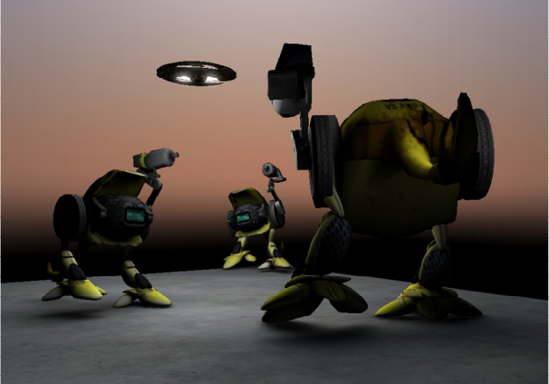
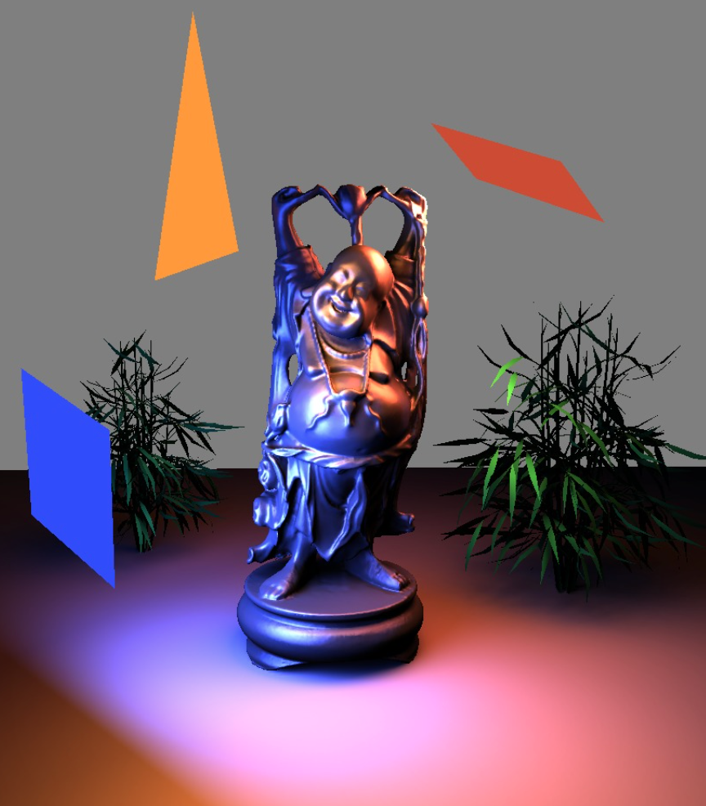
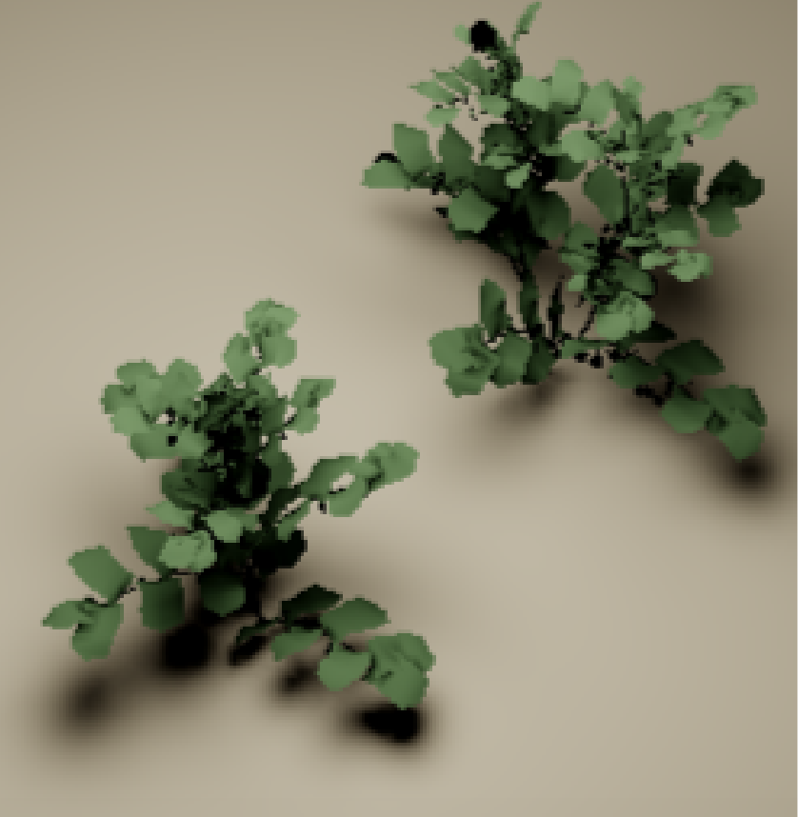
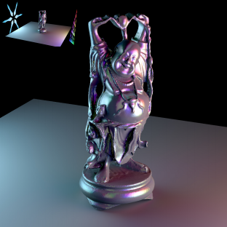
SH in Rendering
Previous Works using SH in Rendering
[Sloan et. al 2002]
[Zhou et. al 2006]
[Wang et. al 2018]
[Wu et. al 2020]
Notes:
In the last two decades, Spherical Harmonics have been proven as a powerful tool for rendering. Awesome works using SH such as PRT and shadow fields make a great role in real-time rendering. And recent works about PRT for area lights and many lights receive lots of attentions. But all these works suffer from expensive SH products.

Slide 7
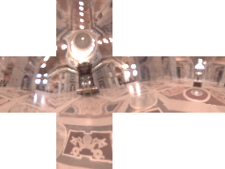
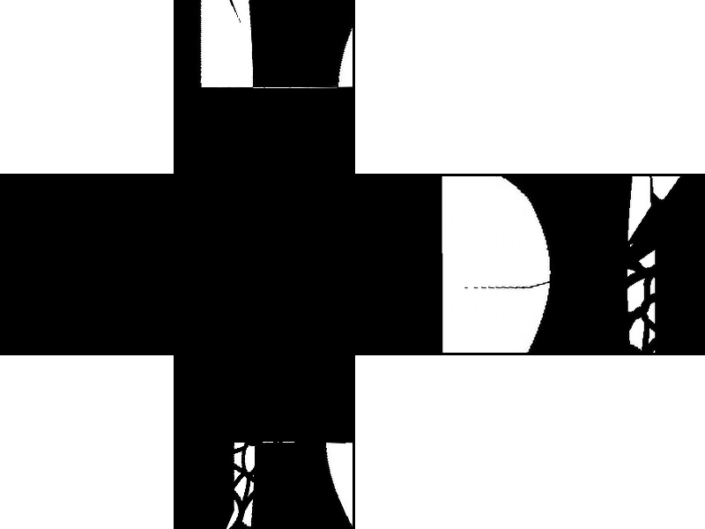

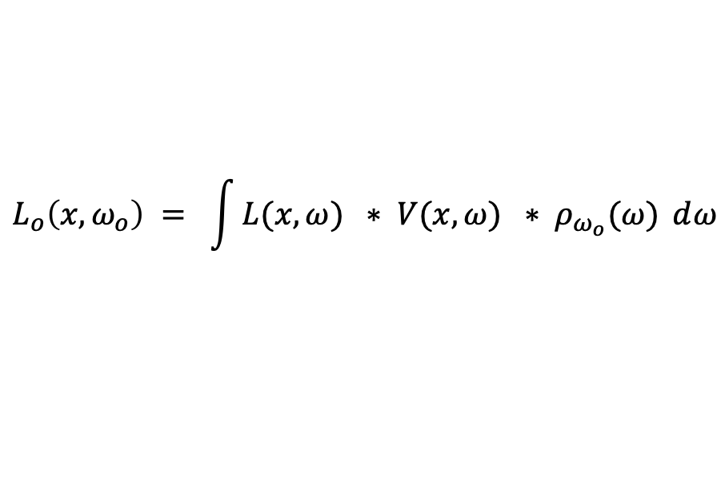
SH in Rendering
Rendering equation
$$L_{o}\left(x,ω_{o}\right) = \int{L(x,ω}) ∗ V(x,ω) ∗ ρ_{ω_{o}}(ω) ⅆω$$
Notes:
In Rendering equation, the lighting[click], visibility[click], and BRDF term[click] in the integrand could be represented as a function defined on the unit sphere.

Slide 8
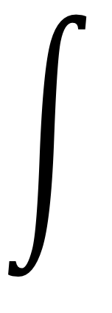



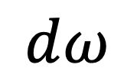


















SH in Rendering
Hard to solve directly!
Rendering equation
$$≈$$
$$f_{1,1}$$
$$f_{1,2}$$
$$f_{1,3}$$
$$f_{1,4}$$
$$∗$$
$$∗$$
$L_{o}\left(x,ω_{o}\right)$
$$=$$
$$ⅆω$$
$$≈$$
$$f_{2,1}$$
$$f_{2,2}$$
$$f_{2,3}$$
$$f_{2,4}$$
$$∗$$
$$∗$$
$$≈$$
$$f_{3,1}$$
$$f_{3,2}$$
$$f_{3,3}$$
$$f_{3,4}$$
Notes:
As we explained before, each function defined on the unit sphere could be approximated by an SH coefficients vector. But the integral of product of three SH coefficients vectors is still hard to solve directly.

Slide 9

SH in Rendering
Triple Product
Rendering equation
$$≈$$
$$f_{1,1}$$
$$f_{1,2}$$
$$f_{1,3}$$
$$f_{1,4}$$
$$∗$$
$$⨂$$
$L_{o}\left(x,ω_{o}\right)$
$$=$$
$$ⅆω$$
$$≈$$
$$f_{2,1}$$
$$f_{2,2}$$
$$f_{2,3}$$
$$f_{2,4}$$
$$∗$$
$$∗$$
$$≈$$
$$f_{3,1}$$
$$f_{3,2}$$
$$f_{3,3}$$
$$f_{3,4}$$
Notes:
But with the SH triple product operation, we could simplify the integral to a SH double product integral problem.

Slide 10





SH in Rendering
$$O(n^{2})$$
Rendering equation
Double Product Integral
$$∗$$
$$≈$$
$$g_{1}$$
$$g_{2}$$
$$g_{3}$$
$$g_{4}$$
$L_{o}\left(x,ω_{o}\right)$
$$=$$
$$ⅆω$$
$$∗$$
$$∗$$
$$≈$$
$$f_{3,1}$$
$$f_{3,2}$$
$$f_{3,3}$$
$$f_{3,4}$$
Notes:
With the triple product operation, we turn two SH coefficients vectors into one, and finally we only need take O(n^2) time to solve the problem.

Slide 11









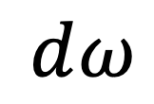






SH in Rendering
Rendering equation
Bottleneck
Triple Product
Dot Operation
$$∗$$
$L_{o}\left(x,ω_{o}\right)$
$$ⅆω$$
$$f_{1,1}$$
$$f_{1,2}$$
$$f_{1,3}$$
$$f_{1,4}$$
$$f_{3,1}$$
$$=$$
$$≈$$
$$∙$$
$$f_{3,2}$$
$$⨂$$
$$f_{3,3}$$
$$∗$$
$$f_{2,1}$$
$$f_{2,2}$$
$$f_{2,3}$$
$$f_{2,4}$$
$$f_{3,4}$$
Notes:
As a summary, SH projection could help us approximate the rendering equation by one triple product operation and one dot operation. And the triple product operation is the bottleneck for most rendering applications using SH.

Slide 12



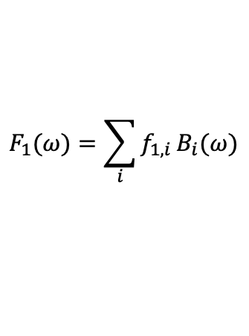




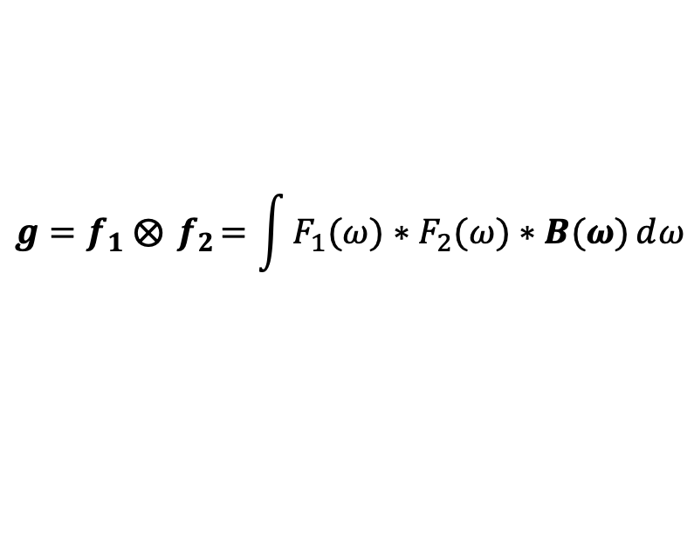


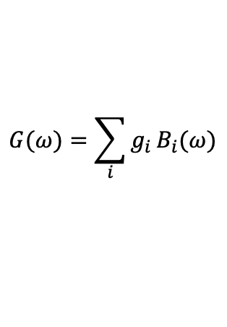



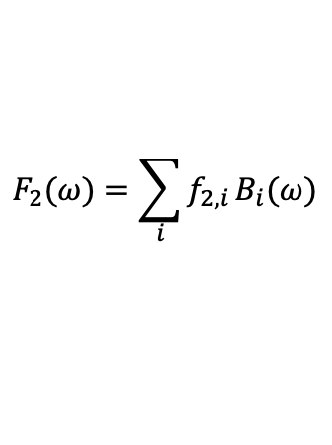


What is Spherical Harmonics Products?
Spherical Harmonics Triple Product
Mathematical definition
$$f_{1,1}$$
$$f_{1,2}$$
$$f_{1,3}$$
$$f_{1,4}$$
$$⨂$$
$$f_{2,1}$$
$$f_{2,2}$$
$$f_{2,3}$$
$$f_{2,4}$$
$$=$$
$$g_{1}$$
$$g_{2}$$
$$g_{3}$$
$$g_{4}$$
$$F_{1}(ω)=\sum_{i}{f_{1,i}}B_{i}(ω)$$
$$F_{2}(ω)=\sum_{i}{f_{2,i}}B_{i}(ω)$$
$$G(ω)=\sum_{i}{g_{i}}B_{i}(ω)$$
$$g=f_{1} ⨂{ f}_{2}=\int{F_{1}(ω})∗F_{2}(ω)∗B(ω)ⅆω$$
Notes:
Given two spherical functions F_one(w)[click],F_two(w) and their corresponding SH coefficients vectors f_one,f_two[click], the SH triple product mentioned before is defined the SH vector of the multiplication of two given spherical functions.

Slide 13
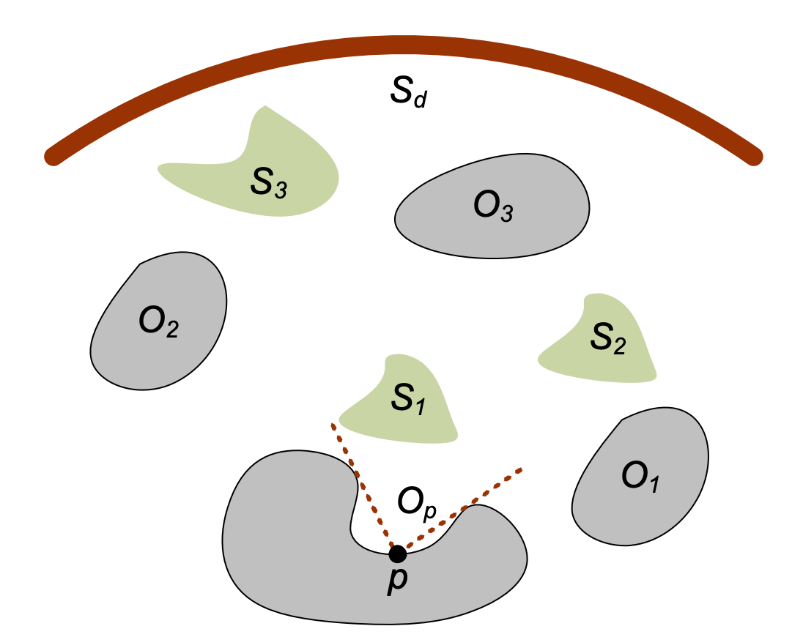
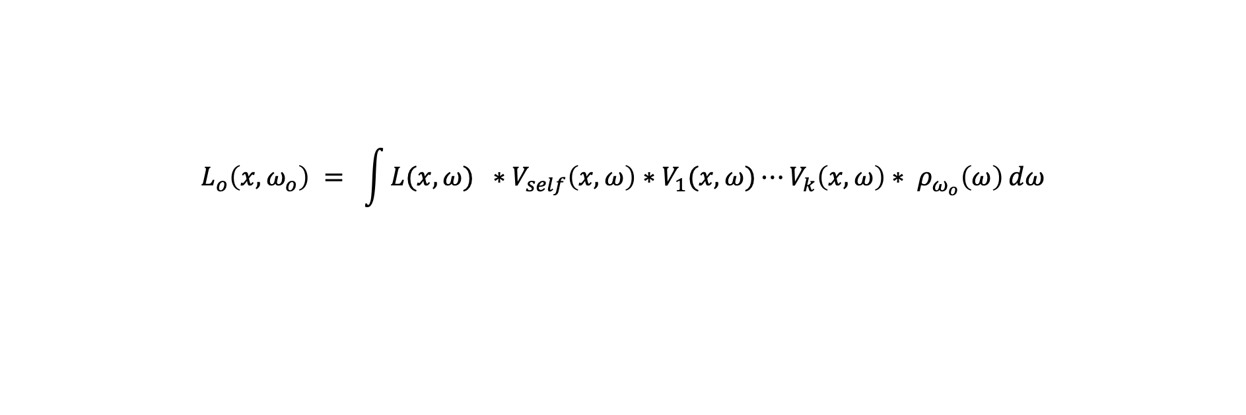
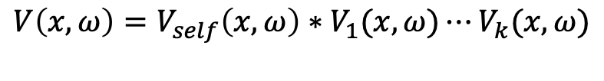
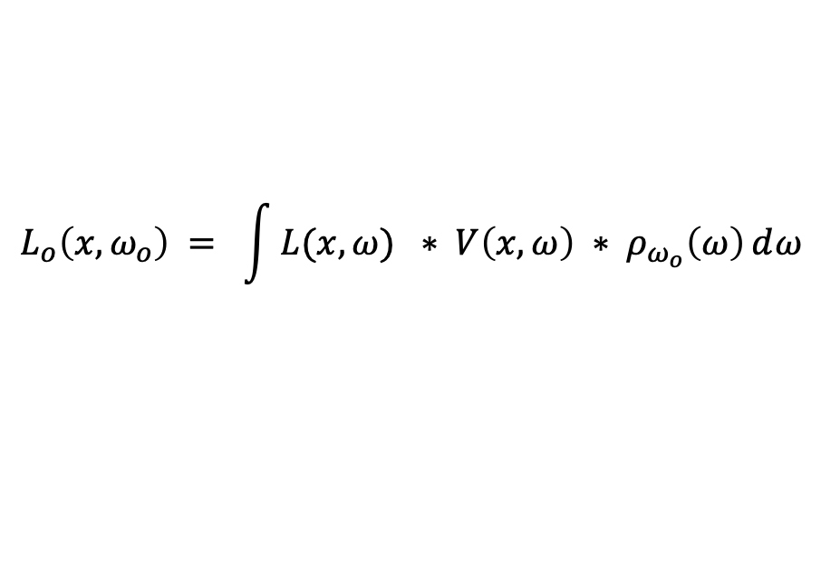
SH in Rendering
Rendering Equation
Visibility Factorization
$$L_{o}\left(x,ω_{o}\right) = \int{L(x,ω}) ∗ V\left(x,ω\right) ∗ ρ_{ω_{o}}\left(ω\right)ⅆω$$
$$V\left(x,ω\right)=V_{self}\left(x,ω\right)∗V_{1}(x,ω)⋯V_{k}(x,ω)$$
[Zhou et. al 2006]
$$L_{o}\left(x,ω_{o}\right) = \int{L(x,ω}) ∗V_{self}\left(x,ω\right)∗V_{1}(x,ω)⋯V_{k}\left(x,ω\right)∗ ρ_{ω_{o}}\left(ω\right)ⅆω$$
Notes:
And real-time rendering needs more than SH triple product, methods like shadow fields break the visibility term into per-object occlusion

Slide 14









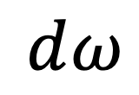









SH in Rendering
Bottleneck
Rendering equation
Multiple Product
Dot Operation
$$∗$$
$L_{o}\left(x,ω_{o}\right)$
$$ⅆω$$
$$f_{1,1}$$
$$f_{1,2}$$
$$f_{1,3}$$
$$f_{1,4}$$
$$f_{k+1,1}$$
$$=$$
$$≈$$
$$∙$$
$$f_{k+1,2}$$
$$f_{2,1}$$
$$f_{2,2}$$
$$f_{2,3}$$
$$f_{2,4}$$
$$f_{k+1,3}$$
$$∗$$
$$⋯⋯$$
$$f_{k+1,4}$$
$$f_{k,1}$$
$$f_{k,2}$$
$$f_{k,3}$$
$$f_{k,4}$$
Notes:
which turn rendering equation into one SH multiple product operation and one dot operation. The SH multiple product is more expensive than SH triple product, and is still the bottleneck.

Slide 15



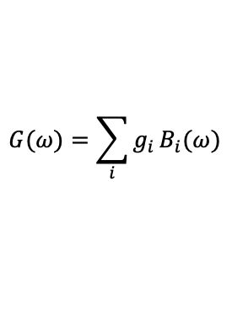





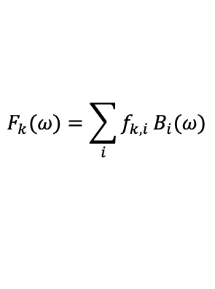


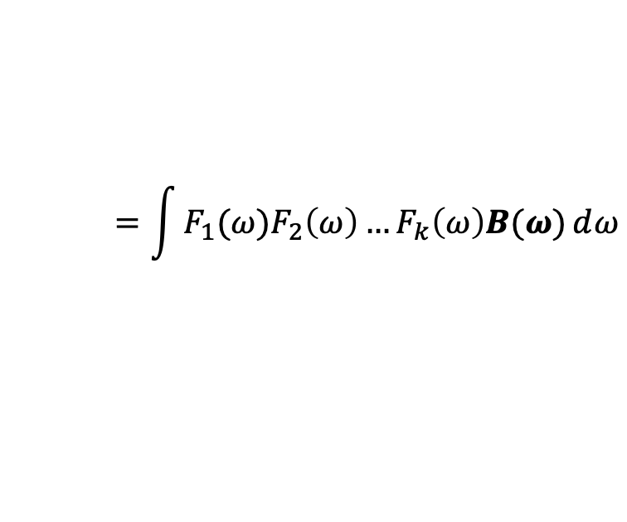


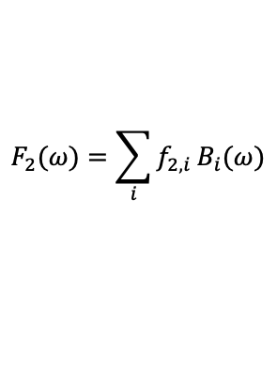

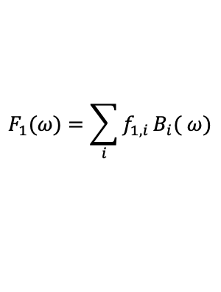








What is Spherical Harmonics Product?
Spherical Harmonics Multiple Product
$$,$$
...
$$⨂_{k+1}($$
$$f_{1,1}$$
$$f_{1,2}$$
$$f_{1,3}$$
$$f_{1,4}$$
$$f_{2,1}$$
$$f_{2,2}$$
$$f_{2,3}$$
$$f_{2,4}$$
$$,$$
$$f_{k,1}$$
$$f_{k,2}$$
$$f_{k,3}$$
$$f_{k,4}$$
$$)=$$
$$g_{1}$$
$$g_{2}$$
$$g_{3}$$
$$g_{4}$$
$$F_{1}(ω)=\sum_{i}{f_{1,i}}B_{i}( ω)$$
$$F_{2}(ω)=\sum_{i}{f_{2,i}}B_{i}(ω)$$
$$F_{k}(ω)=\sum_{i}{f_{k,i}}B_{i}(ω)$$
$$G(ω)=\sum_{i}{g_{i}}B_{i}(ω)$$
Mathematical definition
$$=\int{F_{1}(ω})F_{2}\left(ω\right)…F_{k}\left(ω\right)B(ω)ⅆω$$
$$g=⨂_{k+1}$$
$$(f_{1},f_{2},…,f_{k})$$
Notes:
As defined as triple product, SH multiple product is defined as the SH coefficients vector of the the multiplication of many given spherical functions.

Slide 16
































Challenges
Spherical Harmonics Triple Product
Spherical Harmonics Multiple Product
$$f_{1,1}$$
$$f_{1,2}$$
$$f_{1,3}$$
$$f_{1,4}$$
$$⨂$$
$$f_{2,1}$$
$$f_{2,2}$$
$$f_{2,3}$$
$$f_{2,4}$$
$$=$$
$$g_{1}$$
$$g_{2}$$
$$g_{3}$$
$$g_{4}$$
$$,$$
...
$$⨂_{k+1}($$
$$f_{1,1}$$
$$f_{1,2}$$
$$f_{1,3}$$
$$f_{1,4}$$
$$f_{2,1}$$
$$f_{2,2}$$
$$f_{2,3}$$
$$f_{2,4}$$
$$,$$
$$f_{k,1}$$
$$f_{k,2}$$
$$f_{k,3}$$
$$f_{k,4}$$
$$)=$$
$$g_{1}$$
$$g_{2}$$
$$g_{3}$$
$$g_{4}$$
Poor Performance
Notes:
As a summary, both SH triple product and multiple product are too expensive[click], our goal is to solve this problem fast and accurately.

Slide 17
Previous Works

Slide 18
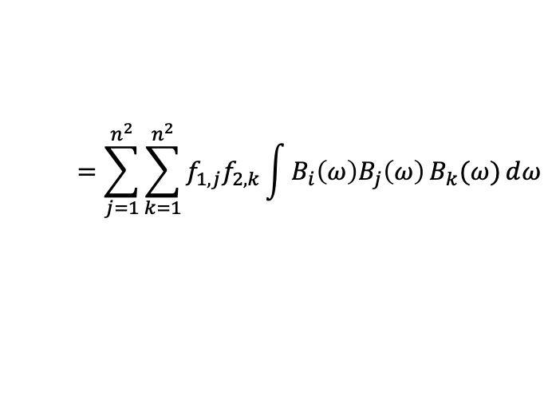
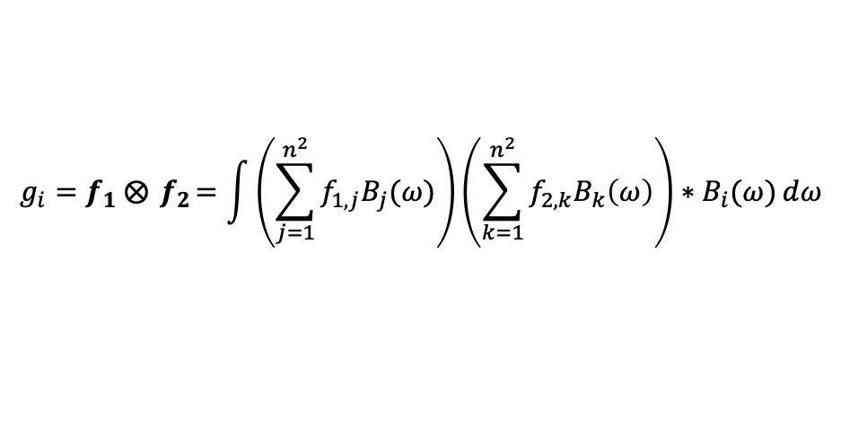
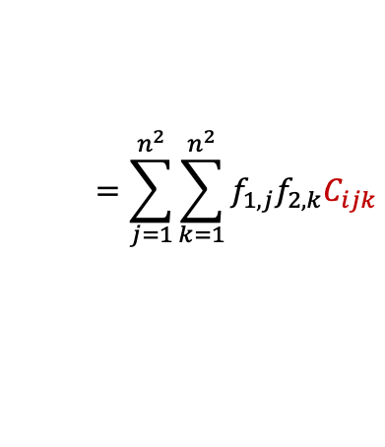
SH Triple Product
Previous method[Ng et al. 2004] for SH Triple Product
$$f_{1,1}$$
$$f_{1,2}$$
$$f_{1,3}$$
$$f_{1,4}$$
$$⨂$$
$$f_{2,1}$$
$$f_{2,2}$$
$$f_{2,3}$$
$$f_{2,4}$$
$$=$$
$$g_{1}$$
$$g_{2}$$
$$g_{3}$$
$$g_{4}$$
$$g_{i}=f_{1} ⨂{ f}_{2}=\int{\left(\sum_{j=1}^{n^{2}}{f_{1,j}B_{j}(ω)}\right)}\left(\sum_{k=1}^{n^{2}}{f_{2,k}B_{k}\left(ω\right)}\right)∗B_{i}(ω)ⅆω$$
$$=\sum_{j=1}^{n^{2}}{\sum_{k=1}^{n^{2}}{f_{1,j}f_{2,k}\int{B_{i}\left(ω\right)B_{j}\left(ω\right)}B_{k}(ω)ⅆω}}$$
$$=\sum_{j=1}^{n^{2}}{\sum_{k=1}^{n^{2}}{f_{1,j}f_{2,k}C_{ijk}}}$$
Tripling Coefficients
Notes:
Previous way for SH triple product is to solve the integral directly[click]. Please note that the integral in the red rectangle[click] could be precomputed, and the precomputed coefficients is called tripling coefficients.

Slide 19
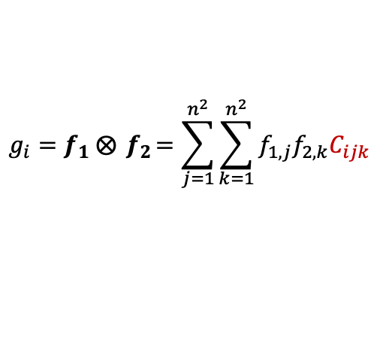

SH Triple Product
Previous method[Ng et al. 2004] for SH Triple Product
Sparsity: only $O\left(n^{5}\right)$ of all $n^{6}$ Tripling Coefficients is nonzero
SOTA method is accurate, but takes $O\left(n^{5}\right)$ time for SH Triple Product
$$f_{1,1}$$
$$f_{1,2}$$
$$f_{1,3}$$
$$f_{1,4}$$
$$⨂$$
$$f_{2,1}$$
$$f_{2,2}$$
$$f_{2,3}$$
$$f_{2,4}$$
$$=$$
$$g_{1}$$
$$g_{2}$$
$$g_{3}$$
$$g_{4}$$
$$g_{i}=f_{1} ⨂{ f}_{2}=\sum_{j=1}^{n^{2}}{\sum_{k=1}^{n^{2}}{f_{1,j}f_{2,k}C_{ijk}}}$$
Tripling Coefficients
SH Triple Product
Notes:
Tripling coefficients have the size of n^6, but not every term is nonzero. Actually, tripling coefficients is sparse and only O(n^5) terms is nonzero. This method is the state of the art to solve triple product accurately, but still has the time complexity of O(n^5).

Slide 20

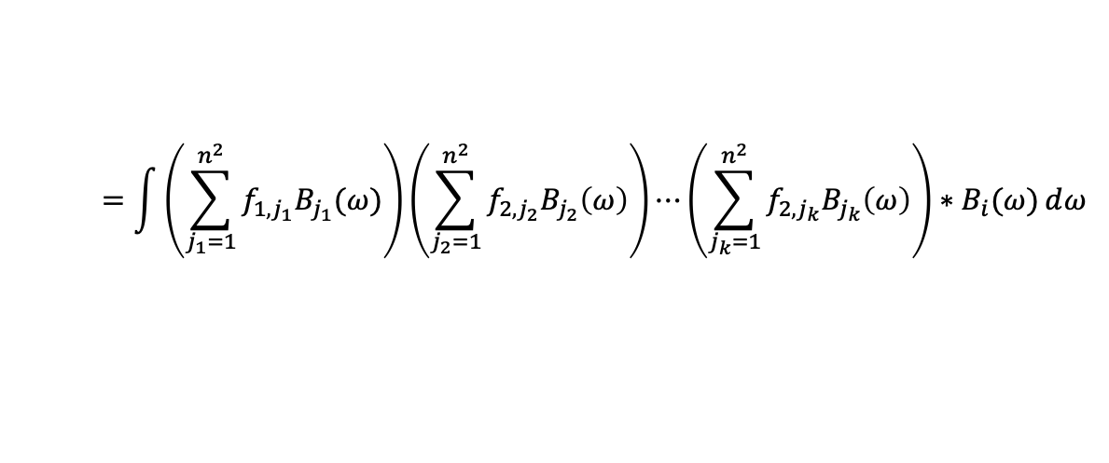

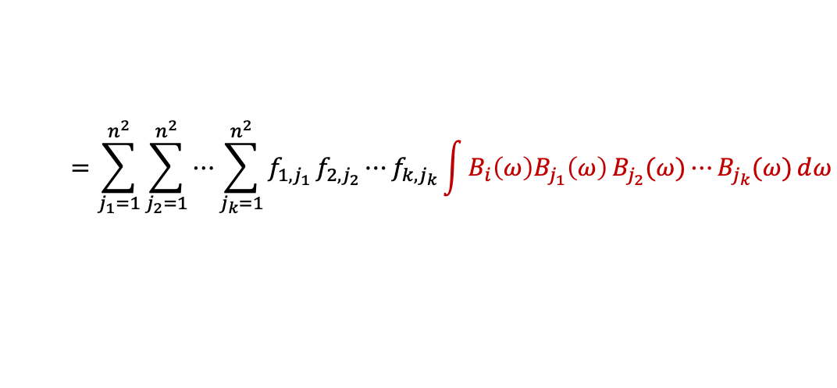
SH Multiple Products
Brute-force method[Sun et. al 2006] for SH Multiple Product
$$,$$
...
$$⨂_{k+1}($$
$$f_{1,1}$$
$$f_{1,2}$$
$$f_{1,3}$$
$$f_{1,4}$$
$$f_{2,1}$$
$$f_{2,2}$$
$$f_{2,3}$$
$$f_{2,4}$$
$$,$$
$$f_{k,1}$$
$$f_{k,2}$$
$$f_{k,3}$$
$$f_{k,4}$$
$$)=$$
$$g_{1}$$
$$g_{2}$$
$$g_{3}$$
$$g_{4}$$
$$g_{i}=⨂_{k+1}($$
$$f_{1},f_{2}⋯f_{k})$$
$$=\int{\left(\sum_{j_{1}=1}^{n^{2}}{f_{1,j_{1}}B_{j_{1}}(ω)}\right)}\left(\sum_{j_{2}=1}^{n^{2}}{f_{2,j_{2}}B_{j_{2}}\left(ω\right)}\right)⋯\left(\sum_{j_{k}=1}^{n^{2}}{f_{2,j_{k}}B_{j_{k}}\left(ω\right)}\right)∗B_{i}(ω)ⅆω$$
SH Triple Product
$$=\sum_{j_{1}=1}^{n^{2}}{\sum_{j_{2}=1}^{n^{2}}{{⋯\sum_{j_{k}=1}^{n^{2}}{f_{1,j_{1}}}f}_{2,j_{2}}⋯f_{k,j_{k}}\int{B_{i}\left(ω\right)B_{j_{1}}\left(ω\right)}B_{j_{2}}(ω)⋯B_{j_{k}}(ω)ⅆω}}$$
Notes:
And the brute-force method for multiple product also solve the integral directly

Slide 21


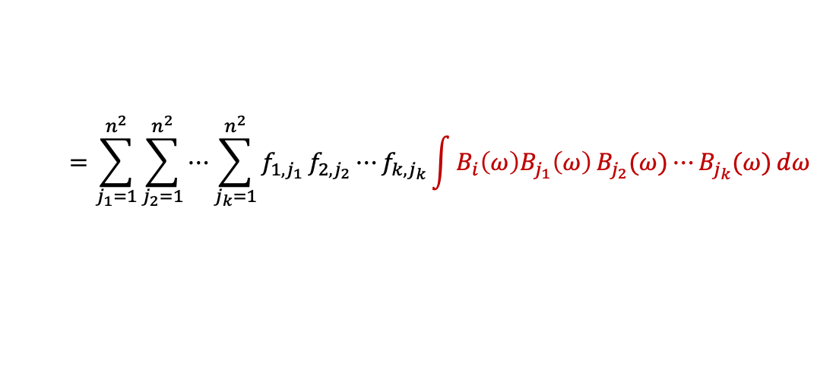
SH Multiple Products
Brute-force method[Sun et. al 2006] for SH Multiple Product
Not sparse as SH Triple Product
Accurate but takes $O(n^{2k})$ time for SH Multiple Products
$$,$$
...
$$⨂_{k+1}($$
$$f_{1,1}$$
$$f_{1,2}$$
$$f_{1,3}$$
$$f_{1,4}$$
$$f_{2,1}$$
$$f_{2,2}$$
$$f_{2,3}$$
$$f_{2,4}$$
$$,$$
$$f_{k,1}$$
$$f_{k,2}$$
$$f_{k,3}$$
$$f_{k,4}$$
$$)=$$
$$g_{1}$$
$$g_{2}$$
$$g_{3}$$
$$g_{4}$$
$$=\sum_{j_{1}=1}^{n^{2}}{\sum_{j_{2}=1}^{n^{2}}{{⋯\sum_{j_{k}=1}^{n^{2}}{f_{1,j_{1}}}f}_{2,j_{2}}⋯f_{k,j_{k}}\int{B_{i}\left(ω\right)B_{j_{1}}\left(ω\right)}B_{j_{2}}(ω)⋯B_{j_{k}}(ω)ⅆω}}$$
$$g_{i}=⨂_{k+1}($$
$$f_{1},f_{2}⋯f_{k})$$
SH Triple Product
Notes:
But unfortunately, for SH multiple product the precomputed coefficients are not sparse any more. The brute-force method is still accurate but takes O(n^2k) time for SH multiple product.

Slide 22



Approximated Methods
Recursive triple product approximation method [Zhou et. al 2005]
SHEXP [Ren et. al 2006]
$$g_{i}=⨂_{k+1}($$
$$f_{1},f_{2}⋯f_{k})≈\left(⋯\left(\left(f_{1}⨂f_{2}\right)⨂f_{3}\right)⨂⋯⨂f_{k}\right)$$
SH Triple Product

Slide 23


Our method vs. Previous works
Method | Brute-force | Recursive. | SHEXP | Ours
Triple Product | $$O(n^{5})$$ | N/A | $$O(n^{6})$$ | $$O(n^{3})$$
Multiple Product | $$O(n^{2k})$$ | $$O({kn}^{5})$$ | $$O(kn^{6})$$ | $$O(kn^{3}+k^{2}n^{2}log⁡\left(kn\right))$$
Accuracy
SH Triple Product
Notes:
Compared with previous accurate methods and approximated methods such as SHEXP and recursive triple product, our method has a much better time complexity than previous methods. And our method is definitely accurate, which would not introduce any error into the results.

Slide 24
Our Approach

Slide 25

Inspiration
Spherical Harmonics Basis Functions
$$l=0$$
$$B_{i}\left(ω\right)=Y_{l}^{m}(ω)$$
$$Y_{l}^{m}\left(θ,φ\right)=\left\{\begin{aligned}K_{l}^{0}P_{l}^{0}\left(cosθ\right),m=0 \\ \sqrt{2}K_{l}^{m}\cos\left(mφ\right)P_{l}^{m}\left(cosθ\right),m>0 \\ \sqrt{2}K_{l}^{\left|m\right|}\sin\left(\left|m\right|φ\right)P_{l}^{\left|m\right|}\left(cosθ\right),m<0\end{aligned}\right.$$
$$l=1$$
$n^{2}$orthonormal basis functions
Band $l$ , mode $m$
$$l=2$$
$…$…
$$……………………$$
$$l=n−1$$
Notes:
Our method is inspired by the fact that [click][click],the definition of SH functions contains many sin and cos terms, which is similar with the Fourier series. And the products in Fourier space is cheap, so we try to move the SH products to Fourier space.

Slide 26










Overview for SH Triple Product
SH to FS
FS Product
$$f_{1}$$
$$f_{1}^{∗}$$
FS to SH
$$∙$$
$$f_{2}$$
$$g^{∗}$$
$$f_{2}^{∗}$$
$$f_{1}^{∗}$$
$$g$$
$$g^{∗}$$
$$f_{2}^{∗}$$
Notes:
As an overview, our approach for SH triple product contains 3 steps. In the first step, we convert the input SH coefficients vectors into Fourier series. Then we do the product of two Fourier series with the help of FFT. Lastly, we convert the result Fourier series back to SH space and get the final result.

Slide 27


2D Fourier Series
2D Fourier Series definition
$$F\left(θ,φ\right)≈\sum_{s,t}{f_{s,t}^{∗}e^{i(sθ+tφ)}}$$
Real space spanned by 2D Fourier Series is same as SH space
$$\sum_{s=1−n}^{n−1}{\sum_{t=1−n}^{n−1}{f_{s,t}^{∗}e^{i(sθ+tφ)}=\sum_{l=0}^{n−1}{\sum_{m=−l}^{l}{f_{l,m}Y_{l}^{m}(θ,φ)}}}}$$
Notes:
Another common way to represent spherical functions is to use Fourier series.
And an interesting fact is that the real space spanned by 2d Fourier Seriess is same as SH space.

Slide 28


Conversions between SH and FS
Conversions between SH and FS is fast and accurate
Conversions between two representations take $O(n^{3})$ time
$$\sum_{s=1−n}^{n−1}{\sum_{t=1−n}^{n−1}{f_{s,t}^{∗}e^{i(sθ+tφ)} \sum_{l=0}^{n−1}{\sum_{m=−l}^{l}{f_{l,m}Y_{l}^{m}(θ,φ)}}}}$$
Notes:
So Fourier series and SH coeffecients vector could be converted between each other losslessly.
And the conversions between SH and FS have between well studied, it only take O(n^3) time.

Slide 29






FS Product
FS product definition
Mathematical definition
$$∙$$
$$f_{1,1}$$
$$f_{1,2}$$
$$f_{1,3}$$
$$f_{1,4}$$
$$f_{2,1}$$
$$f_{2,2}$$
$$f_{2,3}$$
$$f_{2,4}$$
$$=$$
$$g_{1}$$
$$g_{2}$$
$$g_{3}$$
$$g_{4}$$
$$F_{1}(θ,φ)$$
$$F_{2}(θ,φ)$$
$$G(θ,φ)$$
$$G\left(θ,φ\right)= F_{1}(θ,φ)∙F_{2}(θ,φ)$$
$$= \left(\sum_{s_{1},t_{1}}{f_{1,s_{1},t_{1}}^{∗}}e^{i(s_{1}θ+t_{1}φ)}\right)∙\left(\sum_{s_{2},t_{2}}{f_{2,s_{2},t_{2}}^{∗}}e^{i(s_{2}θ+t_{2}φ)}\right)$$
Notes:
After converting SH vector to 2D Fourier series, we only need to compute the multiplication of two converted Fourier series,

Slide 30

FS Product
FS product definition
Mathematical definition
$$∙$$
$$f_{1,1}$$
$$f_{1,2}$$
$$f_{1,3}$$
$$f_{1,4}$$
$$f_{2,1}$$
$$f_{2,2}$$
$$f_{2,3}$$
$$f_{2,4}$$
$$=$$
$$g_{1}$$
$$g_{2}$$
$$g_{3}$$
$$g_{4}$$
$$F_{1}(θ,φ)$$
$$F_{2}(θ,φ)$$
$$G(θ,φ)$$
$$G\left(θ,φ\right)= \sum_{s,t}{g_{s,t}^{∗}e^{i(sθ+tφ)}=}F_{1}(θ,φ)∙F_{2}(θ,φ)$$
$$= \left(\sum_{s_{1},t_{1}}{f_{1,s_{1},t_{1}}^{∗}}e^{i(s_{1}θ+t_{1}φ)}\right)∙\left(\sum_{s_{2},t_{2}}{f_{2,s_{2},t_{2}}^{∗}}e^{i(s_{2}θ+t_{2}φ)}\right)$$
Notes:
With some math work here, the multiplication could be reduced to a convolution problem.

Slide 31


FS Product
FS Product definition
Reduced to convolution problem
$$∙$$
$$f_{1,1}$$
$$f_{1,2}$$
$$f_{1,3}$$
$$f_{1,4}$$
$$f_{2,1}$$
$$f_{2,2}$$
$$f_{2,3}$$
$$f_{2,4}$$
$$=$$
$$g_{1}$$
$$g_{2}$$
$$g_{3}$$
$$g_{4}$$
$$F_{1}(θ,φ)$$
$$F_{2}(θ,φ)$$
$$G(θ,φ)$$
$$g_{s,t}^{∗}=\sum_{\begin{aligned}s_{1}+s_{2}=s \\ t_{1}+t_{2}=t\end{aligned}}{f_{1,s_{1},t_{1}}^{∗}∙f_{2,s_{2},t_{2}}^{∗}}$$
Could be solved by FFT
with $O(n^{2}logn)$
Notes:
The result 2D Fourier coefficients g is exactly a 2D convolution of two input Fourier coefficients. And this process could be accelerated by FFT and only takes O(n^2logn) time.

Slide 32





Summary
Our approach for SH Triple Product is accurate and takes $O\left(n^{3}\right)$ time
$$O(n^{3})$$
$$O(n^{2}logn)$$
$$O(n^{3})$$
Conversion from SH to FS
Fourier Series Product
Conversion from FS to SH
$$O(n^{3})$$
Notes:
As a summary, with the O(n^3) conversions and O(n^2logn) FS product, our method only has a complexity of O(n^3) for SH triple product. And our method does not introduce any error, which is definitely accurate.

Slide 33


Our approach for SH multiple product
Notes:
Our approach for SH triple product could be easily extended for SH multiple product. Same as triple product, first we still convert all input SH vectors to Fouries space, then we compute the multiplications of all Fourier series, and finally convert the result 2D Fourier series back to SH space.

Slide 34

















FS Multiple Product
FS Multiple Product definition
Mathematical definition
$$∙$$
$$f_{1,1}$$
$$f_{1,2}$$
$$f_{2,1}$$
$$f_{2,2}$$
$$f_{2,3}$$
$$f_{2,4}$$
$$⋯$$
$$g_{1}$$
$$g_{2}$$
$$g_{3}$$
$$=$$
$$f_{1,3}$$
$$f_{1,4}$$
$$g_{4}$$
$$g_{1}$$
$$g_{2}$$
$$g_{3}$$
$$g_{4}$$
$$F_{1}(θ,φ)$$
$$F_{2}(θ,φ)$$
$$F_{k}(θ,φ)$$
$$G(θ,φ)$$
$$G\left(θ,φ\right)= F_{1}(θ,φ)∙F_{2}(θ,φ)⋯F_{k}(θ,φ)$$
$$= \left(\sum_{s_{1},t_{1}}{f_{1,s_{1},t_{1}}^{∗}}e^{i(s_{1}θ+t_{1}φ)}\right)\left(\sum_{s_{2},t_{2}}{f_{2,s_{2},t_{2}}^{∗}}e^{i(s_{2}θ+t_{2}φ)}\right)⋯\left(\sum_{s_{k},t_{k}}{f_{2,s_{k},t_{k}}^{∗}}e^{i(s_{k}θ+t_{k}φ)}\right)$$
Notes:
The main difference between our approach for triple product and multiple product is the FS product step. Similar to the triple product case,, the result Fourier coefficients of the product could also be formulated as 2D convolutions of input SH coefficients

Slide 35













FS Multiple Product
Naive strategy
$$f_{1}^{∗}$$
$$f_{2}^{∗}$$
$$f_{3}^{∗}$$
$$f_{4}^{∗}$$
$$f_{5}^{∗}$$
$$⋯⋯$$
$$f_{k}^{∗}$$
Product of $2n−1$ degree
Product of $3n−2$ degree
$$O(k^{3}n^{2}log⁡(kn))$$
Product of $4n−3$ degree
Product of $5n−4$ degree
$$⋯⋯$$
Product of $k\left(n−1\right)+1$ degree
Notes:
We could still use FFT to accelerate the above computation. But the naïve strategy for FS multiple product takes O(k^3n^2log(kn)), since the degree of Fourier series will increase after multiplication.

Slide 36

















FS Multiple Product
Divide-and-conquer strategy
$$f_{1}^{∗}$$
$$f_{2}^{∗}$$
$$f_{3}^{∗}$$
$$f_{k/2}^{∗}$$
$$f_{k/2+1}^{∗}$$
$$f_{k/2+2}^{∗}$$
$$⋯$$
$$f_{k−1}^{∗}$$
$$f_{k}^{∗}$$
Product of
$2n−1$ degree
Product of
$2n−1$ degree
Product of
$2n−1$ degree
Product of
$2n−1$ degree
$$⋯⋯⋯$$
$$⋯⋯⋯$$
Product of
$\frac{k(n−1)}{2}+1$ degree
Product of
$\frac{k(n−1)}{2}+1$ degree
Product of
$k(n−1)+1$ degree
$$O(k^{2}n^{2}log⁡(kn))$$
Notes:
For better efficiency, we utilize a divide-and-conquer strategy instead of successively computing convolutions. Our key observation is that the convolution operator is associative. Hence, the order in applying convolutions will not affect the final results. And the divide-and conquer strategy takes only O(k^2n^2log(kn)) time.

Slide 37





Summary
Our approach is accurate and takes $O\left(kn^{3}+k^{2}n^{2}log(kn)\right)$ time
$$O(kn^{3})$$
$$O({k^{2}n}^{2}\log\left(kn\right))$$
$$O({kn}^{3})$$
Conversion from SH to FS
Fourier Series Product
Conversion from FS to SH
$$O(kn^{3}+k^{2}n^{2}log(kn))$$
Notes:
As a summary, our approach for SH multiple product is accurate and takes O(kn^3 + k^2n^2log(kn)) time.

Slide 38
Results

Slide 39

Triple Product Performance (CPU)
Ours is faster when $n>6$
SH Order | 10 | 15 | 20
Speedup | 3.0x | 9.9x | 21.7x
Notes:
As shown above, our method(green line) performs much better than the traditional method(red line) when n is larger than 6 on CPU. And our method achieves a speedup of 3.0×, 9.9×, and 21.7× on CPU for n = 10, 15 and 20,

Slide 40
Triple Product Performance (CPU)
Notes:
We further analyze the execution time of different steps in our method. While the convolution step has a lower time complexity than that of conversion steps , it is still the bottleneck of the whole computation for all SH orders tested.

Slide 41

Triple Product Performance (GPU)
Ours is faster when $n>7$
SH Order | 10 | 15 | 20
Speedup | 1.9x | 8.9x | 17.8x
Notes:
Our triple product method is better when n is larger than 7 on GPU, and chiveds 1.9x, 8.9x, 17.8x speeup when n is 10,15,20, respectively.

Slide 42
Triple Product Performance (GPU)
Notes:
Same as profiling on CPU, convolutions step is still the bottleneck for our method on GPU, which is due to the large constant of FFT complexity.

Slide 43




Multiple Products Performance (CPU)
$$k=4$$
$$k=6$$
$$k=8$$
Our accurate. is much faster than the traditional brute-force.
Our accurate. is even faster than the traditional recursive. when $n$ is large
Notes:
We also compare our method with other accurate and approximated methods for SH multiple products on CPU. Ours is much better than the traditional brute-force method, and even is faster than other approximated method when n is large.

Slide 44



Multiple Products Performance (CPU)
$$k=4$$
$$k=6$$
$$k=8$$
FS multiple product(Convolutions) step is still the bottleneck
FS multiple product take up more time when $k$ is large .
Notes:
By profiling our method for multiple products on CPU, we found the convolutions step is still the bottleneck. And FS multiple product take up more time when k is large.

Slide 45

Multiple Products Performance (GPU)
$$k=4$$
$$k=6$$
$$k=8$$
Our accurate. is much faster than the traditional brute-force.
Our accurate. is even faster than the traditional recursive. when $n$ is large
Notes:
On GPU, our method is still much better than the traditional method.

Slide 46
Multiple Products Performance (GPU)
$$k=4$$
$$k=6$$
$$k=8$$
FS multiple product(Convolutions) step is still the bottleneck
FS multiple product take up more time when $k$ is large .
Notes:
Same as CPU, the convolutions step is still the bottleneck on GPU.

Slide 47




Glossy Relighting using PRT
Environment lights Relighting with changeable glossy materials$(n=10)$.
Traditional method : 14.9FPS / Our method : 26.4FPS
Speedup: 1.8x
Notes:
We also test our method for real rendering applications. For glossy relighting using PRT, our method is 1.8x faster than the previous method.

Slide 48




Glossy Relighting using PRT
Area lights Relighting with changeable glossy materials$(n=15)$.
Traditional method : 3.0FPS / Our method : 25.5FPS
Speedup: 8.5x
Notes:
And for glossy relighting using PRT under area lights with n = 15，our method is 8.5 times faster than before.

Slide 49






Shadow fields
Recursive$(n=10)$
Our acc.$(n=10)$
SHEXP$(n=10)$
PT(4096spp)
Trad. 12FPS/Our 24FPS
13.8FPS
5FPS
Speedup: 2.0x
Notes:
For complex scenes rendered with shadow fields, our method achives 2.0x speedup and is even faster than the approximated method such as SHEXP.

Slide 50






Shadow fields
Recursive$(n=15)$
Our acc.$(n=15)$
SHEXP$(n=15)$
PT(4096spp)
Trad. 1.4FPS/Our 13FPS
6.3FPS
2FPS
Speedup: 9.3x
Notes:
When n = 15, shadow fields using our method achives 9.3 times speedup compared with the previous method.

Slide 51



Shadow fields
Recursive$(n=15)$
Our acc.$(n=15)$
SHEXP$(n=15)$
PT(4096spp)
Trad. 0.1FPS/Our 0.9FPS
0.5FPS
0.2FPS
Speedup: 9.2x
Notes:
We also test our method for large scenes containing more than 30 thousands vertices, which also achives 9.2x speedup and show that our method is robust for different cases.

Slide 52

Limitations and future works
Poor performance at low SH orders $n$ with a few components of multiplication $k$.
Estimate or bound the truncation errors for multiple product using recursive triple product approximation.
Explore the Fourier transform idea deeper to accelerate other complex computations in rendering.
Notes:
Our method also has some limitations.
Although our method has a great advantage on the time complexity. However, due to the large constant factor in the time complexity of FFT, our current implementation can be slower than the traditional method when n and k are low. [click]And it is also interesting to efficiently estimate or bound the truncation errors introduced in the triple product approximation. [click]
And in the future, we hope our work would inspire researchers to explore the Fourier transform idea deeper to accelerate other complex computations in rendering. For example, as a subset of spherical harmonics, triple and multiple product of zonal harmonics.

Slide 53
Acknowledgements
Anonymous reviewers
Lifan Wu
National Natural Science Foundation of China.
Beijing Higher Institution Engineering Research Center
Ling-Qi Yan's gift funds from Adobe, Dimension 5 and XVerse
Notes:
We want to thank the reviewers and the funding agencies.

Slide 54
Hanggao Xin
Notes:
Finally, I would like to thank you all for your attention.

