Slide 1
An Improved Geometric Approach for Palette-based Image Decomposition and Recoloring
Yili Wang, Yifan Liu, Kun Xu
Tsinghua University
Notes:
Good morning everyone, I am Yili Wang from Tsinghua University.
I will introduce our project to you. It presents an improved geometric approach for palette-based imgae decomposition and recoloring.

Slide 2
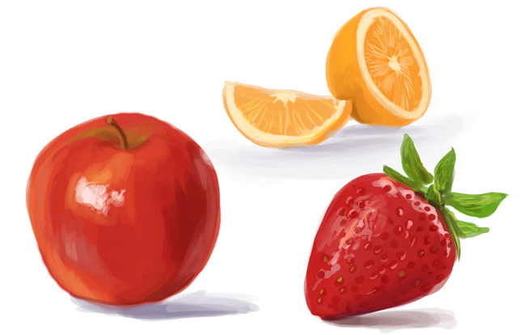
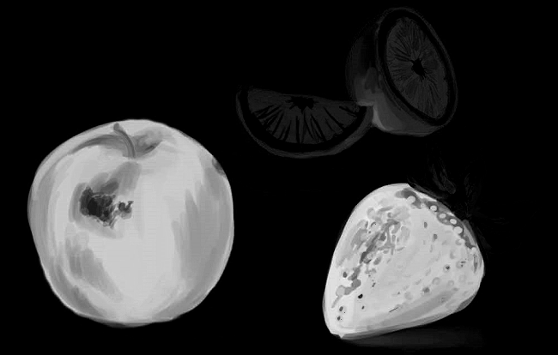
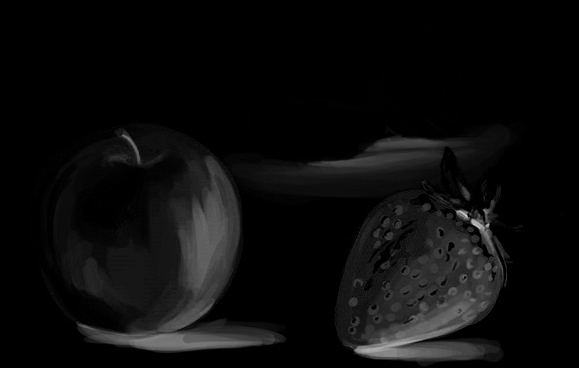
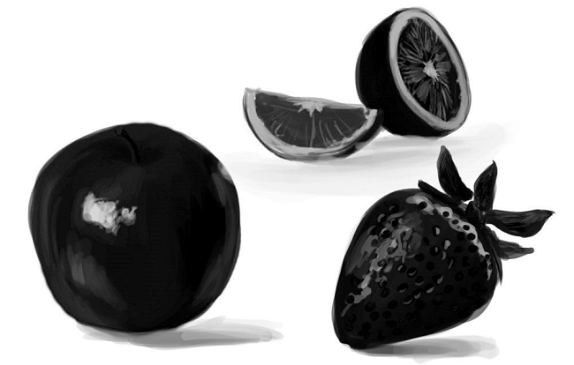
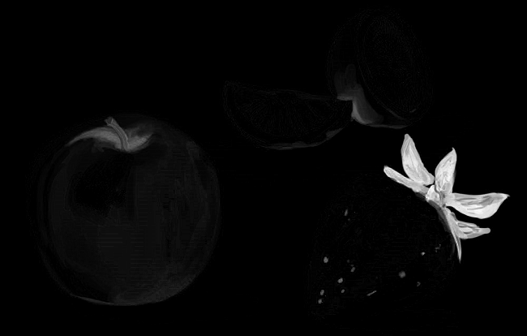
Motivation
Input
Output
Recoloring
RGB Image I
Color Palette V
Additive Layers W
s.t,
Notes:
Image editing softwares like photoshop usually use a data structure called “layer” to help image editing.
When layers are not given, we may want to decompose an image into a set of layers to make it more editable.
Here, we reversely decompose the image to a color palette and their corresponding mixing weight layers.
Formally speaking, our input is an RGB image I
Our output is a color palette V , a color palette is a small set of colors, which represents image color distribution.
then, we decompose the image into a set of additive layers. Each layer is an opacity map modulated by a corresponding palette color.
The relationship is modeled by the following equations.
(each pixel color is equal to the sum of palette colors weighted by the corresponding layer opacities. Besides, the opacities over all layers are constraint to sum to one) In this way, we can easily recolor the image by modifying its palette colors.
This is a under constrained problem, since unknown variable number is much larger than known equation numbers.

Slide 3
Color Palette Extraction
Layer Decomposition
Notes:
We solve this problem by two steps. First, we get a color palette from the image. Second, we decompose the image into layers using the extracted palette.
There are several previous works focusing on palette-based image decomposition problems.

Slide 4
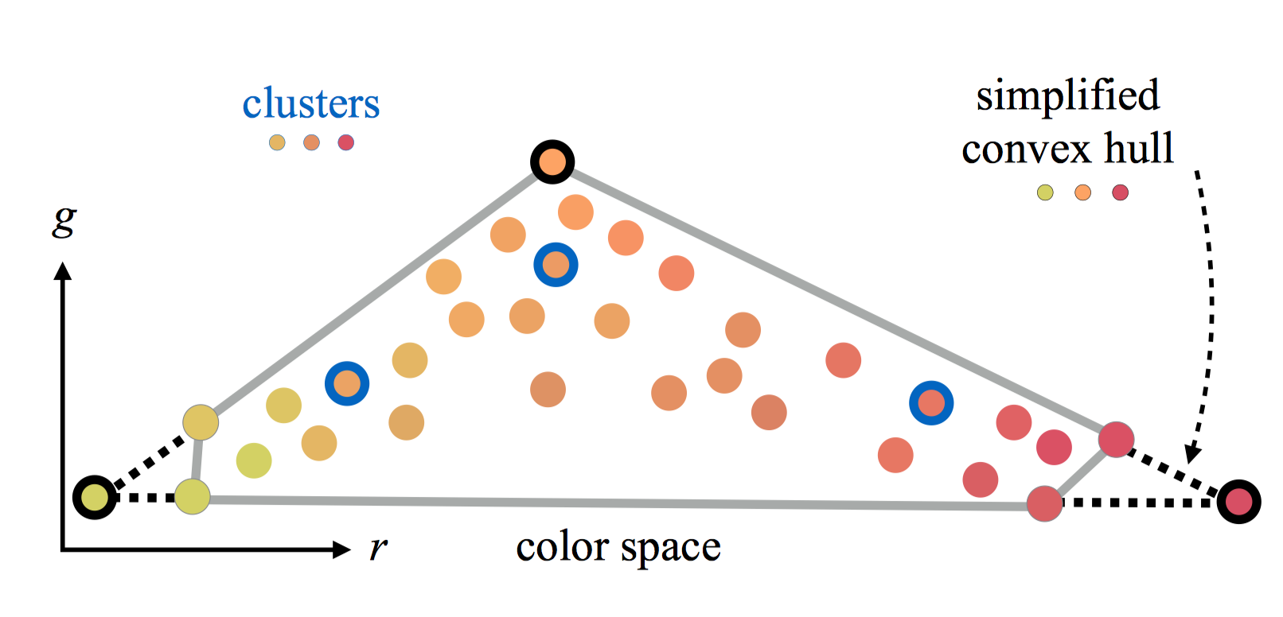
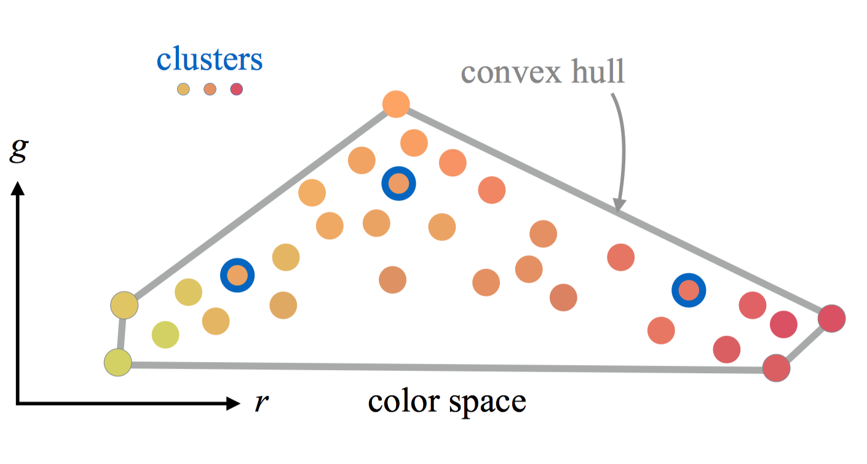
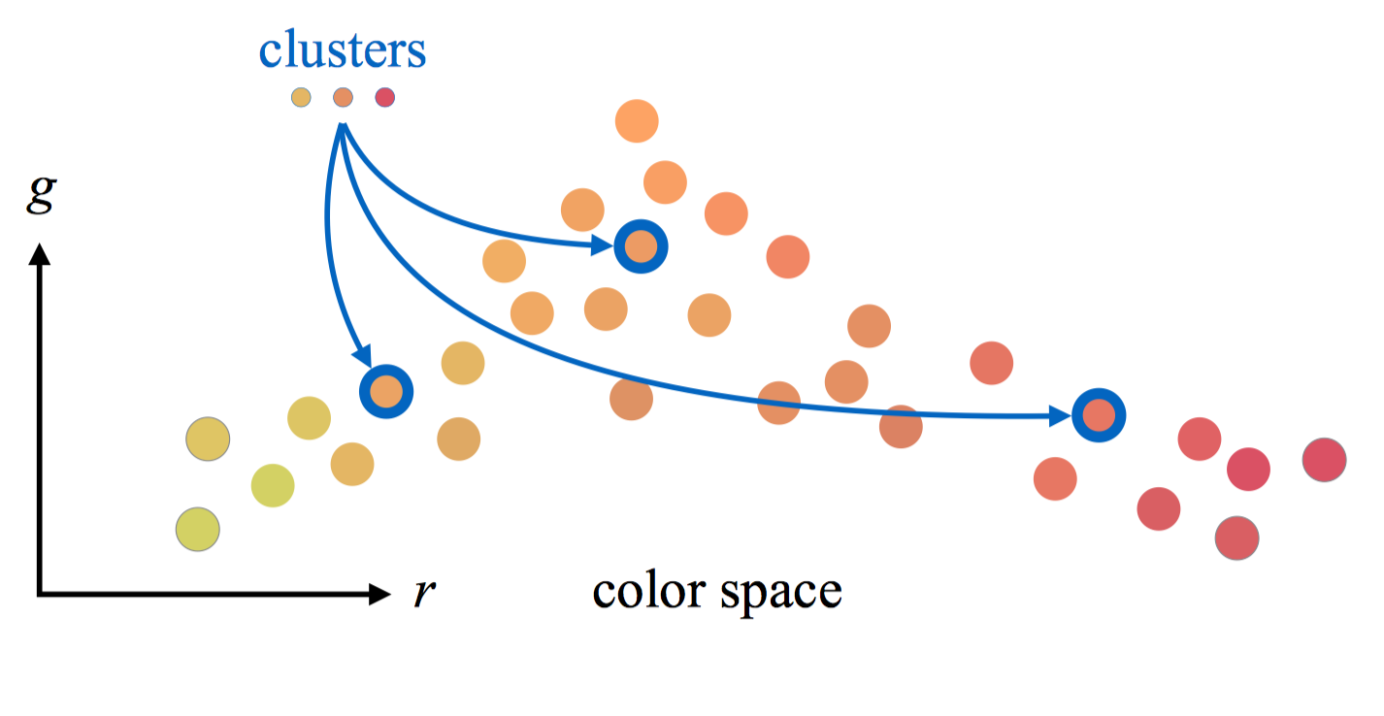
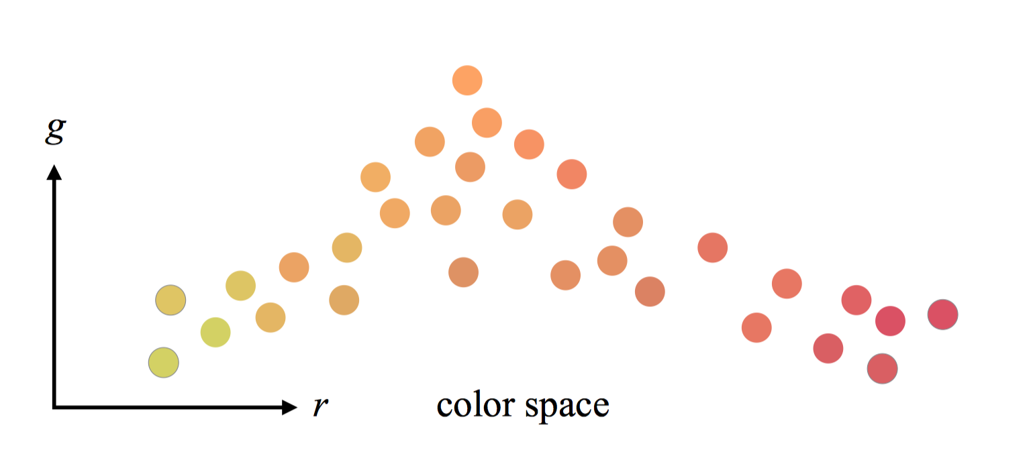
Related Work: Color Palette Extraction
Geometric (Convex hull based)
Tan et al. 2017; Tan et al 2018
K-means clustering
Chang et al. 2015; Nguyen et al. 2017; Zheng et al. 2017
image
Notes:
As for Palette Extraction, there are two main kinds of approaches. The first kind of approaches use k-means clustering of pixels to select a palette, which can capture dominant colors in an image.
The second kind is geometric-based methods. In particular, they first compute an RGB-space convex hull which encloses all pixel colors, then they simplify the hull iteratively. The palette colors are vertices of the simplified convex hull.

Slide 5
Related Work : Layer Decomposition
Optimization based method
Tan et al. 2017; Zhang et al. 2017; Lin et al. 2017; Aksoy et al. 2017
Interpolation model (based on geometric method for palette extraction)
Tan et al. 2017; Tan et al 2018
Notes:
As for layer decomposition, One category of methods formulate it as an optimization problem which enforce layer opacities smooth and sparse by adding composition constraints.
Optimization-based methods could produce visually pleasing and smooth results, however, the time cost is usually high, they usually take minutes to hours in order to process a single image.
Another specific class of approaches have been proposed get the layer opacities through interpolation rather than solving the costly optimization problem.

Slide 6
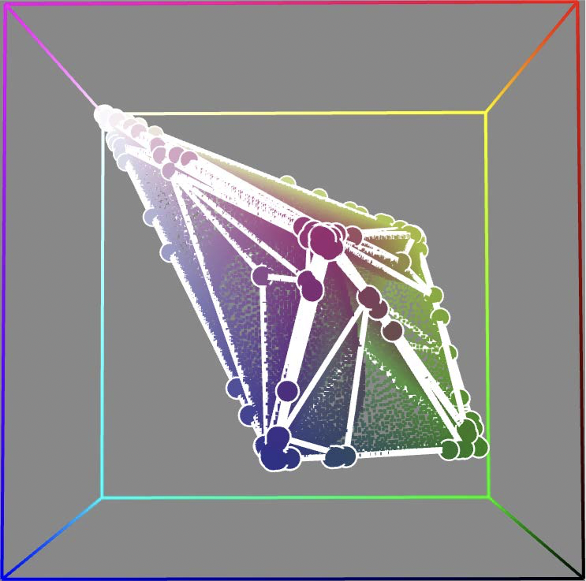
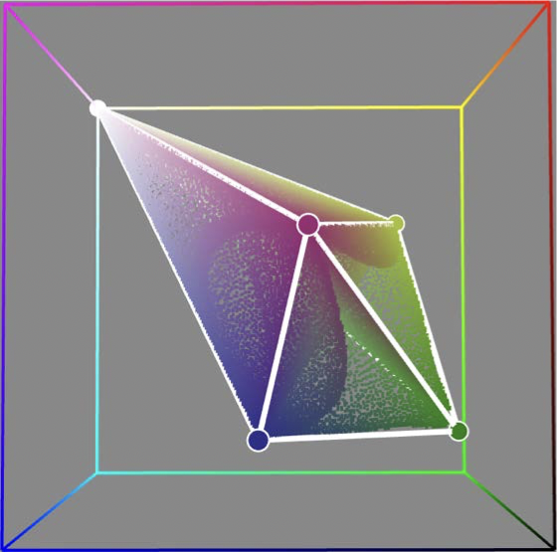
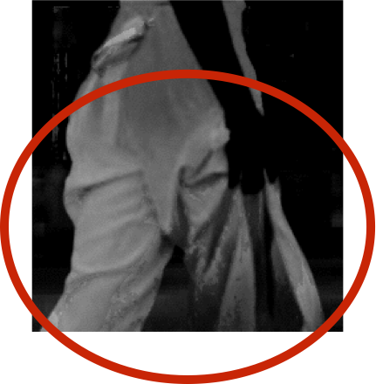
State-of-the-art: Convex hull based approaches
Layer Decomposition (Tan et al. 2017)
Palette Extraction (Tan et al. 2017)
Extracting
Mixing weights
Iteratively
collapse edges
Convex hull
Generalized Barycentric Coordinate
Simplified Convex hull
Notes:
Among all works on palette-based image decomposition whole, the convex hull based approaches are state-of-the-art ones.
For they produces the most satisfactory results considering the quality and computation efficiency.
In the work Tan et al 2017, they tessellate the convex hull, then any pixel can be represented as a linear combination of the 4 vertices of its enclosing tetrahedron using barycentric coordinates. They simply use the barycentric coordinates as the layer opacity value.
This approach is very fast, however, it suffers for the artifacts caused by the lack of spatial continuity.
in this kind of approaches.

Slide 7
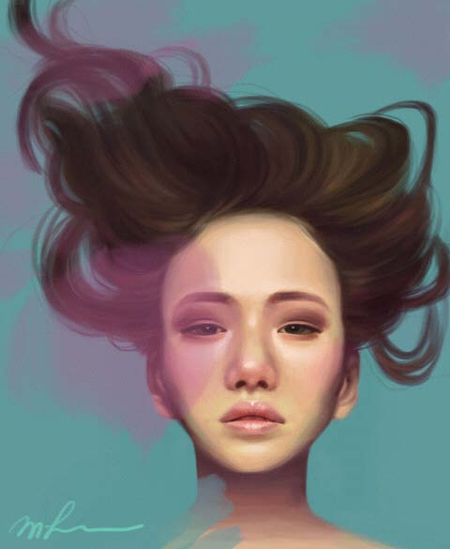
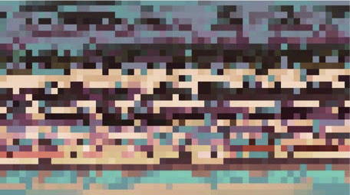
State-of-the-art: Convex hull based approaches
Layer Decomposition (Tan et al. 2018)
WRGB
W = WRGB * WRGBXY
WRGBXY
RGBXY palette (projected to RGB)
RGB palette
Construct a 3D convex hull in RGB space
Construct a 5D convex hull in RGBXY space
Tessellate the hull to get RGB simplices
Tessellate the hull to get RGBXY simplices
A RGBXY palette vertice is interpolated by 4 RGB palette vertices
A pixel is interpolated by 6 RGBXY palette vertices
Notes:
Tan et al 2018 extended their work to 5D RGBXY space (that is, adding the 2d positions into consideration and tessellated simplices in the 5D space) This mehod produced spatially smoother layers than Tan et al. 2017 method but building the 5D convex hull is slow, which usually takes minutes for a single image.
Our method is built on top of the convex hull based approaches.
However, they still have two challenges hidden in this kind of approaches.

Slide 8
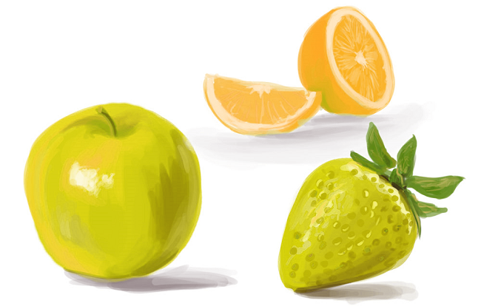
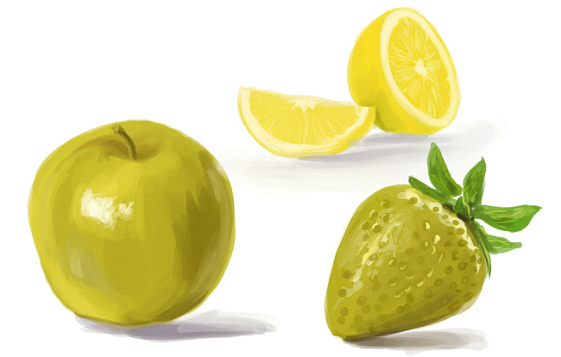
Improvement 1 : Palette Representativeness
Convex hull based Approach
Ours
Notes:
First is that the palette colors they extracted are vertices of convex hull, which may not exist in the image. Dominant image colors, which are in the middle of RGB space, could not be selected as palette colors due to geometric properties of convex hulls. Therefore, its extracted palette colors may have a low degree of representativeness.
As we can see from this example
The input image includes three objects: a red apple, a red strawberry and an orange.
the convex hull based method does not select a dominant color ‘orange’ as a palette color, but instead select ‘yellow’, which does not exist in the image.
It would make further recoloring less intuitive and less predictable —— adjusting palette color 'red' will largely influence the appearance of the orange.

Slide 9
Our approach : Optimized Polyhedron
Input: a convex hull
$$v$$
Target: a polyhedron
$$v_{c}$$
convex hull
polyhedron
We want the polyhedron to enclose as many pixels as possible
g
$$i$$
$$i_{project}$$
We want vertices get more close to existing colors
r
Energy Function:
Notes:
Our approach improve this approach by take the reconstruction accuracy and degree of representativeness both into account.
Here we use a polyhedron to represent the color palette and formulate the palette extraction process as an optimization problem
First, we enforce the polyhedron to enclose as many pixels as possible, that is, maintaining reconstruction accuracy as high as possible.
Second, we would also like the vertices of the polyhedron to be representative with respect to the image, that is, constraining each individual vertex close to existing colors in the image as much as possible.
Our goal is to generate a polyhedron P that minimizes the following energy function
reconstruction loss accounts for the accuracy of reconstruction which it the sum of the distance of all points in ​to their projected points.
representative loss​ accounts for the degree of representativeness of vertices.
Where v denotes a vertex of the polyhedron, ​ vc denotes the center of the neighboring points of ​v/
Lambda is a parameter to control the relative contributions between the two losses.

Slide 10
Initialization
construct the simplified convex hull
Refinement of a vertex v
Compute the neighbor center point vc
Update the vertex to the new position v0. (on the line where v and vc are located)
Repeat Step 2 until converge
(usually need 2 to 3 cycles)
Notes:
We use an iterative approach to solve this optimization problem.
First is the initialization, we use convex hull produced using Tan’s method.
Then we start the optimization, each time we only select one vertex to optimize and keep all other vertices fixed. (To reduce search space, we restrict the vertex v to be on the line where its corresponding center point are located)
In this way, we cycle through all vertices until convergence.
The optimization problem can be efficiently solved in a few seconds.

Slide 11
Initialization
construct the simplified convex hull
Refinement of a vertex v
Compute the neighbor center point vc
Update the vertex to the new position v0. (on the line where v and vc are located)
Repeat Step 2 until converge
(usually need 2 to 3 cycles)
Notes:
We use an iterative approach to solve this optimization problem.
First, we use the vertex position of the convex hull produced using Tan’s method as the initial vertex position of our polyhedron.
Then we start the optimization, each time we only select one vertex to optimize and keep all other vertices fixed. (To reduce search space, we restrict the vertex v to be on the line where its corresponding center point are located)
In this way, we cycle through all vertices until convergence.
The optimization problem can be efficiently solved in a few seconds.

Slide 12
Initialization
construct the simplified convex hull
Refinement of a vertex v
Compute the neighbor center point vc
Update the vertex to the new position v0. (on the line where v and vc are located)
Repeat Step 2 until converge
(usually need 2 to 3 cycles)
Notes:
We use an iterative approach to solve this optimization problem.
First, we use the vertex position of the convex hull produced using Tan’s method as the initial vertex position of our polyhedron.
Then we start the optimization, each time we only select one vertex to optimize and keep all other vertices fixed. (To reduce search space, we restrict the vertex v to be on the line where its corresponding center point are located)
In this way, we cycle through all vertices until convergence.
The optimization problem can be efficiently solved in a few seconds.

Slide 13
Initialization
construct the simplified convex hull
Refinement of a vertex v
Compute the neighbor center point vc
Update the vertex to the new position v0. (on the line where v and vc are located)
Repeat Step 2 until converge
(usually need 2 to 3 cycles)
Notes:
We use an iterative approach to solve this optimization problem.
First, we use the vertex position of the convex hull produced using Tan’s method as the initial vertex position of our polyhedron.
Then we start the optimization, each time we only select one vertex to optimize and keep all other vertices fixed. (To reduce search space, we restrict the vertex v to be on the line where its corresponding center point are located)
In this way, we cycle through all vertices until convergence.
The optimization problem can be efficiently solved in a few seconds.

Slide 14
Initialization
construct the simplified convex hull
Refinement of a vertex v
Compute the neighbor center point vc
Update the vertex to the new position v0. (on the line where v and vc are located)
Repeat Step 2 until converge
(usually need 2 to 3 cycles)
Notes:
We use an iterative approach to solve this optimization problem.
First, we use the vertex position of the convex hull produced using Tan’s method as the initial vertex position of our polyhedron.
Then we start the optimization, each time we only select one vertex to optimize and keep all other vertices fixed. (To reduce search space, we restrict the vertex v to be on the line where its corresponding center point are located)
In this way, we cycle through all vertices until convergence.
The optimization problem can be efficiently solved in a few seconds.

Slide 15
Improvement 2 : Decomposition Speed
RGB space (Tan et al. 2017)
Optimization (smooth but slow for high resolution)
Interpolation (lack spatial smoothness)
RGBXY space (Tan et al. 2018)
Interpolation (smooth but extra time for preprocessing)
Notes:
The second improvement is to speed up the layer decomposition process. In Tan et al. 2017, they propose both the optimization-based and interpolation based approaches.
Optimization-based approaches could produce visually pleasing and smooth layers, however, they are very slow, usually take minutes to even hours for a single image. The interpolation method is fast and produces sparse layer opacities , however, it has only C0 continuity and easily produces speckling artifacts during recoloring.
In Tan et al. 2018, they propose the RGBXY method , which extends the idea of interpolation to the 5D RGBXY space. Its interpolation is also fast, and its results are much more smooth, however, it requires a preprocessing step to construct a 5D convex hull for each image, which take minutes and gigabytes memories to process a single image with megapixels.
Therefore, the limitations of these approaches motivated us to find a new approach for layer decomposition.

Slide 16
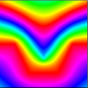
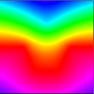
Our approach : MVC-based Decomposition
Interpolation based on MVCs (Mean Value Coordinate)
Efficient and smooth
Notes:
Based on the fact that any colors inside the polyhedron could be expressed as a linear interpolation of polyhedron vertices.
We propose using MVCs(mean value coordinate)
MVCs have analytic formulas and could be computed efficiently.
The mathematical properties of MVCs also ensure that they are continuous anywhere and are smooth inside the polyhedron.
Therefore, MVC based decomposition is more efficient without precomputations and produces spatially smoother layers.

Slide 17
Results and Comparisons
Notes:
Here are our results and comparisons with previous method.
Note that we have made improvements on two components. One is an improved geometric palette extraction approach
the other is MVC-based layer decomposition.
We further seprately assess these two components.

Slide 18
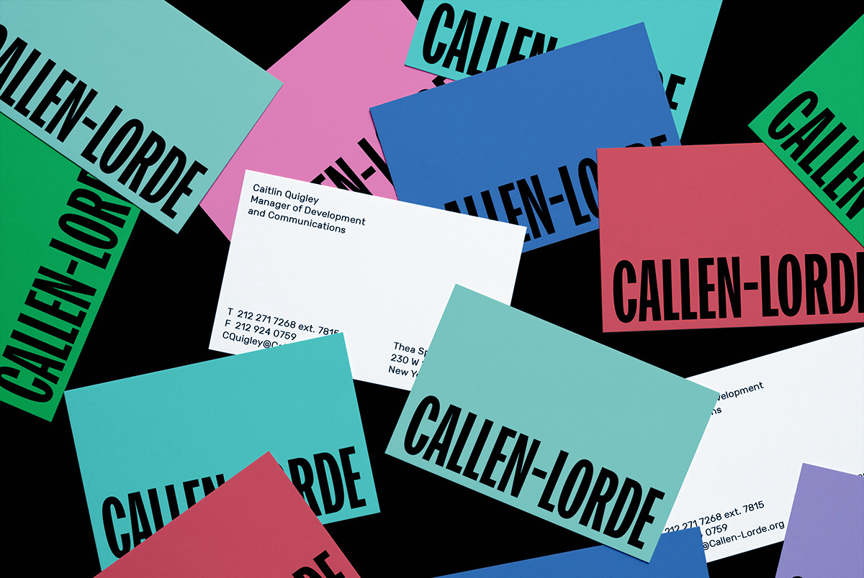
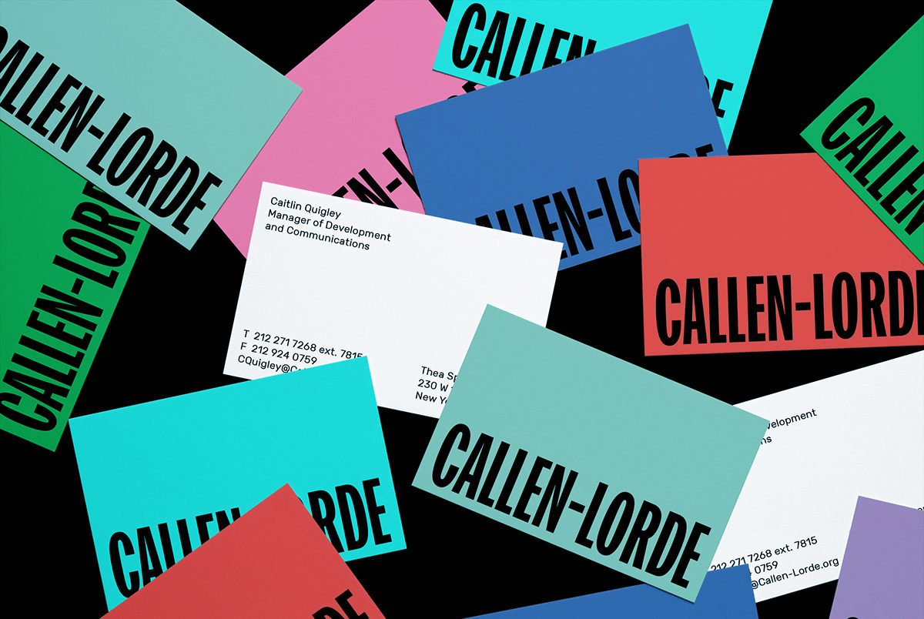
Compared to results on Palette Extraction
Original Image
Convex hull based method
Our Method
Notes:
We can see that the RGBXY method may easily lead to 'color bleeding' artifacts. since its palette colors are usually far from existing colors and are less representative
example —— poscard
changing the color of a yellow envelope leads to an apparent change of another red envelope
example —— surf
changing the color of the surfboard leads to a large scale of background change.
in contrast our palette extraction method produces desirable recoloring results.

Slide 19
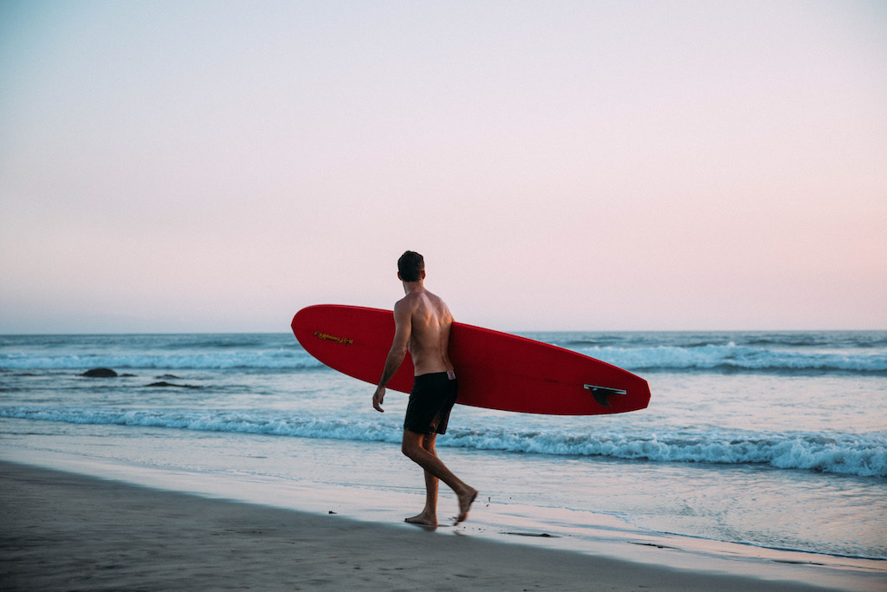
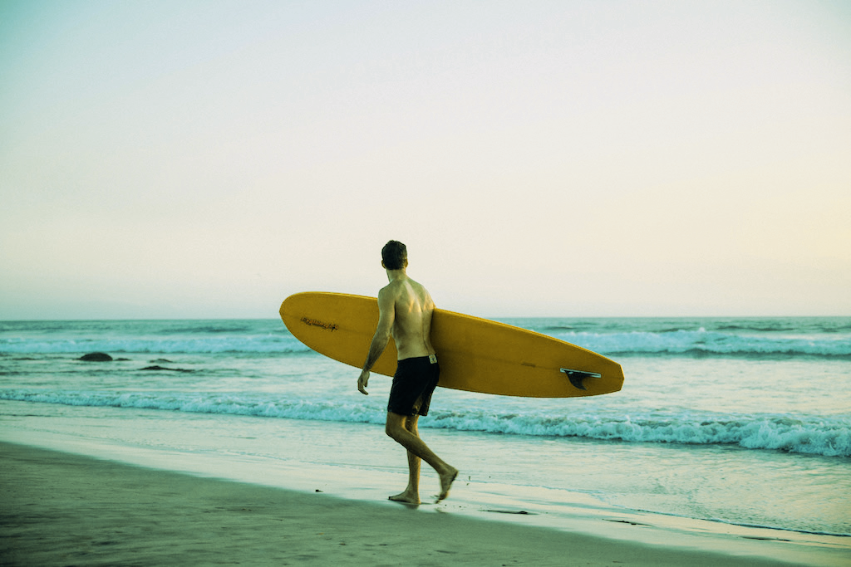
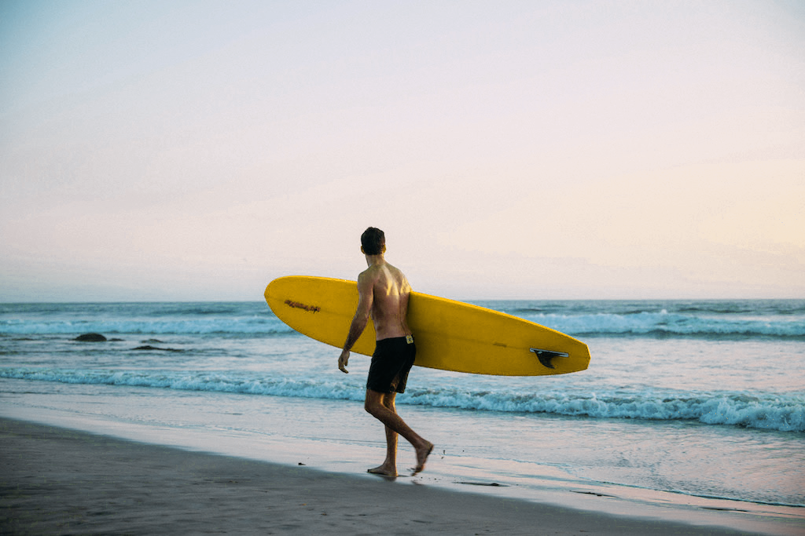
Compared to results on Palette Extraction
Original Image
Convex hull based method
Our Method
Notes:
We can see that the convex hull-based method may easily lead to 'color bleeding' artifacts. since its palette colors are usually far from existing colors and are less representative
example —— poscard
changing the color of a yellow envelope leads to an apparent change of another red envelope
example —— surf
changing the color of the surfboard leads to a large scale of background change.
in contrast our palette extraction method produces desirable recoloring results.

Slide 20
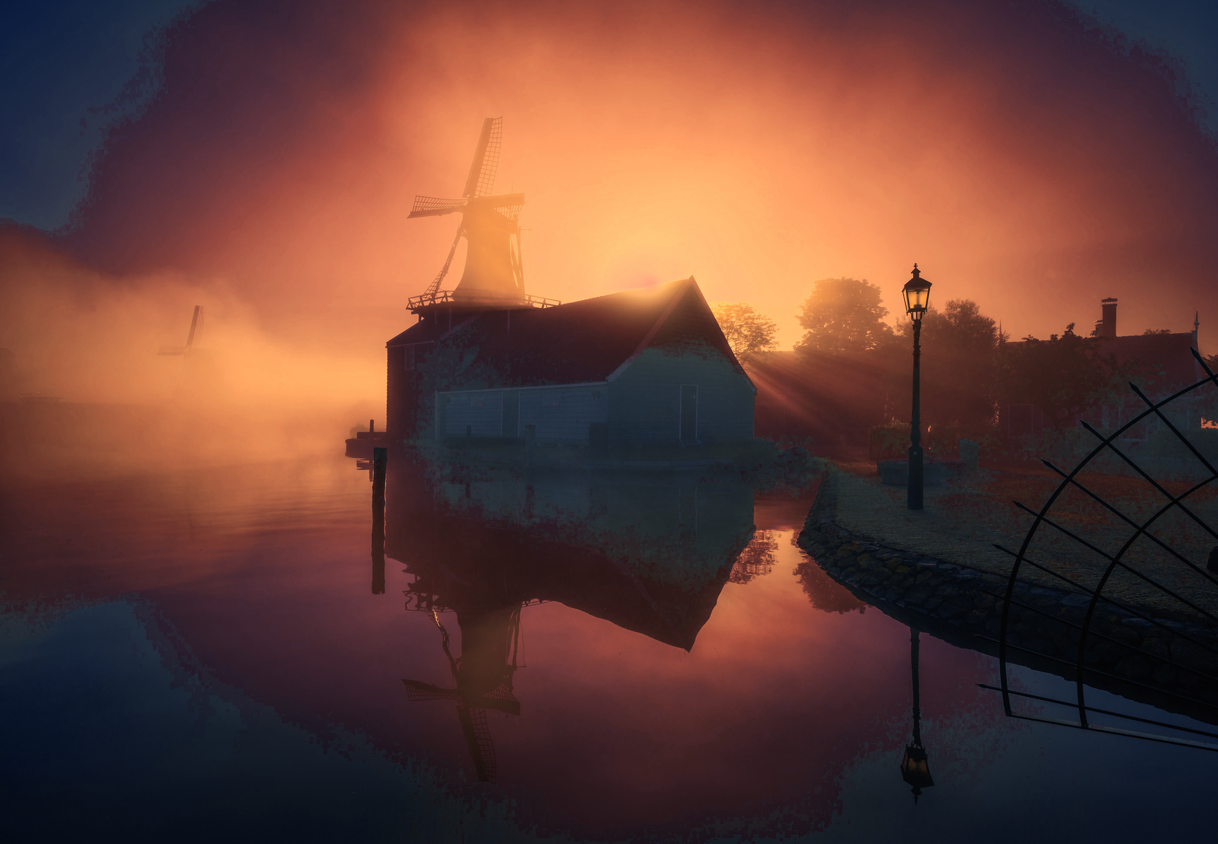
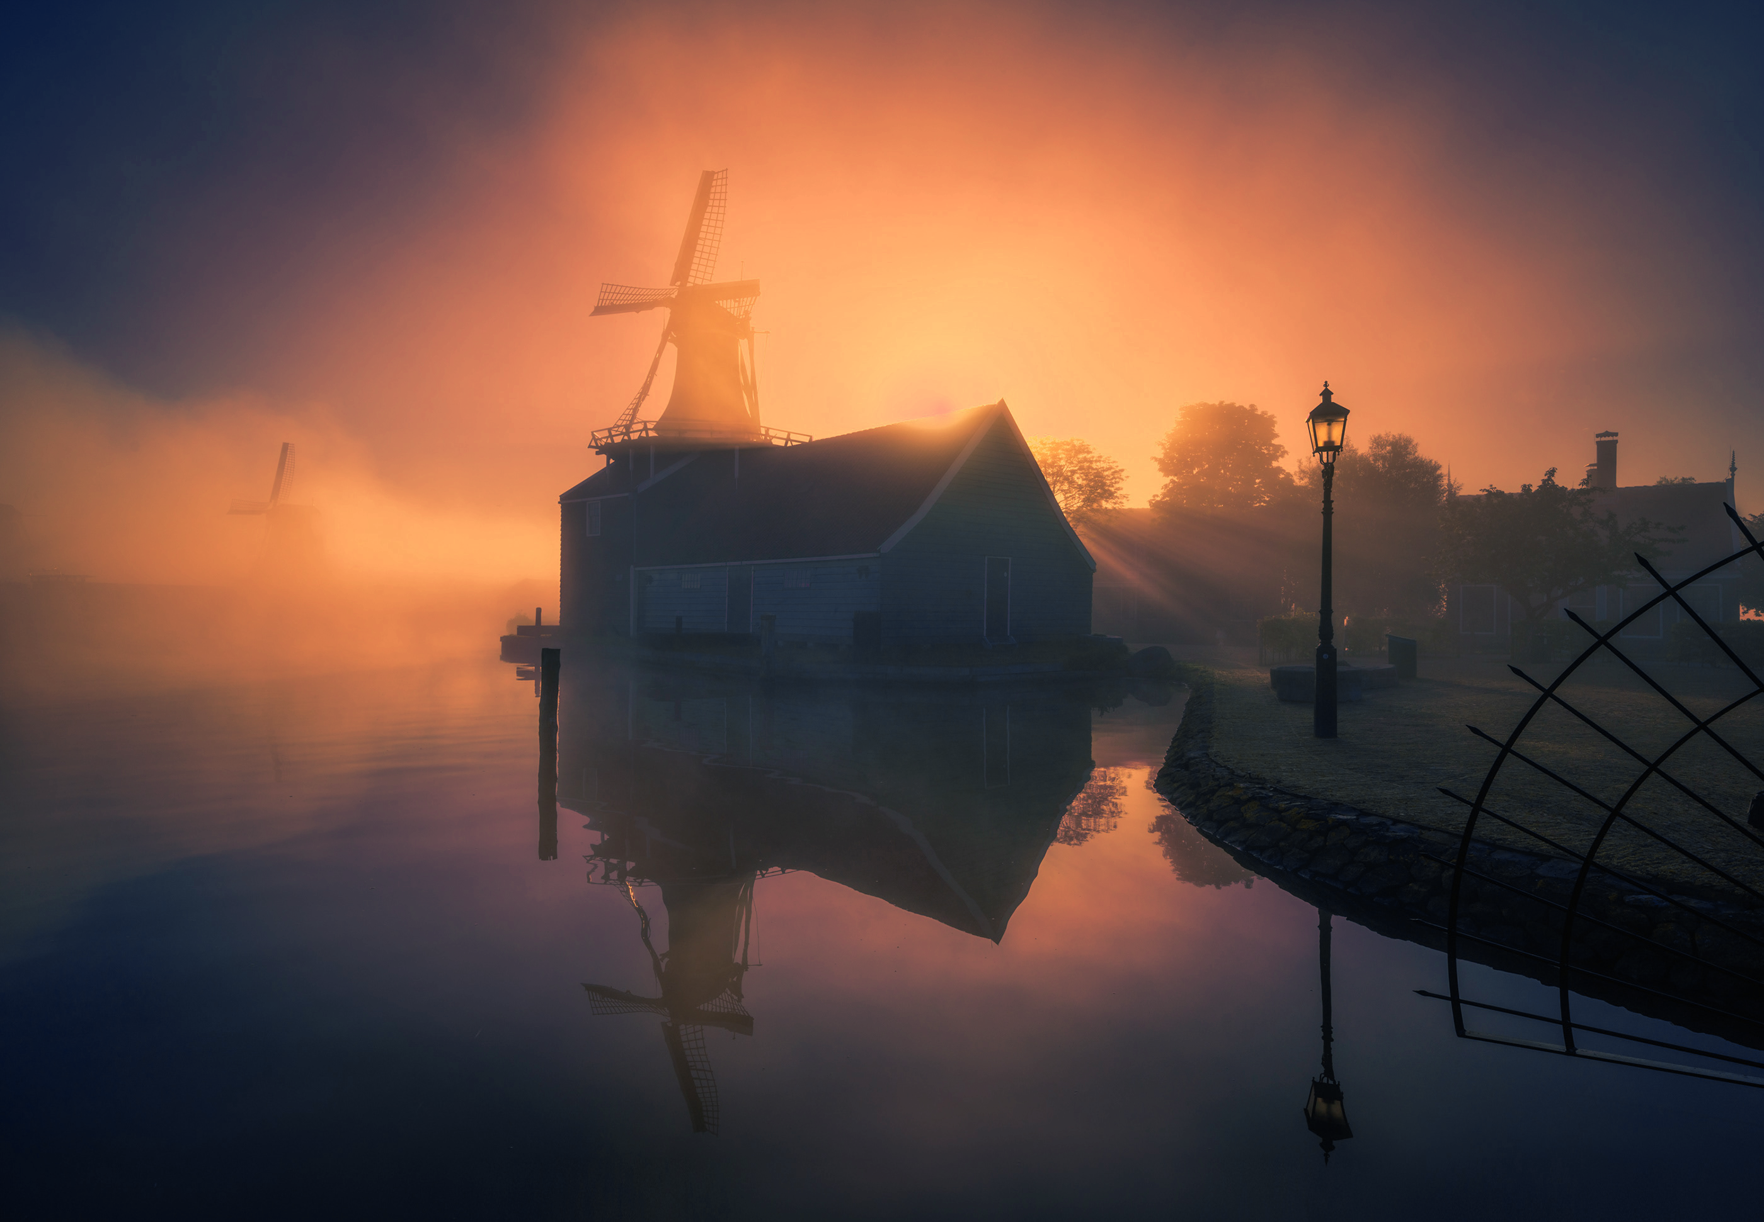
Compared to results on Layer Decomposition
RGB Interpolation Method
(Tan et al. 2017)
Our MVC Method
Notes:
Second is our comparisons on Layer Decomposition.
MVC-based decomposition method (ASAP approach [TLG17]) the RGB optimization approach [TLG 17] and the RGBXY approach TEG18 —— same palette extraction method
1. from the results, we could find that all other approaches are likely to produce artifacts in areas where colors are slowly changing such as sky fogs and soft shadow areas.
2. The ASAP and RGB optimization approaches somtimes produce undesirable sharp boundaries. (bridge and lake images)
3. RGBXY approach sometimes produces artifacts like color bleeding (roadsigns the color of the road sign is changed when editing the color of sky) noises in areas with slow color changing (top right area of the lake image) soft boundaries (soft shadows in the toy image)
4. our MVC based decomposition method consistently produces smooth and visually pleasant results/

Slide 21
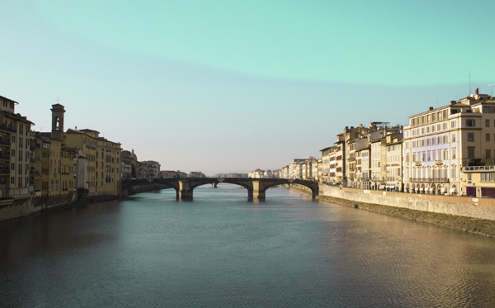
Compared to results on Layer Decomposition
RGB Optimization Method
(Tan et al. 2017)
Our MVC Method
Notes:
MVC-based decomposition method (ASAP approach [TLG17]) the RGB optimization approach [TLG 17] and the RGBXY approach TEG18 —— same palette extraction method
1. from the results, we could find that all other approaches are likely to produce artifacts in areas where colors are slowly changing such as sky fogs and soft shadow areas.
2. The ASAP and RGB optimization approaches somtimes produce undesirable sharp boundaries. (bridge and lake images)
3. RGBXY approach sometimes produces artifacts like color bleeding (roadsigns the color of the road sign is changed when editing the color of sky) noises in areas with slow color changing (top right area of the lake image) soft boundaries (soft shadows in the toy image)
4. our MVC based decomposition method consistently produces smooth and visually pleasant results/

Slide 22
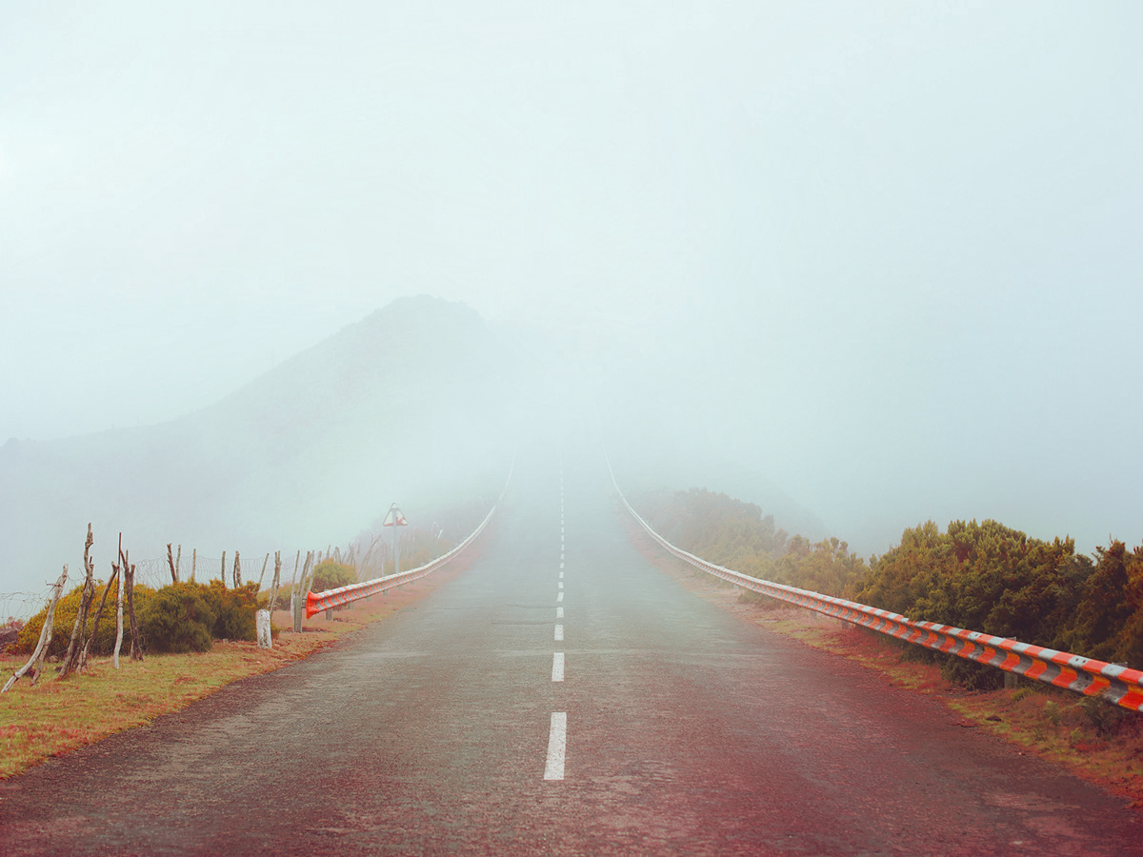
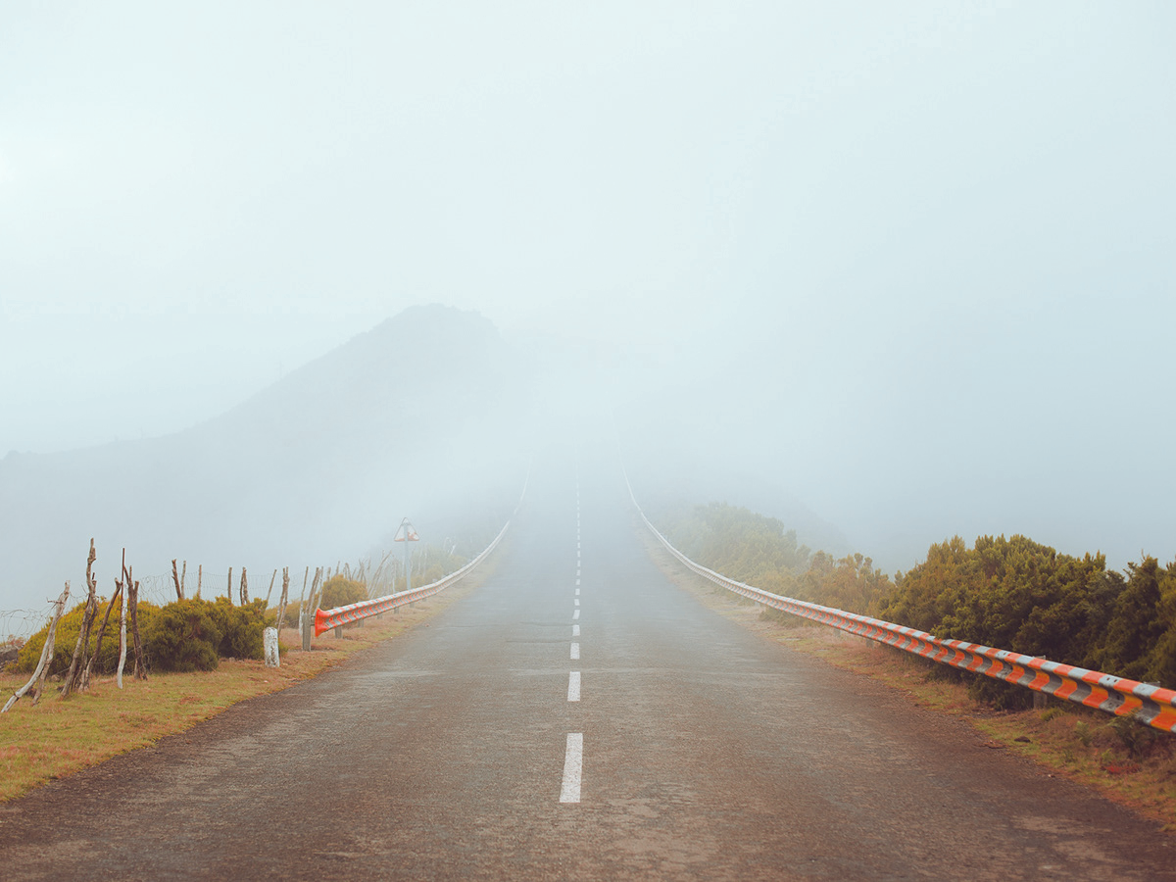
Compared to results on Layer Decomposition
RGBXY Interpolation Method
(Tan et al. 2018)
Our MVC Method
Notes:
MVC-based decomposition method (ASAP approach [TLG17]) the RGB optimization approach [TLG 17] and the RGBXY approach TEG18 —— same palette extraction method
1. from the results, we could find that all other approaches are likely to produce artifacts in areas where colors are slowly changing such as sky fogs and soft shadow areas.
2. The ASAP and RGB optimization approaches somtimes produce undesirable sharp boundaries. (bridge and lake images)
3. RGBXY approach sometimes produces artifacts like color bleeding.
4. our MVC based decomposition method consistently produces smooth and visually pleasant results/

Slide 23
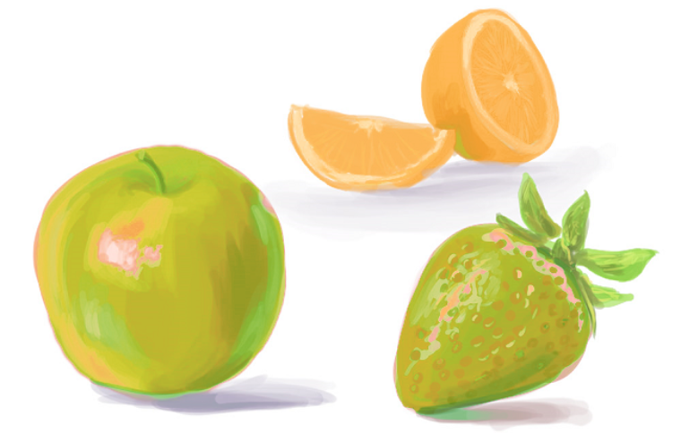
Compared to results for the whole pipeline
Chang et al. 2015
Ours
Notes:
K-means clustering model in chang2015.
To be a fair comparison, each method extracts its own palette from the input image, so we attempt to mimic our result as closely as possible.
unmixing based approach (Aksoy et al. [AASP17])
Slow (4 hours and 25G memory to process a 100M)
user interaction is complicated and uset-unfriendly
Chnag et al. [CFL 15 ] &RGBXY [TEG18]
color bleeding artifacts

Slide 24
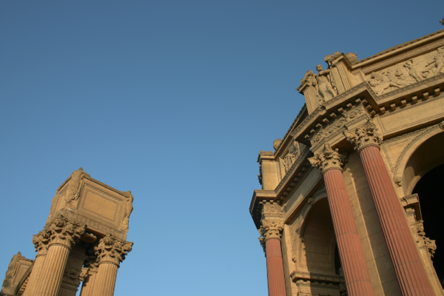
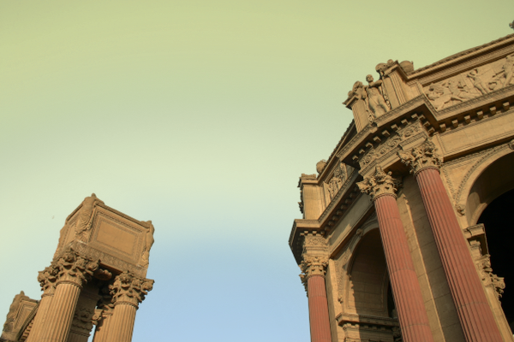
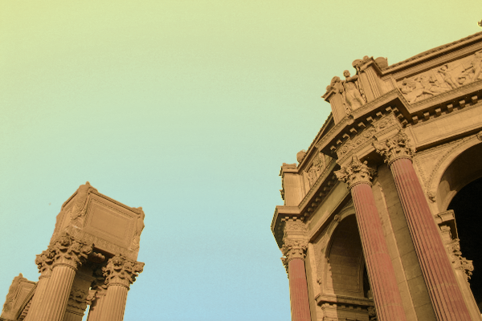
Compared to results for the whole pipeline
Aksoy et al. 2017
Ours
Notes:
Finally, here we compared our whole method with 3 typical existing palette-based editing method.
To be a fair comparison, each method extracts its own palette from the input image, so we attempt to mimic our result as closely as possible.
unmixing based approach (Aksoy et al. [AASP17])
Slow (4 hours and 25G memory to process a 100M)
user interaction is complicated and uset-unfriendly
Chnag et al. [CFL 15 ] &RGBXY [TEG18]
non-smooth results / color bleeding artifacts

Slide 25
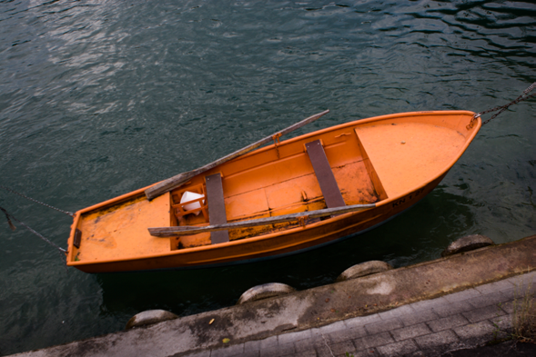
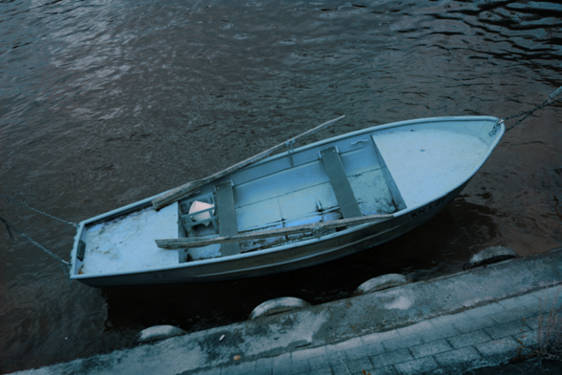
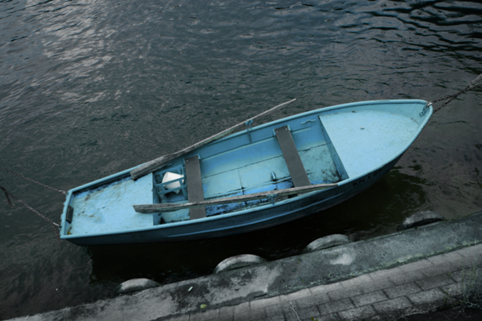
Compared to results for the whole pipeline
Original Image
Tan et al. 2018
Ours
Notes:
Here we compared our model based recoloring results with porter-duff model in tan2016 and Gaussian mixture model in chang2015.
To be a fair comparison, each method extracts its own palette from the input image, so we attempt to mimic our result as closely as possible.
unmixing based approach (Aksoy et al. [AASP17])
Slow non-smooth
Chnag et al. [CFL 15 ] &RGBXY [TEG18]
color bleeding artifacts

Slide 26
Conclusion
Introduced an improved geometric approach for color palette extraction, which Increase representativeness
Provided a simple MVC based layer decomposition scheme which produce spatially smoother layers
Efficient
Spatially smoother
Notes:
In conclusion, we propose a palette-based recoloring system which is generally more intuitive and efficient and less artifacts, compared to state-of-the-art approaches.
In specific, we introduced an improved geometric approach for color palette extraction, considering both reconstruction accuracy and degree of representativeness.
We also provided a simple MVC based layer decomposition scheme, which is rather efficient and is able to produce spatially smoother layers.

Slide 27
Limitation and Future Work
The polyhedron topology does not change
Investigate algorithms that simultaneously optimize for vertex positions and polyhedron topology
Extend to videos

Slide 28
Thank You!
Contact Information
Yili Wang: wangyili16@mails.tsinghua.edu.cn
Yifan Liu: yf-liu17@mails.tsinghua.edu.cn
Kun Xu: xukun@tsinghua.edu.cn
Notes:
Here is our contact information
If you have any suggestions or questions, please contact us
Thank you!
Q: when will your approach fail?
A: if an image has distracting colors that encompass much of the RGB space, our method would fail. In such cases, our method may produce a palette with little difference to the original palette generated by the convex hull based approaches.
Q: will the number of vertices change during optimization?
A:
We use the RGBXY method [Tan 2018] to generate the convex hull as the initialization of our polyhedron.
During optimization, the topology of the polyhedron and the number of vertices is unchanged.
We only optimize for vertex positions.
Q: Parameter Evaluation.
There are several parameters.
parameter lambda: to control the relative contributions of the reconstruction loss and the representative loss.
larger lambda --> less reconstruction error
smaller lambda --> more tight polyhedron
We have evaluated this parameter, and find lambda = 20 is a good trade-off.
number of iterations:
Our method converges very quickly, so we set the number of iterations to 2 (2 rounds of all vertices) is enough to reach convergence.
some details:
neighborhood size: we define the representative loss by measuring the distance from a vertex to the center of its neighborhood. So we need to define the size of a neighborhood. The neighborhood size could not be too small, since itmay result in unstable results which can be easily affected by outliers or noises. We find that setting it as 0.1% of the number of sampled pixels is good.
Please find more details inside our paper.
Q: Performance details.
A: For palette extraction, it usually takes a few seconds to generate the initial convex hull, and take another 1 or 2 seconds for palette refinement.
For layer decomposition and image recoloring, the time using our MVC based layer decomposition is almost negligible. (e.g., tens of milliseconds.)

