Slide 1
Change Blindness Images
Li-Qian Ma¹, Kun Xu¹, Tien-Tsin Wong², Bi-Ye Jiang¹, Shi-Min Hu¹
¹Tsinghua University
²The Chinese University of Hong Kong
Notes:
Thanks for the introduction.
In this talk, I will present a recent approach on change blindness images.

Slide 2
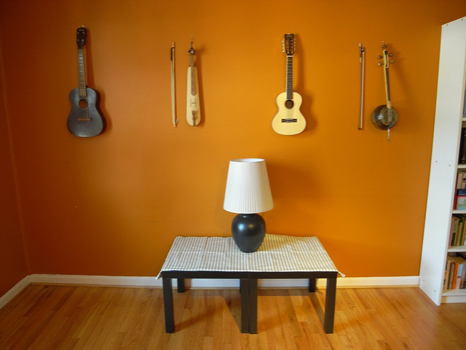

Spot-the-difference Game
Notes:
I believe all of you have played the interesting, popular spot-the-difference game before. (--click)
Like this one, there is a single difference between the two images, can you find out the difference? (---click)
Yes, this is an easy one.

Slide 3


Spot-the-difference Game
Notes:
However, this pair is a harder example. Can you find the difference? (--click)
Now you can see, the position of the pumpkin head’s nose is modified.

Slide 4
Motivation
These image pairs are mainly generated by artists manually
The degree of recognition difficulty is controlled by artists empirically
Notes:
OK. Currently, these kind of image pairs are mainly generated by artists manually. No existing methods can automatically generate these image pairs.
Furthermore, the degree of recognition difficulty for image pairs are mainly controlled by artists empirically. The quality of these image pairs relies on the skill of the artist. There is no computational model to measure this kind of difficulty.
However, automatically generating them will be very helpful, like they can provide a custom version of spot-the-difference game using users’photos.

Slide 5


Goal
Given an image, automatically generate a counterpart of the image
With a controlled degree of “difficulty”
Notes:
Hence, (--click)
Give an image, our goal is to automatically generate a counterpart of the image(--click), with a controlled degree of difficulty for people to notice the difference(--click)

Slide 6
Psychological background
Change blindness
  Widely studied in psychology
    is caused by failure to store visual information in our short-term memory
  Factors influencing
    visual attention (saliency),
    object presentation
  Mostly qualitative
Notes:
After survey, we find that the spot-the-difference game is highly related to a phenomenon, called change blindness, which is already
Widely studied in the psychological literature. More accurately, change blindness is the visual perception phenomenon that very large changes made to an image may often go unnoticed by observers.
Existing psychological studies give many useful conclusions and have found many factors influencing the “difficulty” to find the change. Such as visual attention, object presentation, and even the age of the observer (18-64).
However, I have to say that their conclusion is mostly qualitative. There doesn’t exist a quantitative metric to measure how difficult for people to notice the change.

Slide 7
The Metric
We define a metric to measure the blindness of an image pair
There is a single change between the image pair
The change region and the operator are known in advance
The change is limited to the following operators:
  Insertion/Deletion
  Replacement
  Relocation
  Scaling
  Rotation
  Color-shift
Notes:
Based on psychological findings, we define a metric for measuring the recognition difficulty of an image pair, which we call the blindness.
Our metric is based on the assumption that there is a single object-level change, and the change is limited to some predefined change operators. The change region and the operator are known in advance.

Slide 8
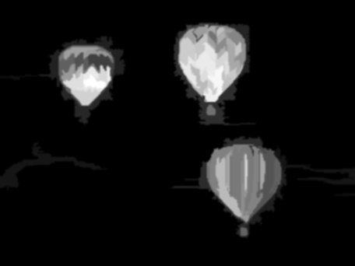
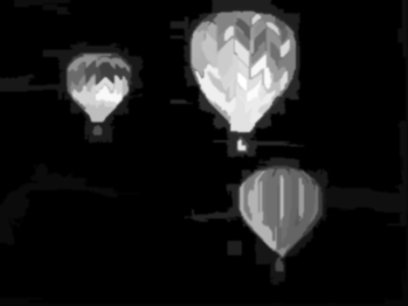
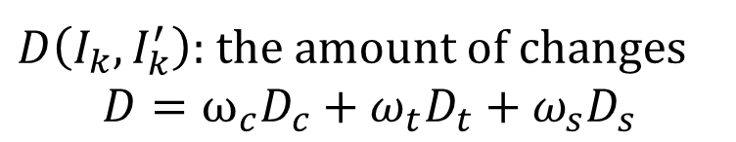
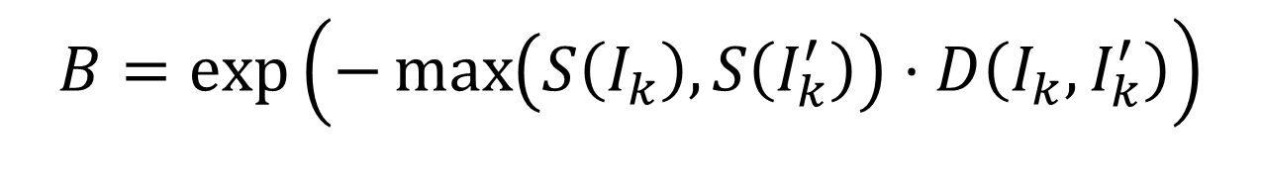
The Metric
$$B=\exp\left(−\max\left(S\left(I_{k}\right),S\left(I_{k}^{′}\right)\right)⋅D\left(I_{k}, I_{k}^{′}\right)\right)$$
$D\left(I_{k}, I_{k}^{′}\right)$: the amount of changes
$$D=ω_{c}D_{c}+ω_{t}D_{t}+ω_{s}D_{s}$$
Notes:
We proposed the metric here.
We define the metric as the product of a saliency term and an amount of change term, motivated by the facts that both saliency and amount of change are crucial factors.
As illustrated in this example(--click)
I_k and I_k primed denote the regions being changed(--click)
S means the saliency of that region(--click)
D means the amount of change(--click),
Including the amount of color, texture and geometric changes.

Slide 9

Amount of Change
$$D=ω_{c}D_{c}+ω_{t}D_{t}+ω_{s}D_{s}$$
Color Difference
Texture Difference
Spatial Difference
Notes:
The amount of change is defined as the sum of multiple feature differences.
Here, Dc, Dt, and Ds are the color difference(--click), texture difference(--click) and the spatial difference(--click) of the two regions, respectively.
Wc, wt and ws are the corresponding weights.
In detail, the color difference dc is evaluated as the earth-mover’s distance between the color histograms of the two regions in lab color space.
The texture difference dt is evaluated using the earth-mover’s distance between gabor wavelet features.
The spatial difference ds is evaluated as the average two-Dimension distance between corresponding point pairs along the boundaries of the two regions. The correspondence is found by matching minimizes shape context costs.

Slide 10

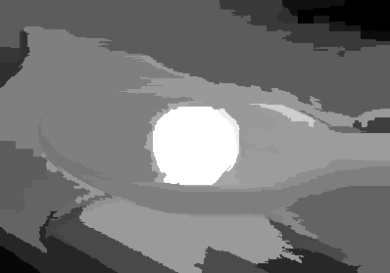

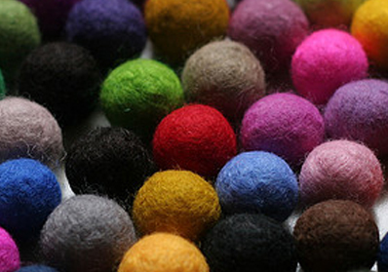
Saliency
Visual attention is highly context-dependent
No existing saliency model attempts to explicitly quantify background complexity
Notes:
Change blindness is highly affected by visual attention. We must find an effective saliency model to our metric.
Previous psychology works found that visual attention is highly context-dependent, look at this example.(--click)
These two images show two more or less identical red felt balls positioned at the image center. We observe that the visual saliency of the felt ball decreases as the background becomes more complicated. This suggests that visual saliency is modulated by background complexity.
However(--click), no existing saliency model attempts to explicitly quantify background complexity.
State-of-the-art models, such as global contrast saliency(--click), fail to model the influence of background complexity on the saliency, and the felt ball receives more or less the same saliency.

Slide 11

Context-Dependent Saliency
Modulate saliency via spatially varying complexity
$$S\left(I_{k}\right)=S_{0}\left(I_{k}\right) ⋅ C(I_{k})$$
Context-dependent saliency
Existing saliency model
Spatially varying complexity
Notes:
To take region context into consideration, we propose the new context-dependent saliency model.(--click)
This saliency model is region-based.
The key is to modulate saliency via a spatially varying complexity term.
Here Ik denote an region.(--click)
S zero means existing saliency model.(--click)
C is the spatially varying complexity term.(--click)
And S, the new context-dependent saliency model, is the multiple of S0 and C.

Slide 12
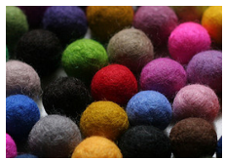
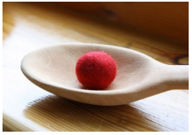

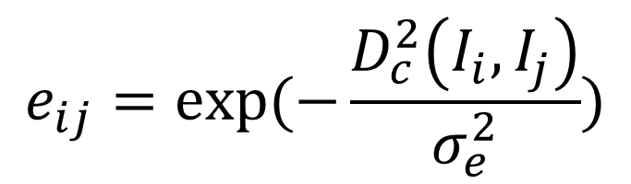



Color Similarity
Color similarity :
$$e_{ij}=exp⁡(−\frac{D_{c}^{2}\left(I_{i},I_{j}\right)}{σ_{e}^{2}})$$
$$I_{i}$$
$$I_{j}$$
$$I_{i}$$
$$I_{j}$$
Small color similarity
Large color similarity
Notes:
In order to define the spatial varying complexity, we firstly define color similarities between a region pair(--click)
The color similarities between a region pair is simply defined as a gaussian of the color difference between them.(--click)
Look at the two examples.(--click)
In the left one, these two regions has small color similarity.(--click)
While in the right one, these two regions gain larger color similarity.

Slide 13
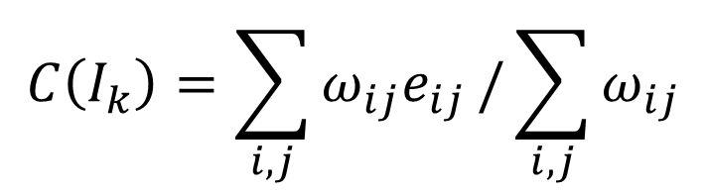
Spatial varying Complexity
Weighted sum of color similarities between all region pairs around
$$C\left(I_{k}\right)=\sum_{i,j}{ω_{ij}e_{ij}}/\sum_{i,j}{ω_{ij}}$$
Notes:
The spatial varying complexity term is defined as the weighted sum of color similarities between all region pairs around.
The idea is simple. Nearby regions with large color similarities make the context less complex.
Here is the formulation(--click). E_ij measures the color similarity of two segments. W_ij is the corresponding weight defined as follows(--click)

Slide 14

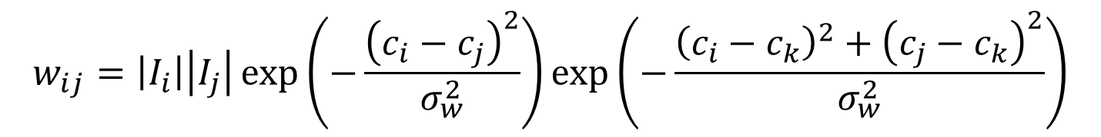
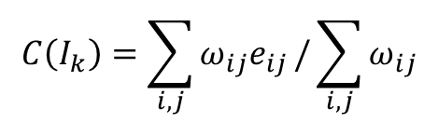


Spatial varying Complexity
$$C\left(I_{k}\right)=\sum_{i,j}{ω_{ij}e_{ij}}/\sum_{i,j}{ω_{ij}}$$
$$w_{ij}=\left|I_{i}\right|\left|I_{j}\right|\exp\left(−\frac{{\left(c_{i}−c_{j}\right)}^{2}}{σ_{w}^{2}}\right)\exp\left(−\frac{{{\left(c_{i}−c_{k}\right)}^{2}+\left(c_{j}−c_{k}\right)}^{2}}{σ_{w}^{2}}\right)$$
$$I_{i}$$
$$I_{j}$$
$$I_{k}$$
Notes:
W_ij is the importance of region pair I_i and I_j to I_k.
And is determined by many factors.(--click)
This is the size of region I_i. Obviously, larger regions should be given larger weights.(--click)
This is the size of region I_j.(--click)
This term measures the distance factor between I_i and I_j. here c_i and c_j are the center points of region I_i and I_j. This means close-by region pairs contribute more to the complexity than drifted apart region pairs. (--click)
This term measures the distance factor between I_k and the region pair. Since nearby region pair contributes more to the spatial varying complexity than region pairs far away.

Slide 15


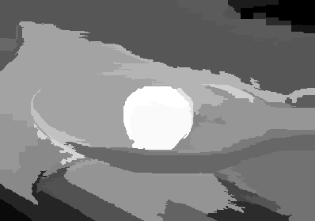
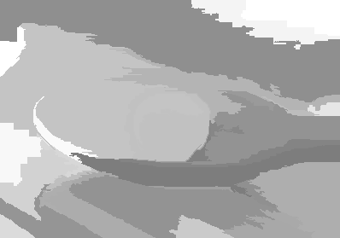
Context-Dependent Saliency
Global contrast
saliency
Spatial varying
complexity
Input images
Context-dependent
saliency
Notes:
Here shows the example of the improvement of our context-dependent saliency. (--click)
These are the former two balls example.(--click)
Global contrast saliency, the felt ball receives more or less the same saliency.(--click)
These are the spatial varying complexity map computed by our model, the above felt ball has a more complex background.(--click)
Multiplied by the global contrast saliency, we get our context dependent saliency. Our saliency model suppresses the saliency when the complexity of background is high, and improves the saliency when the complexity is small, repectively.

Slide 16

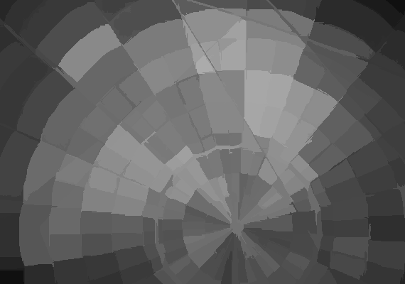
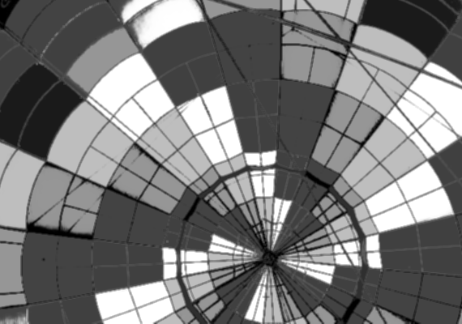

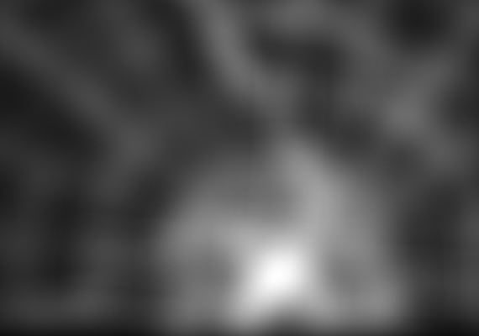
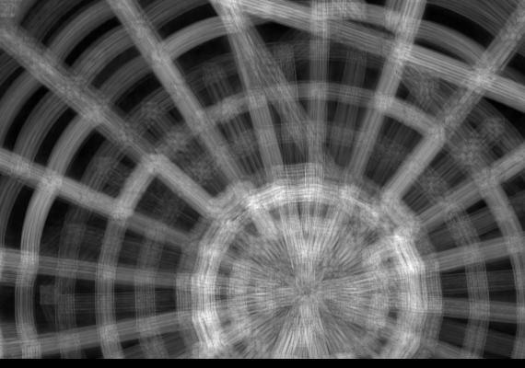


Context-Dependent Saliency
Input image
Global contrast saliency
Learning-based saliency
Image signature
Itti model
AIM saliency
Judd model
Context-Dependent Saliency
Notes:
We compare our context-dependent saliency model to state-of-the-art saliency models using a challenging example.
This input image is quite crowded and, in fact, distracting. It is hard to tell which specific region draws visual attention the
Most.
As existing saliency models do not consider contextual complexity, they may predict various regions to be most salient. Note that their predictions are not consistent with each other. In contrast, our context-dependent model returns rather low saliency values for almost all regions, which matches our visual experience better

Slide 17
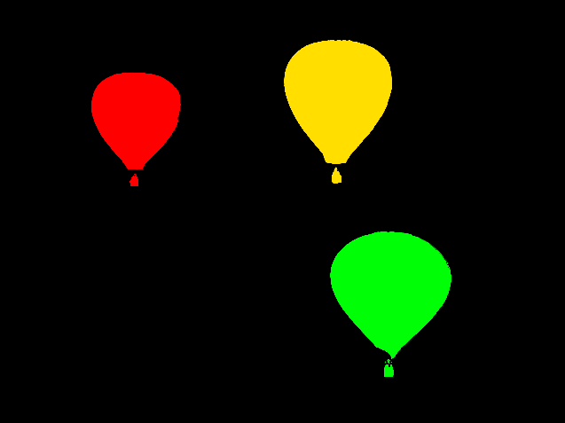
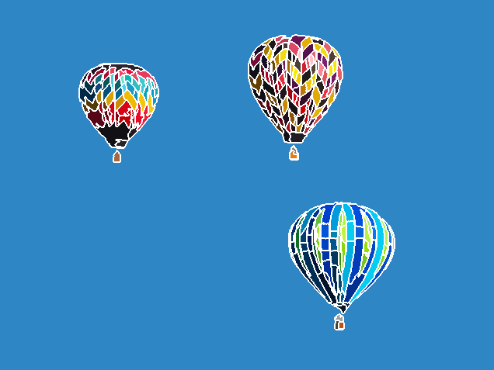

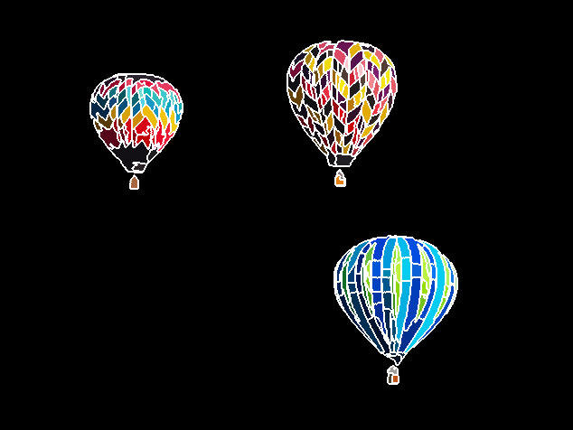

Synthesis
Original Image
Optional user manually refinement
Desired Difficulty $B^{∗}$= 0.5
Notes:
So, after defining the metric, our synthesis method works as follows.(--click)
The input is the original image I and a desired difficulty level $B^{∗}$ . we aim at generating a changed counterpart I’with the desired difficulty level.
Firstly we extract certain candidate regions that are most likely to be foreground object. We segment the input image using mean shift approach(--click), then we remove extremely large segments, discard tiny and long narrow segments(--click). The resultant disjoint segments are regarded as candidate regions(--click).
We allow optional user manually refinement of the segments(--click), since the automatic method may fail for some images.

Slide 18

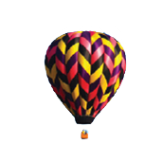
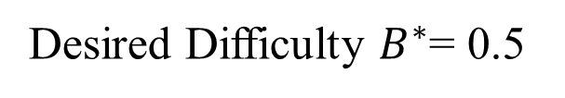
Synthesis
Original Image
Changed Counterpart
Move
Desired Difficulty $B^{∗}$= 0.5
Measured Difficulty B =
0.5
0.7
1
  Randomly pick a region and a change operator
  Search in the parameter space of the change operator
Notes:
To do the synthesis, We first randomly pick a region $I_{k}$ and a change operator(--click)
Then, we need to determine the parameters of the change operator, for example, how much it should be moved; (--click--click)
So, this is done by searching over the parameter space, till the measured difficulty equals to the desired difficulty. (--click)
Obtain the best parameters of the change operator, minimizing the difference between $B^{∗}$ and the measured difficulty level $B$(--click)

Slide 19
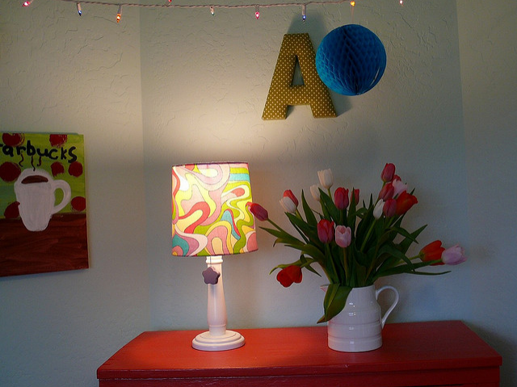
More Results
Notes:
Here are some more examples.
Yes, this example is generated using a small difficulty level, 0.05;(--click)

Slide 20
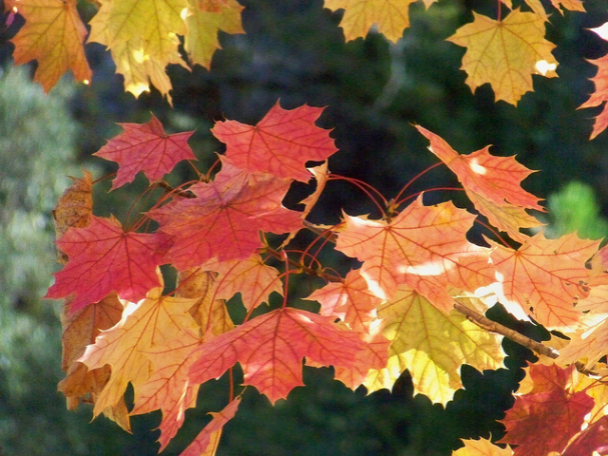
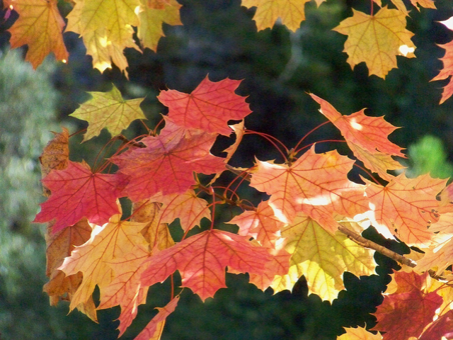
More Results
Notes:
And this one is done using a larger difficulty level 0.61;
And it is not easy to find(--click)

Slide 21
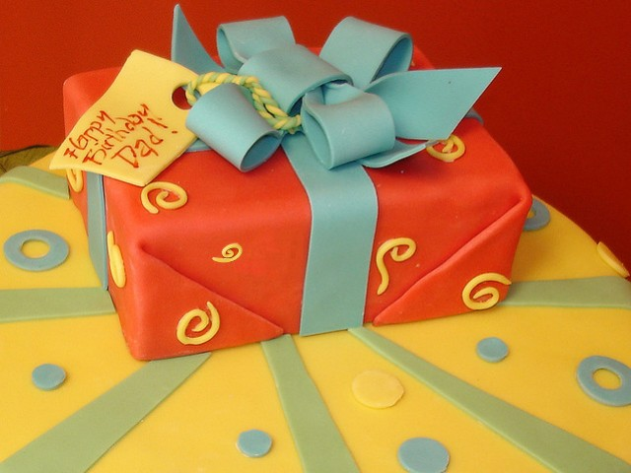


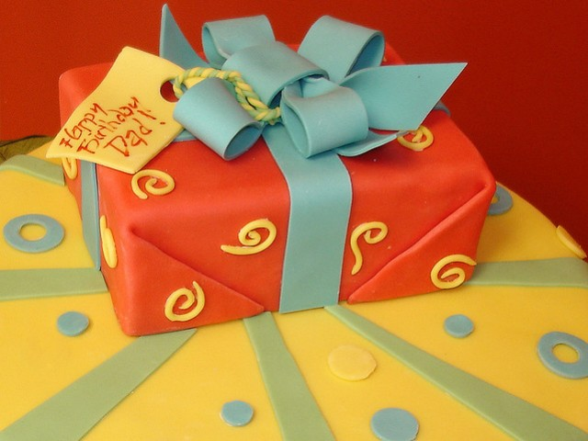



More Results
Original Image
Changed Counterpart
Desired Difficulty $B^{∗}$= 0.2
Desired Difficulty $B^{∗}$= 0.5
Desired Difficulty $B^{∗}$= 0.8
Notes:
This is an example to synthesis changed counterparts of different blindness levels with the same input image.
(--click)
This is the result generated with desired B star equals zero dot two
(--click)
The change is here.(--click)
This is the result generated with B* = 0.5 and this is a little harder
(--click)
The position of this stuff is changed.(--click)
This is the result with B* = 0.8.
(--click)
This is the hardest one.

Slide 22


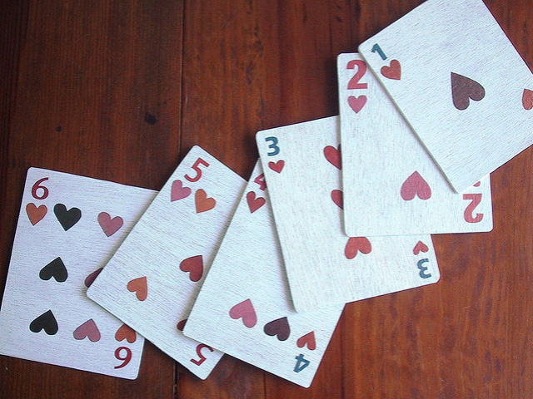
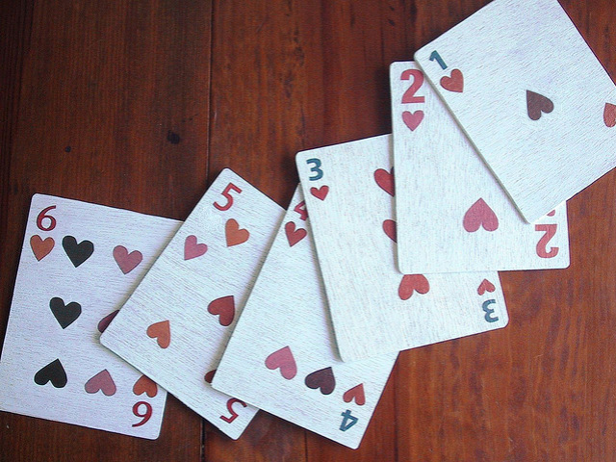
More Results
Notes:
Furthermore, our framework can be straightforwardly applied in multiple passes in order to obtain multiple changes.
Each pass simply takes the output from the previous pass as its input, avoiding making the same change in following passes.
Here is the example. It is applied with 3 changes, can you find them all?
(--click)
Yeah, here are the changes.
(--click)
Here is another example, and it is also applied with 3 changes.
(--click)
Here are the results.

Slide 23
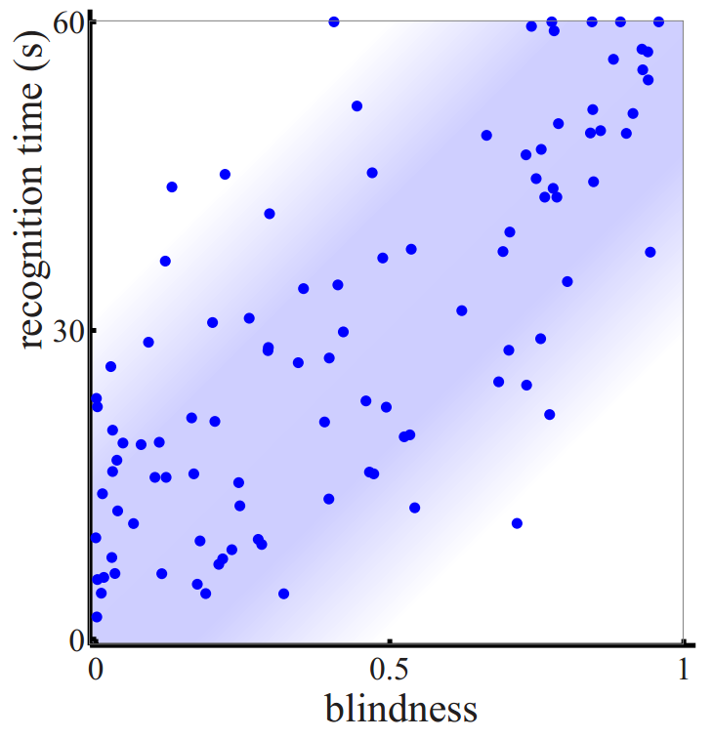
User Study
Generate 100 image pairs
30 subjects
Pearson’s correlation:
0.74
Notes:
We have conducted a user study to evaluate the predictability of our metric in controlling the degree of blindness in change blindness tasks.
We download 100 real-world images from Internet and generate 100 changed counterparts with blindness degrees approximately uniformly distributed over the range 0 to 1.
Thirty subjects with normal vision participated in the experiment.
The subjects are asked to identify the change and the time taken is recorded, with a maximum of 60 seconds allowed.
For each image pair, we compute an average recognition time.
(--click)
This plot shows the relationship between the average recognition time and the blindness value we predicted of the 100 image pairs. Pearson’s correlation between them is 0.74.

Slide 24
User Study
Model | Global contrast | Learning based | Image signature | Itti model
Correlation | 0.44 | 0.38 | 0.34 | 0.42
Model | Judd model | AIM model | Context-Dependent
Correlation | 0.43 | 0.42 | 0.74
Notes:
We also compute the correlation value using other saliency models in our metric, the result is reported here.
Compared to other saliency models, our saliency model gives the best predictability.

Slide 25
Conclusion
Computational model for change blindness
Context-dependent saliency model
Change blindness image synthesis with desired degree of blindness
Notes:
In conclusion, this paper presents the first computational model for change blindness, together with the first context-dependent saliency model which takes into account background complexity.
User studies demonstrate the effectiveness of our model in predicting degrees of change blindness.
Our change blindness metric enables synthesis of changed images with a desired degree of blindness, which can be used in spot-the-difference games.

Slide 26
Future Works
Add high-level image features into the metric
Improve the predictability using more sophisticated forms
Improve the accuracy of the metric considering just-noticeable difference(JND)
Notes:
Our metric has certain limitations. since the components involved in our metric, such as image saliency and image color/texture/shape differences, are mainly low-level image features, hence, it might overlook some important semantic changes which our metric cannot model.
(--click)
So in the future, additional semantic features, such as face and symmetry information, can be potentially integrated into our metric in order to consider the influence of visually important semantics.
(--click)
Secondly, there is still a lot of room to further improve the predictability. Our current formulation should be a good start, and more sophisticated forms may get even better predictability.
(--click)
Another possible direction to further improve the accuracy of the metric is to calibrate the amount of change by considering the just-noticeable-difference (JND).

Slide 27
Acknowledgement
Anonymous TVCG reviewers
Thank you
for your attention.
Notes:
Thank you for your attention. Any questions?

